Slide 1
CFIHOS Data Model
C-DM-001 version 2.0
CFIHOS 2.0 © 2024 by IOGP is licensed under Attribution 4.0 International. To view a copy of this license, visit http://creativecommons.org/licenses/by/4.0/

Slide 2
Change log
29 Sep 2024. Virtually all slides edited for v2. Deleted: 55, 58, 62, 63. Added SPIRS: 32, 33,34. Views all updated: 108 – 114.
Slides modified on 27 Jun 2024: 6, 10, 14, 17, 21, 23, 24, 25, 26, 27, 28, 29, 30, 31, 41, 47, 50, 52, 56, 57, 58, 61, 67, 68, 69, 77, 84, 89
Slides modified on 25 Mar 2024: 7, 19, 20 through to 32 (in this sequence 6 slides deleted), 38 (was 44 etc.), 39, 40, 41, 44, 47, 58, 61, 67 (was 73 etc.), 68, 69, 84, 89, 100, 103, 104, 107, 108
Slides modified 12, 13 and 14 on Jan 6, 2023 in preparation of 1.5.1

Slide 3

Notes
This page provides some explanation of how to read the data model. The tool used to generate the drawings is ER Studios and so some of the conventions are driven by that tool. As a result, this page does not try to provide a comprehensive legend but highlights key points the user should be aware of.
Indicates a subtype. A subtype is a sub-grouping of the entities in an entity type that is meaningful to the organization and that shares common attributes or relationships distinct from other subgroups. Subtypes inherit all supertype attributes. The parent entity is indicated via the arrow. By convention subtypes do not have a relationship verb.
The significance of dashed vs solid relationship lines is due to the notation selected in ER Studios. For optional relationships, IE (Crows Feet ) uses dashed relationship lines, whereas the Martin notation uses solid lines for all relationships.
vs

Slide 4
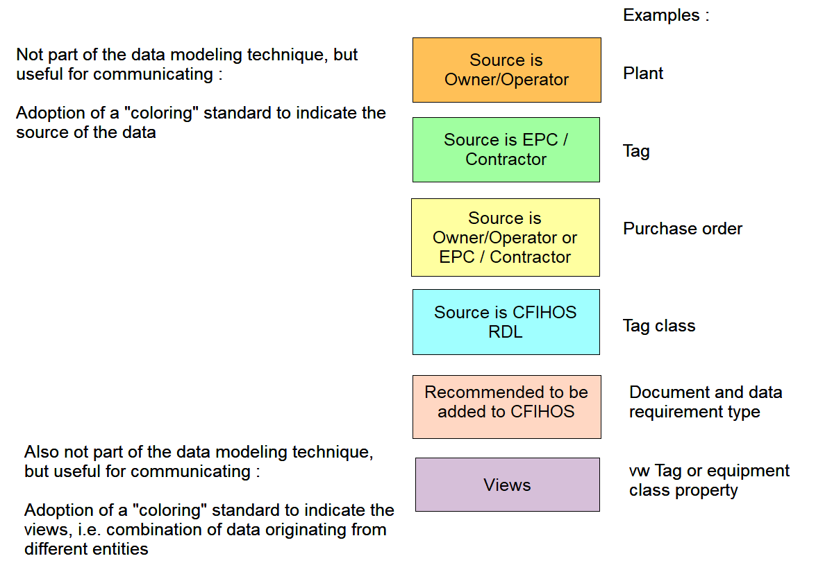

Slide 5
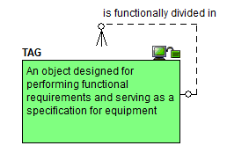
Starting point : the tag

Slide 6
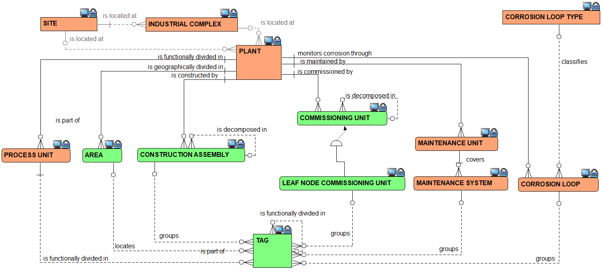
Plant breakdown structure : the relationships view

Slide 7
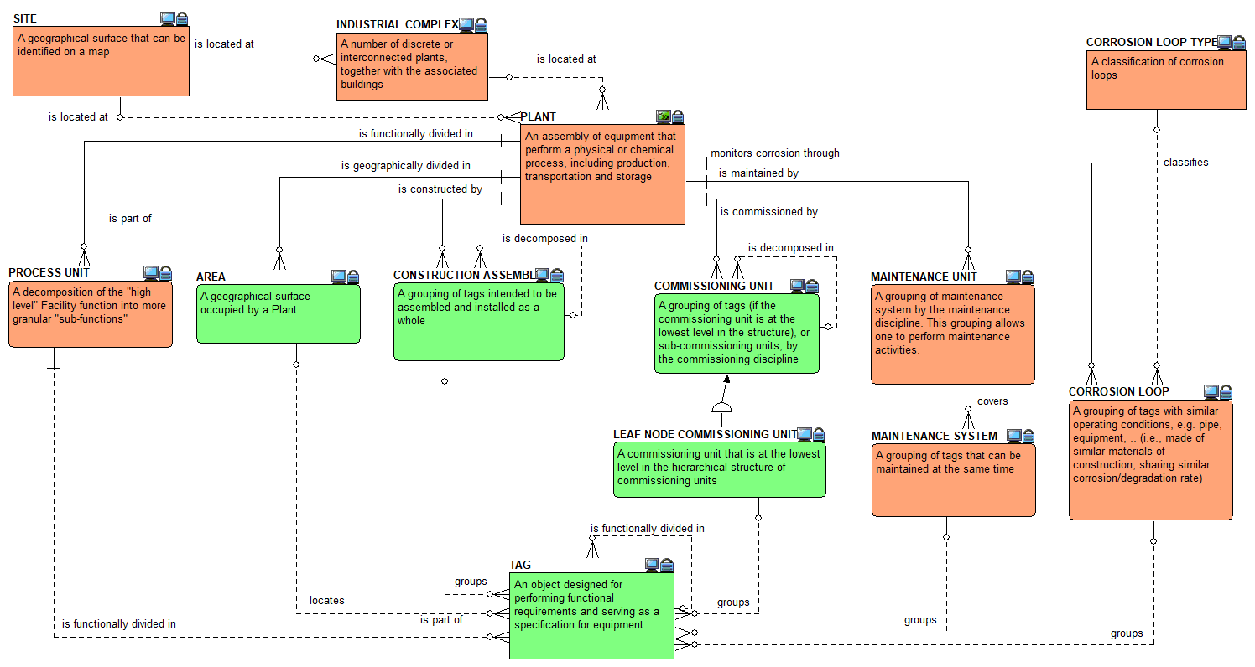
Plant breakdown structure : the definitions view

Slide 8
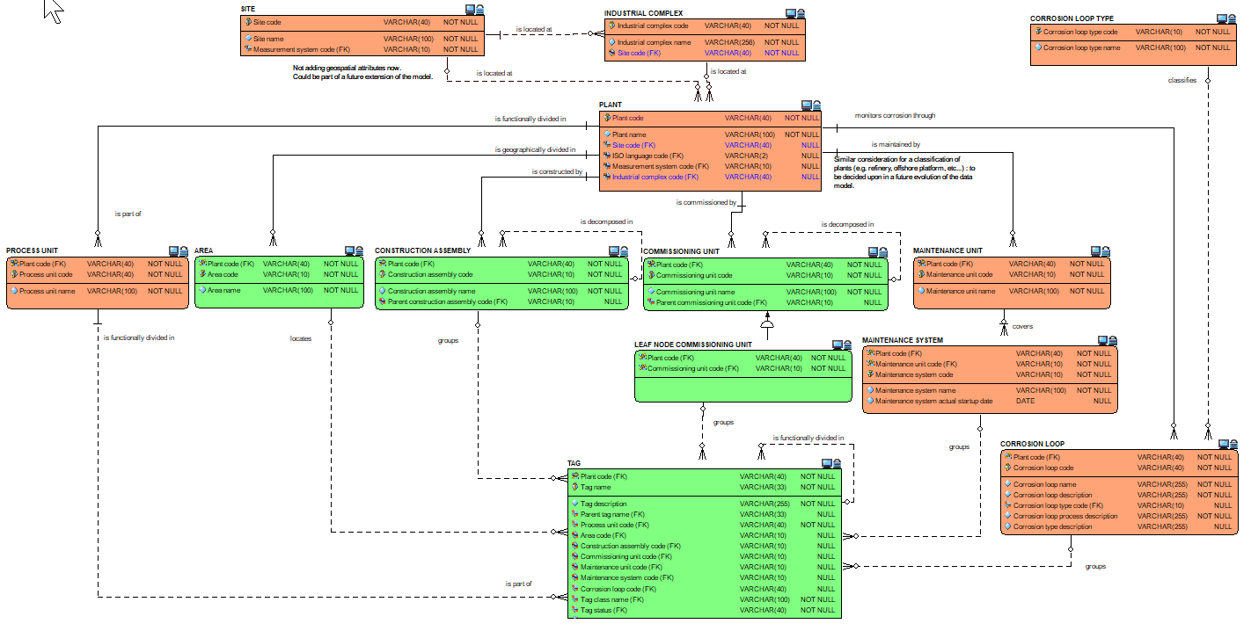
Plant breakdown structure : the attributes view

Slide 9
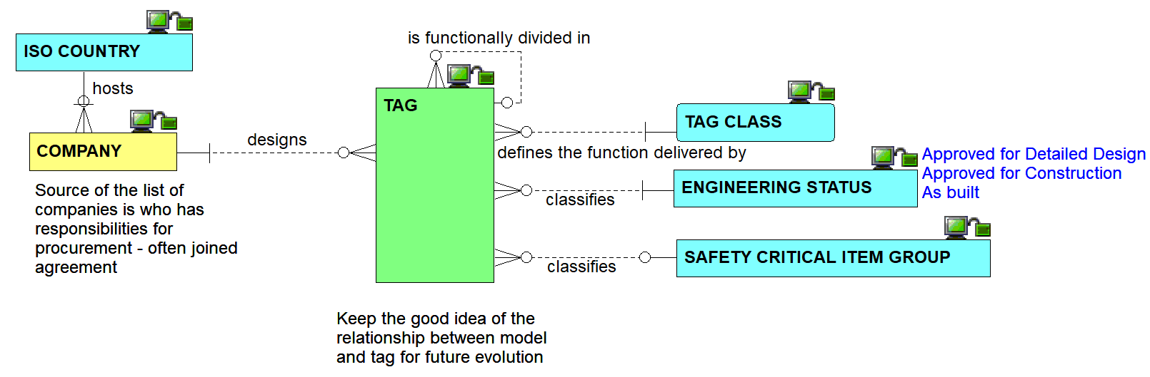
Other tag inbound relationships view

Slide 10
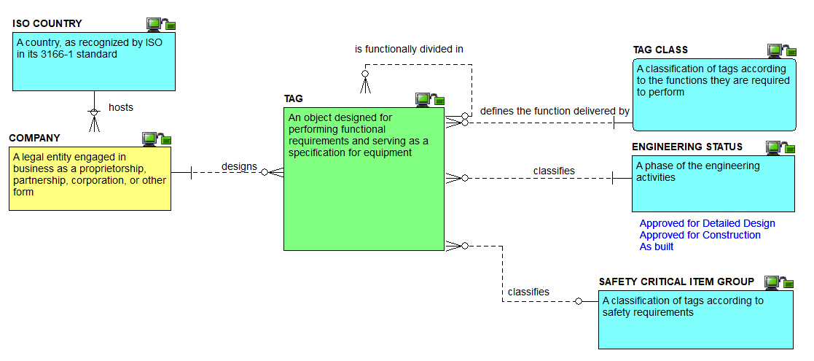
Other tag inbound definitions view

Slide 11
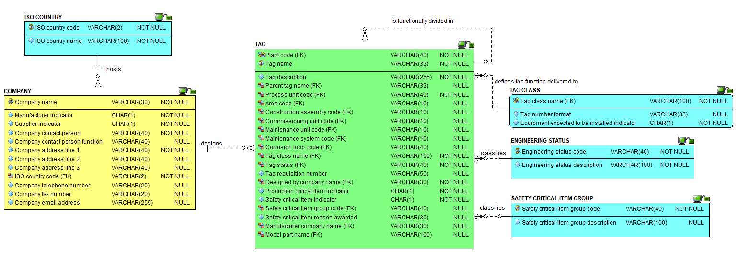
Other tag inbound attributes view

Slide 12
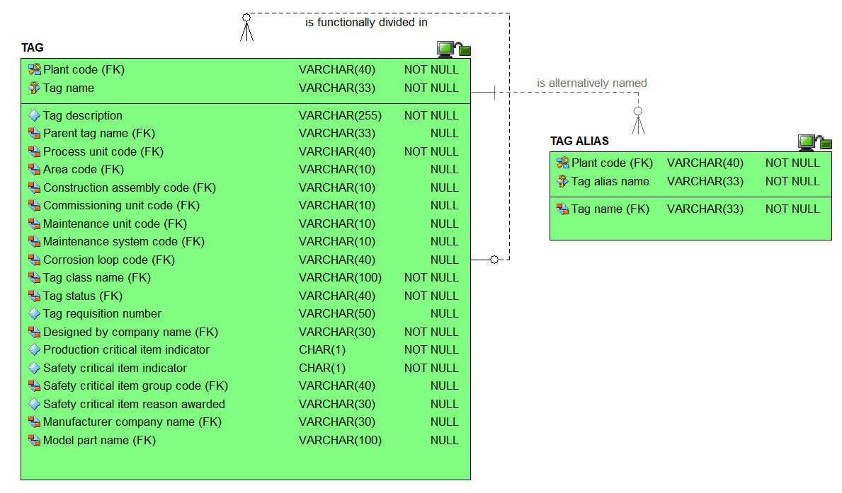
The tag attributes view

Slide 13
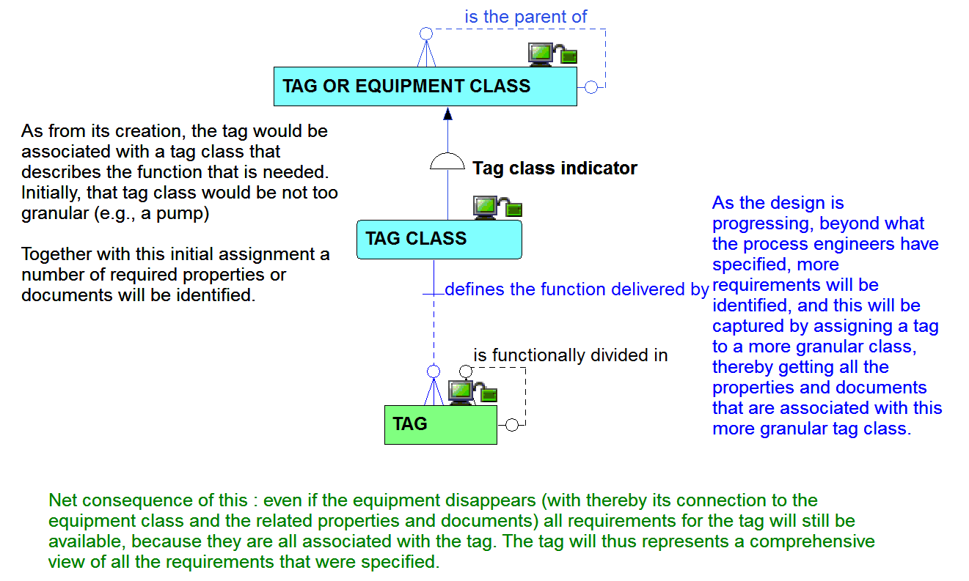
Tag and its relationship to tag class

Slide 14
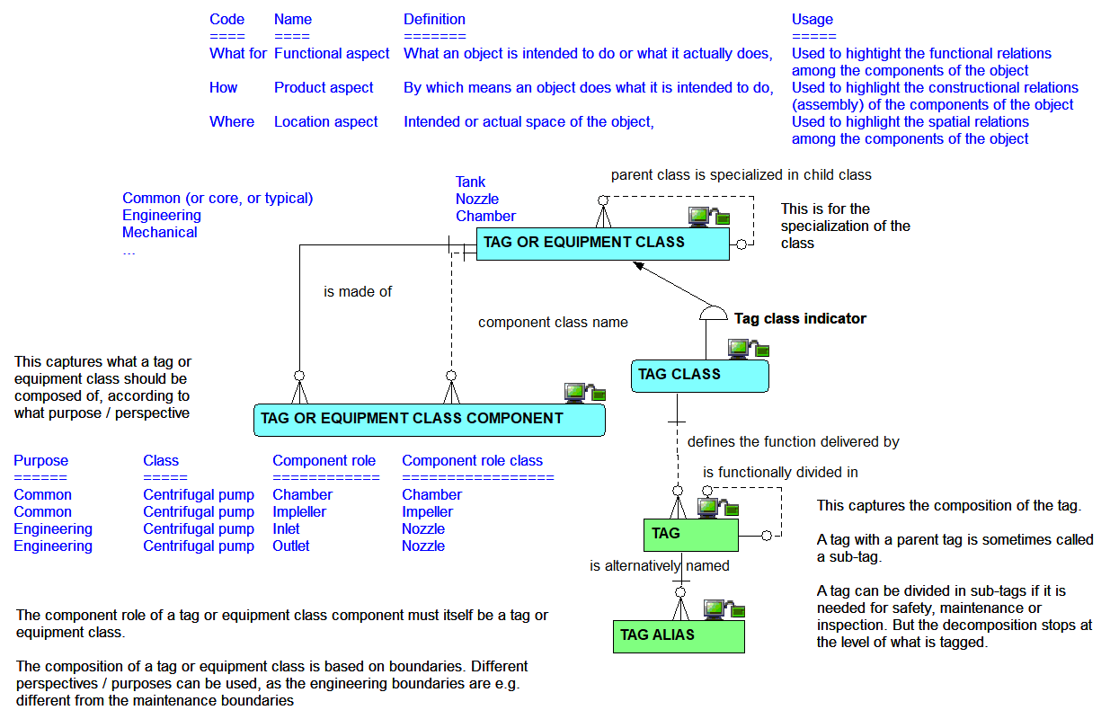
Tag class component relationships

Slide 15
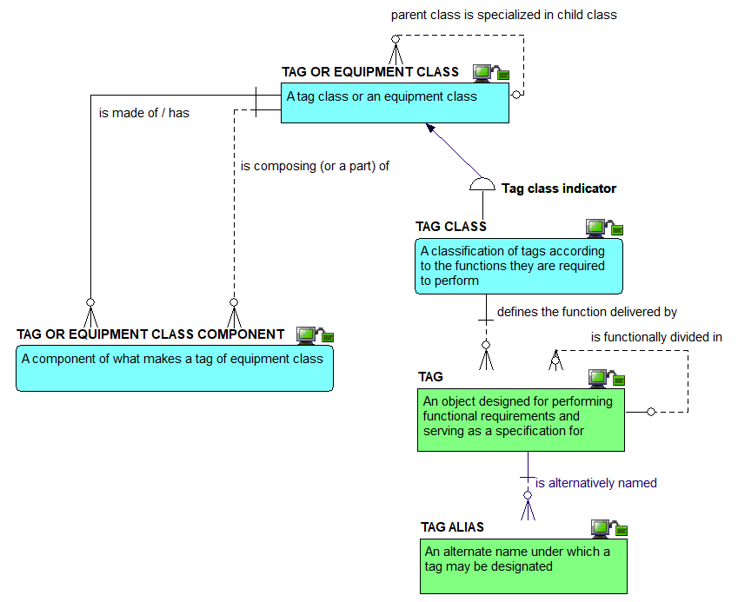




Tag class component definitions view

Slide 16
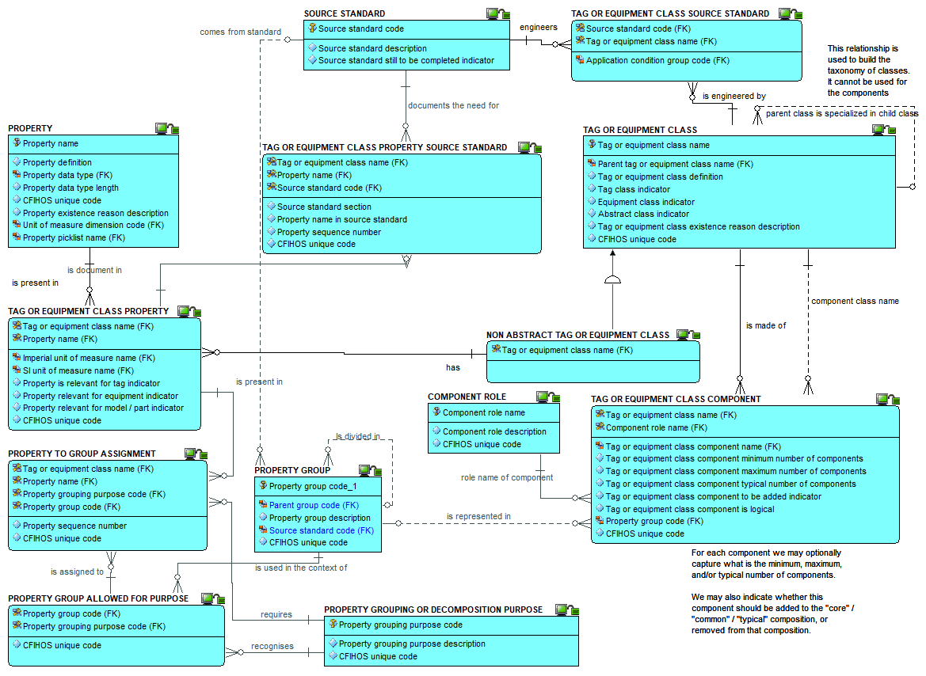
Tag class
component
Attributes: attributes view

Slide 17
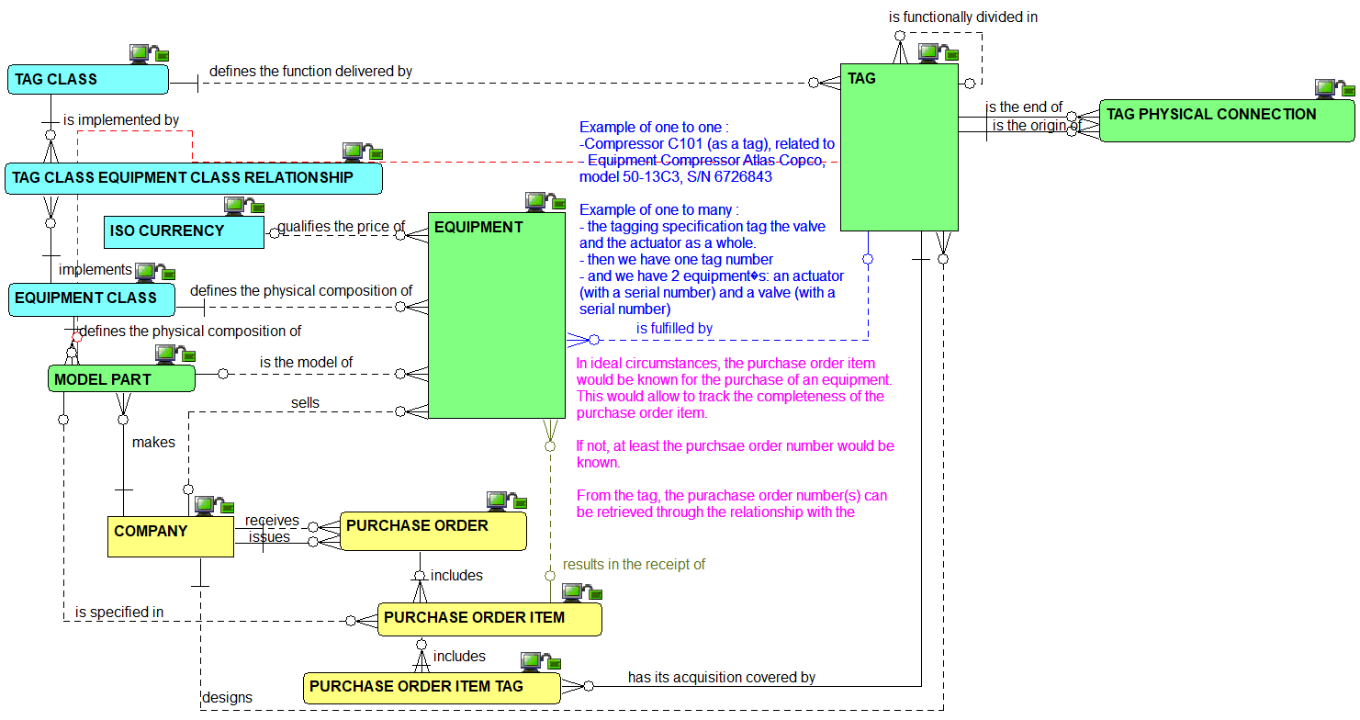
Tag to equipment : the relationships view

Slide 18
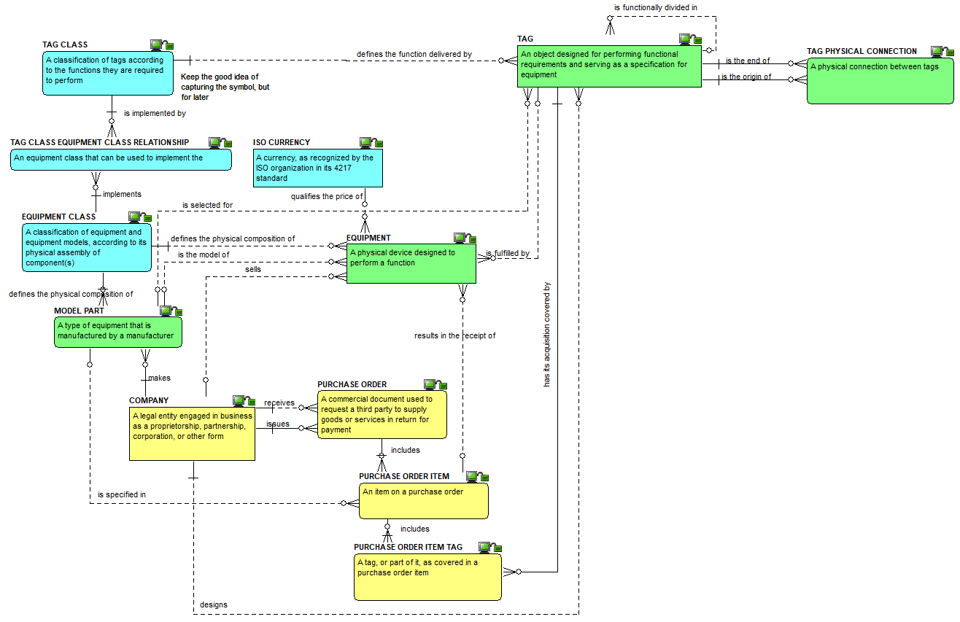
Tag to equipment : the definitions view

Slide 19
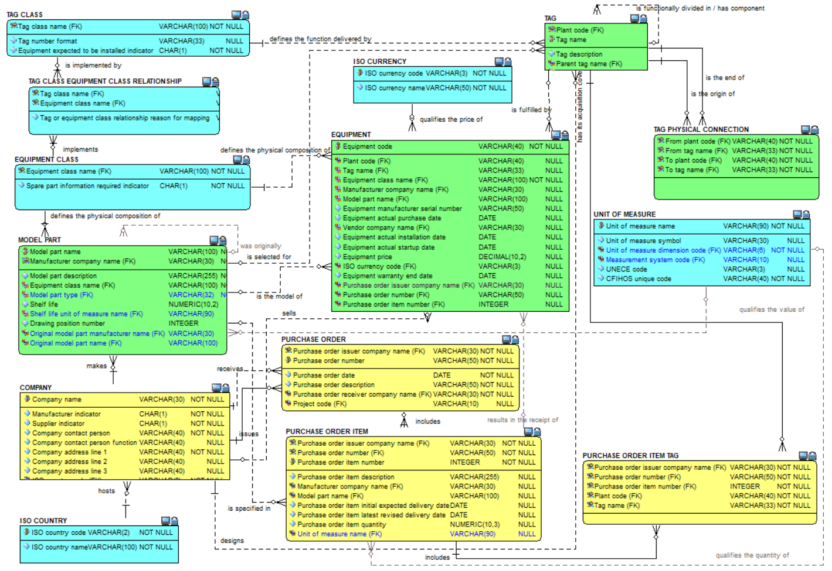
Tag to
equipment:
the
attributes
view

Slide 20
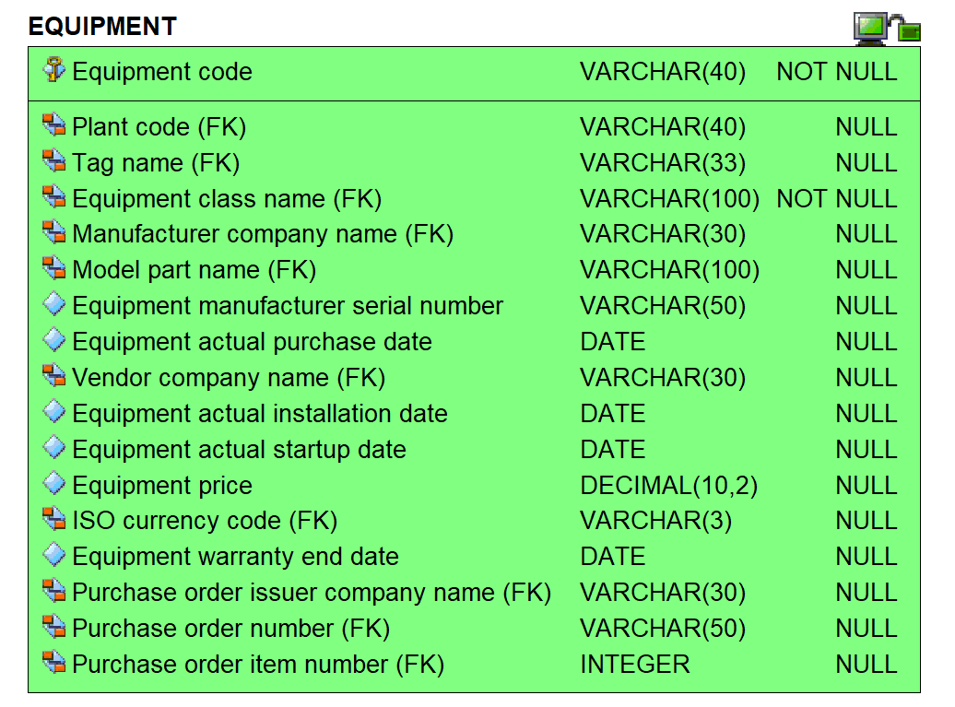
Equipment: attributes view

Slide 21
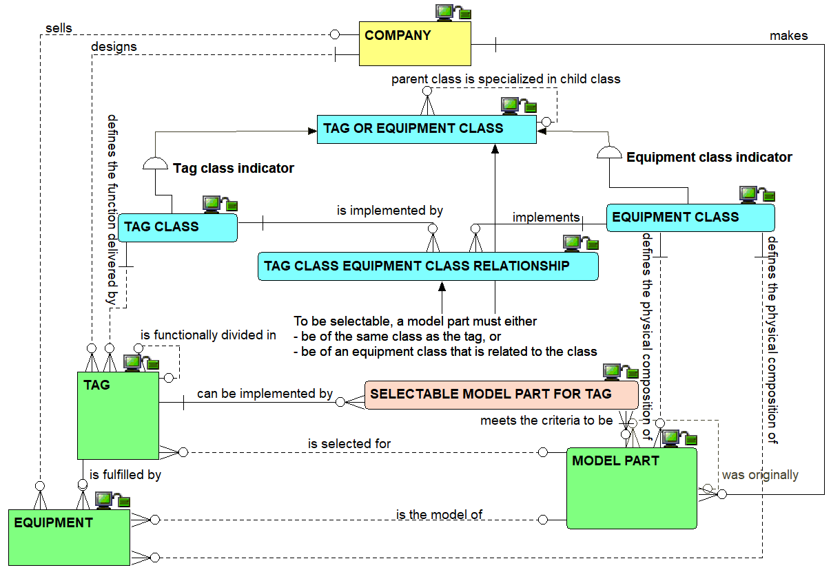
Tag to model : the relationships view

Slide 22
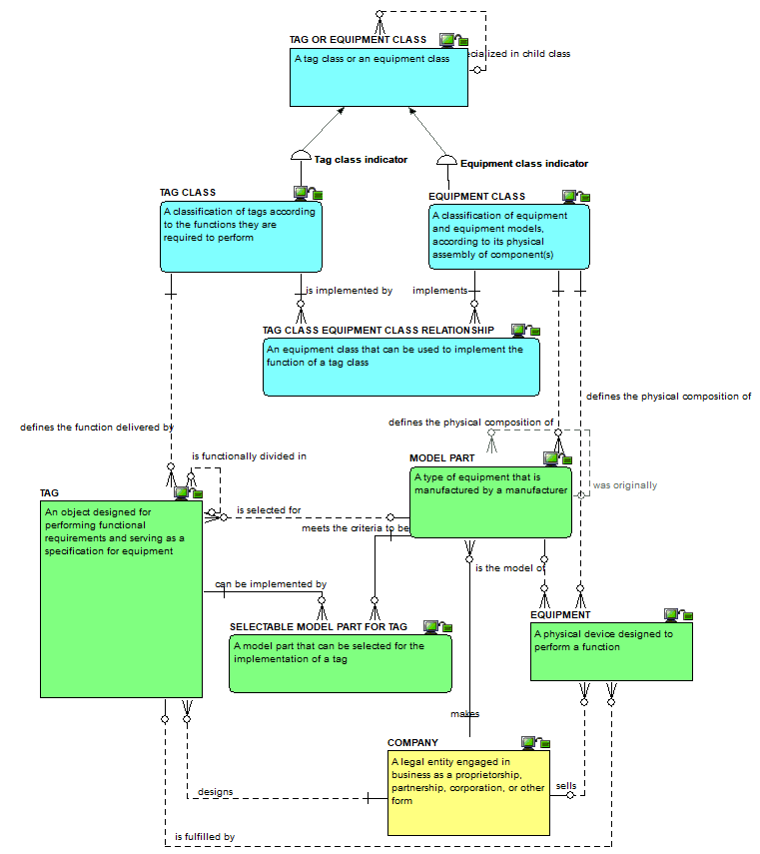
Tag to model : the definitions view

Slide 23
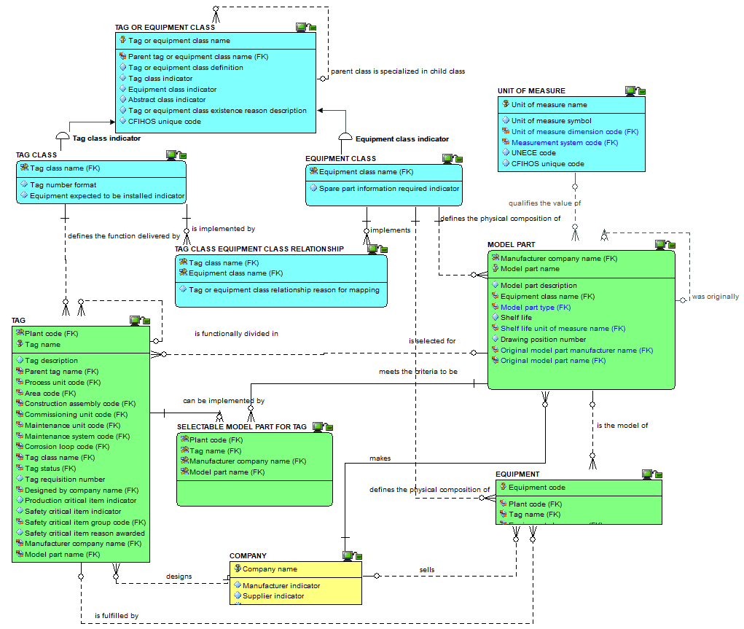
Tag to model:
the attributes view

Slide 24
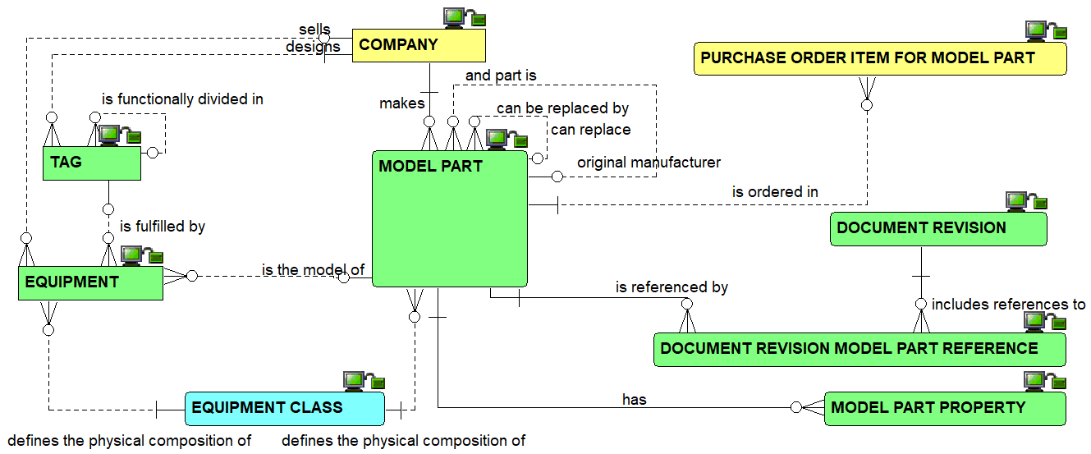
Model part relationships: relationships view

Slide 25
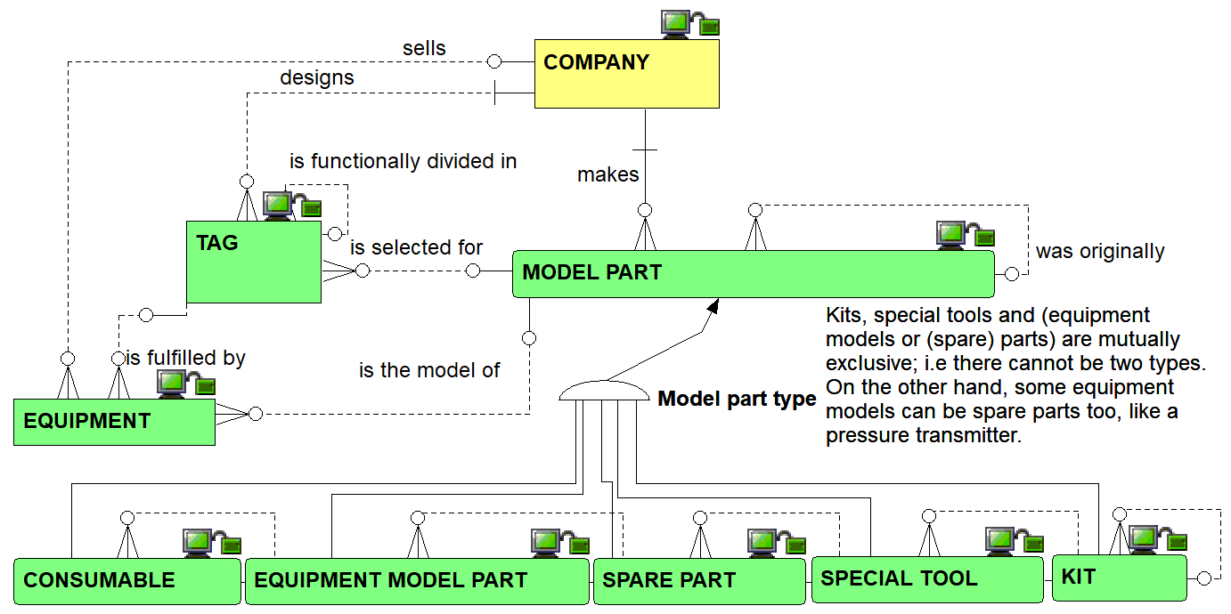
Model parts – subtype relationships view

Slide 26
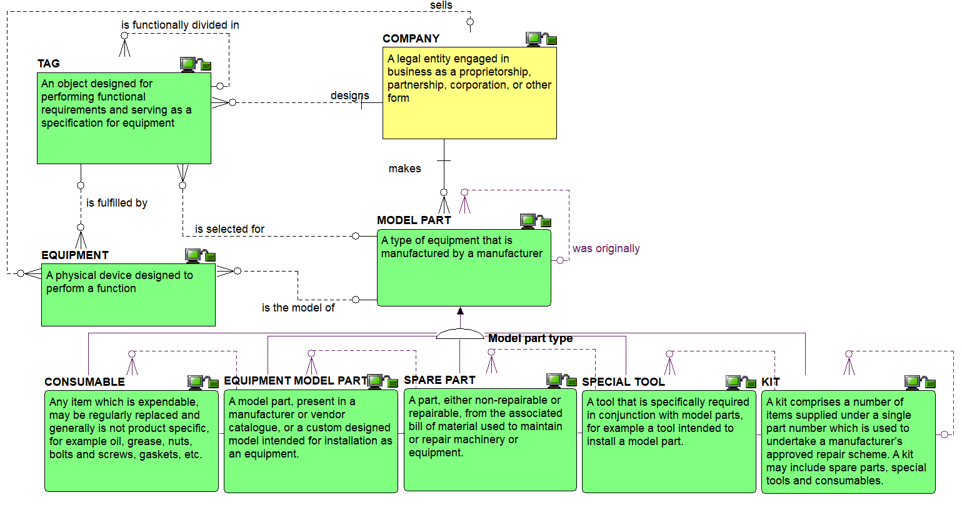
Model parts – subtype definitions view

Slide 27
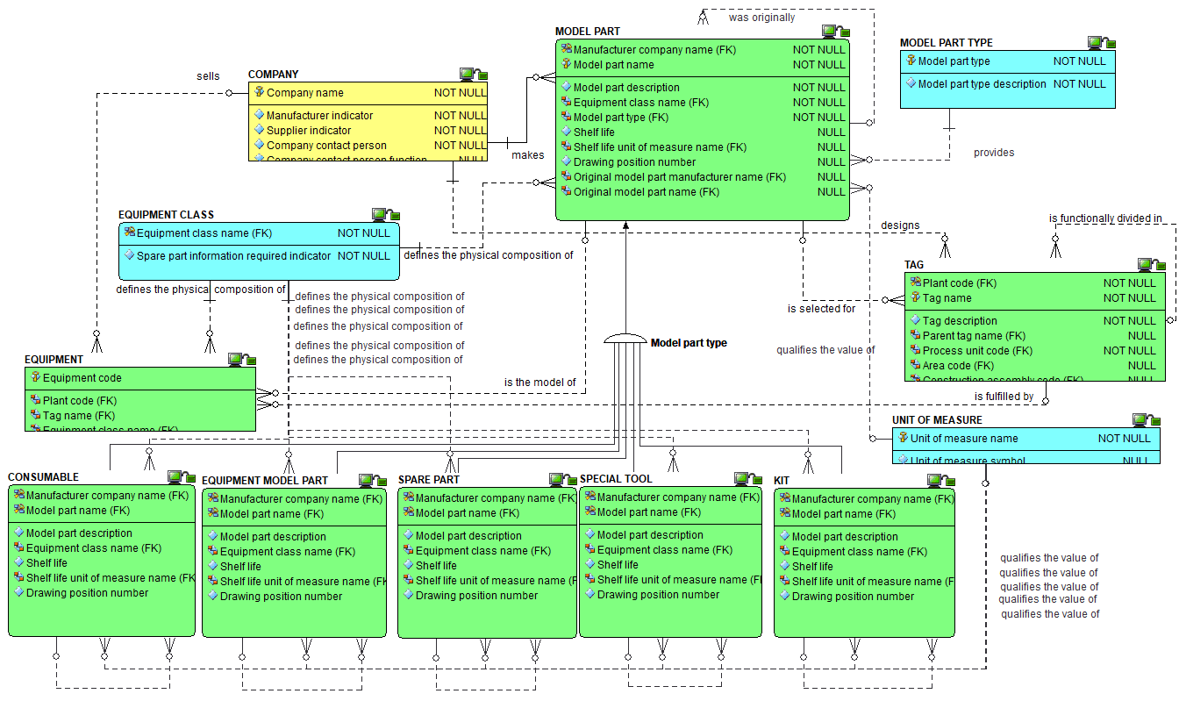
Model parts – subtype attributes view

Slide 28
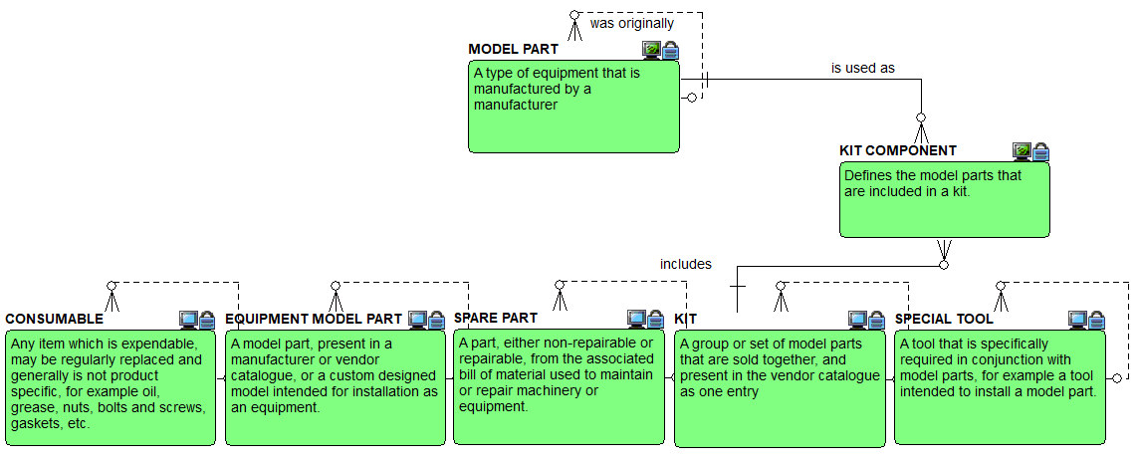
Model part components definitions view

Slide 29
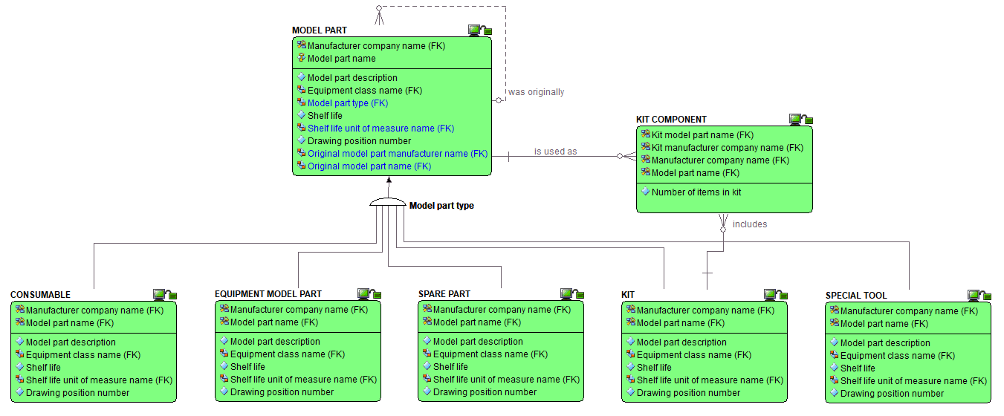
Spare part kit components attributes view

Slide 30
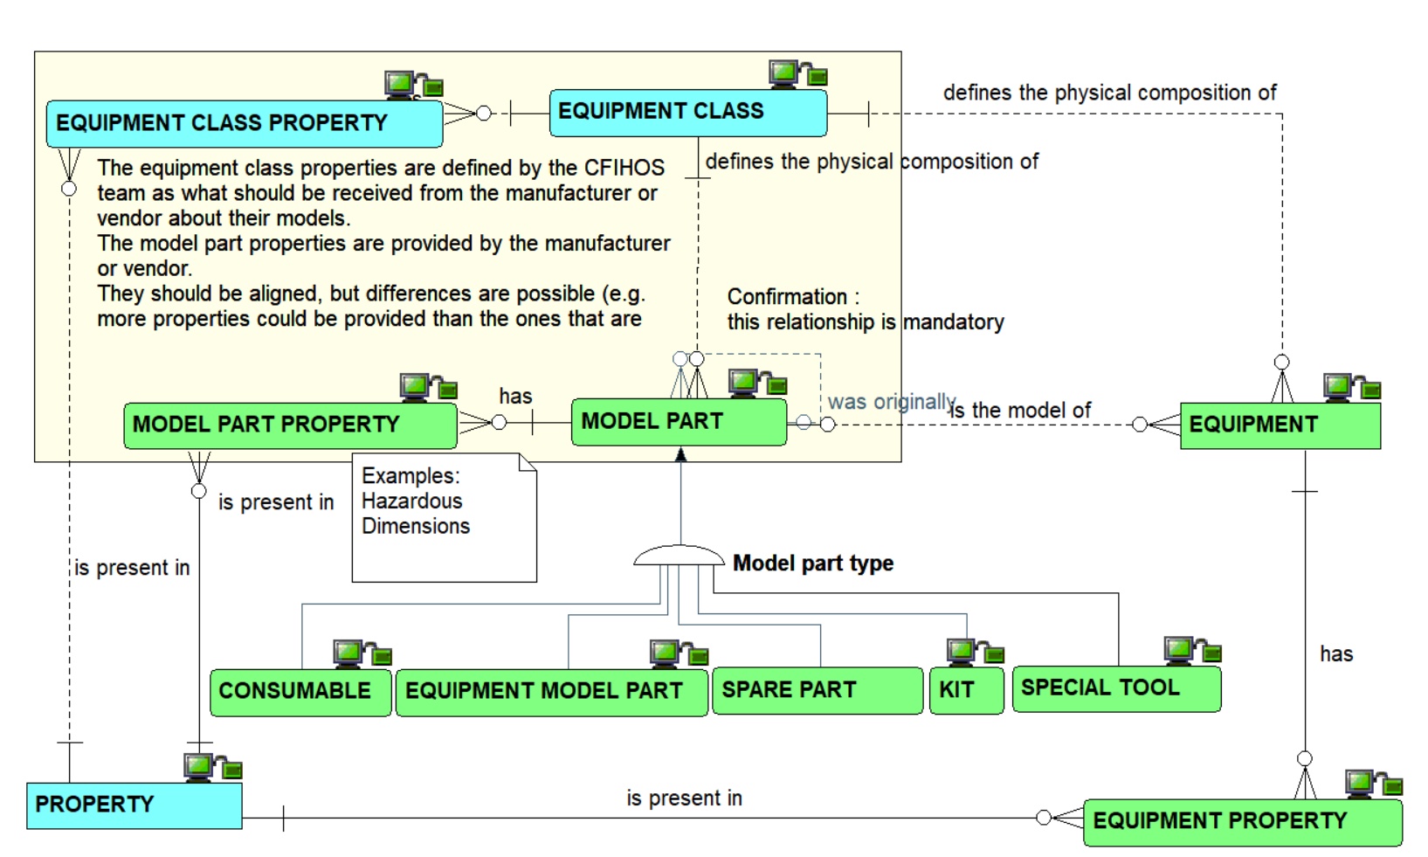
Model part properties overview

Slide 31
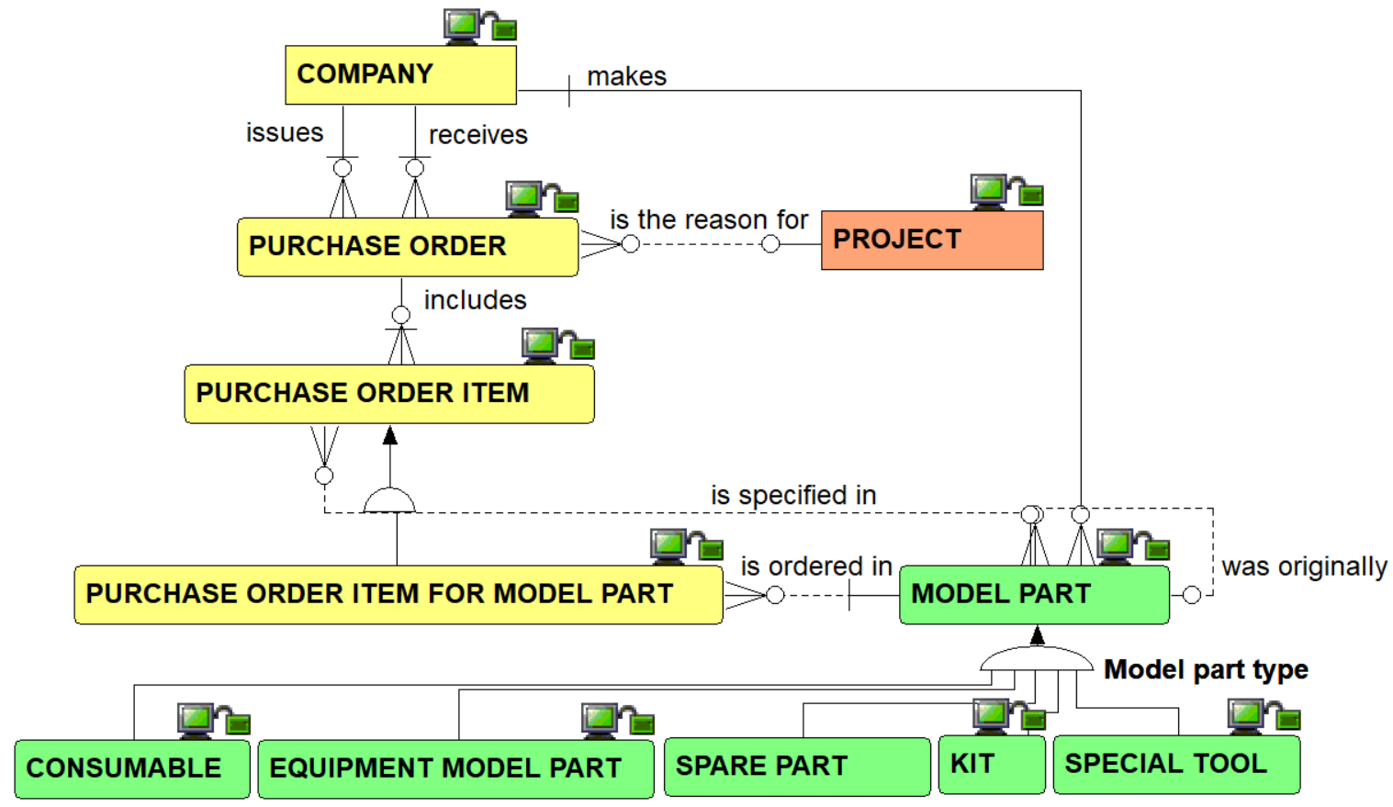
Model part purchase relationships view

Slide 32
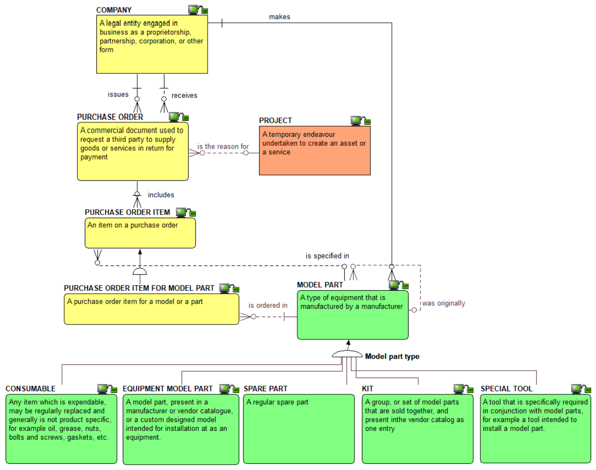
Model part purchase definitions view

Slide 33
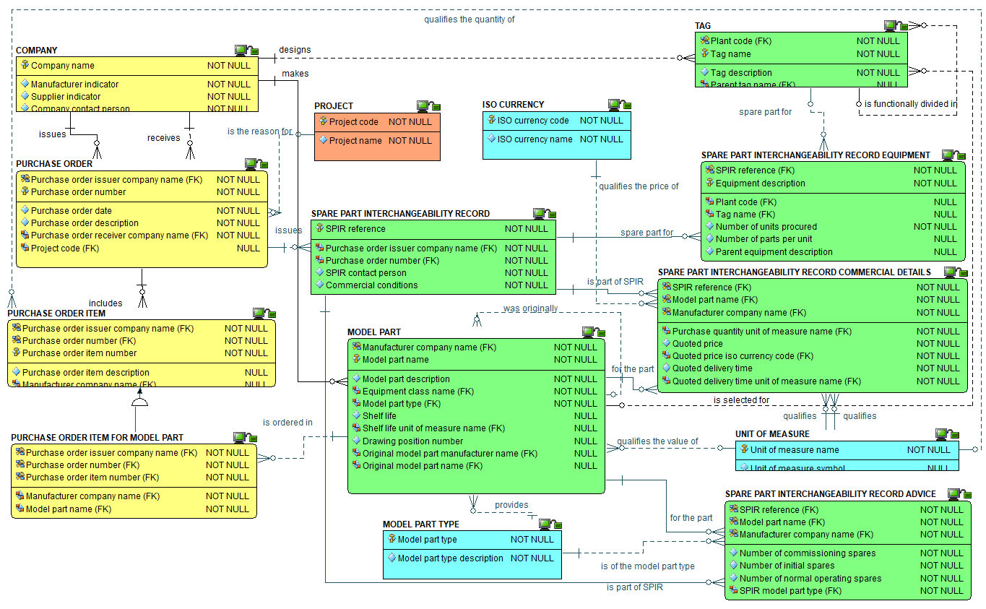
Model part purchase attributes view

Slide 34
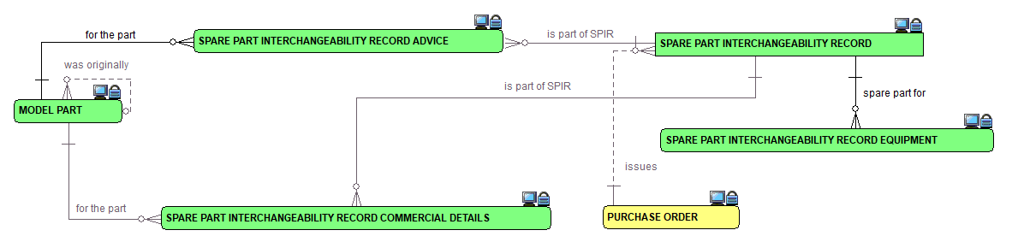
Spare Part Interchangeability record (SPIRS) relationship view

Slide 35
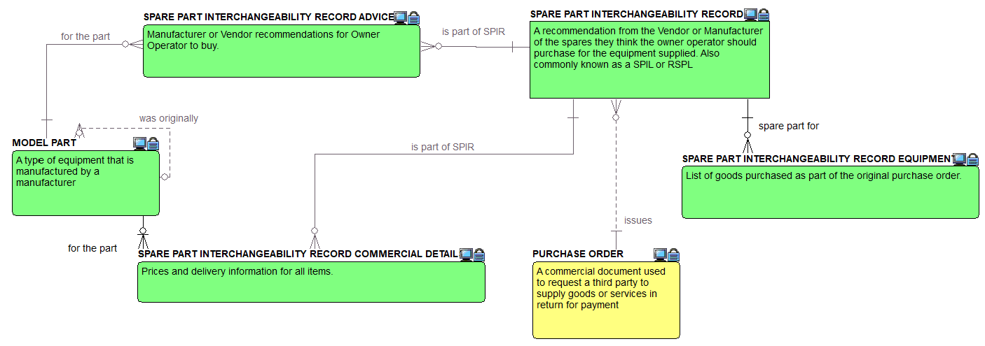
Spare Part Interchangeability record (SPIRS) definitions view

Slide 36
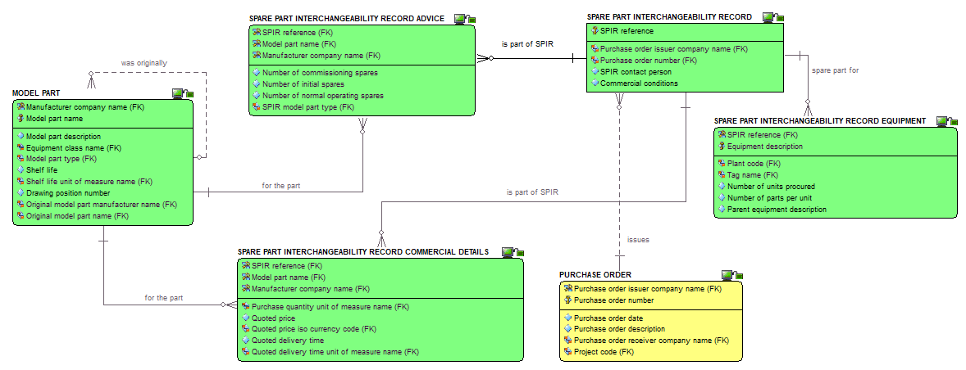
Spare Part Interchangeability record (SPIRS) attributes view

Slide 37
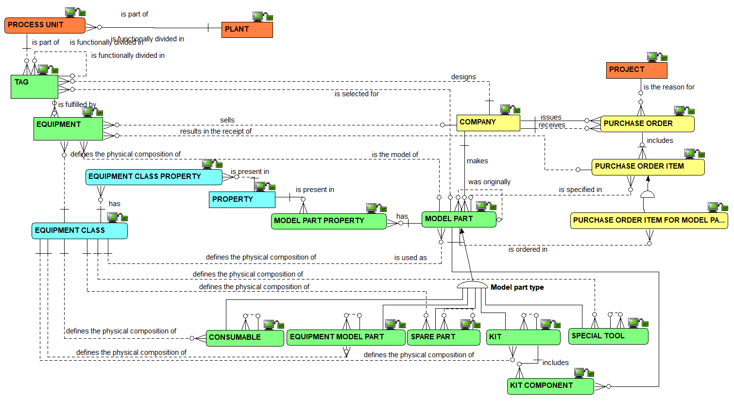
Model part complete overview

Slide 38
Checkpoint 1 : Summary after review of the first third of the data model
As was

Slide 39
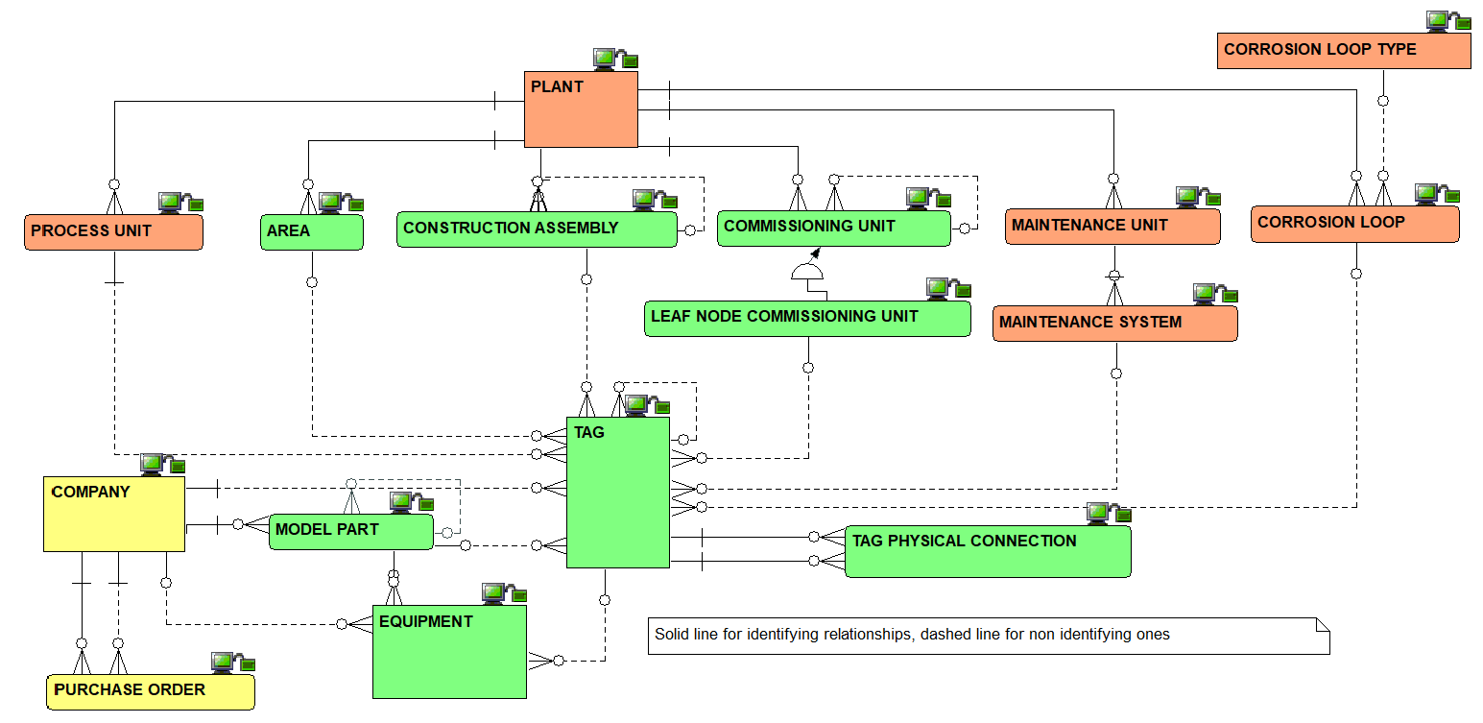
Checkpoint 1 : Summary after review of the first third of the data model
As is

Slide 40
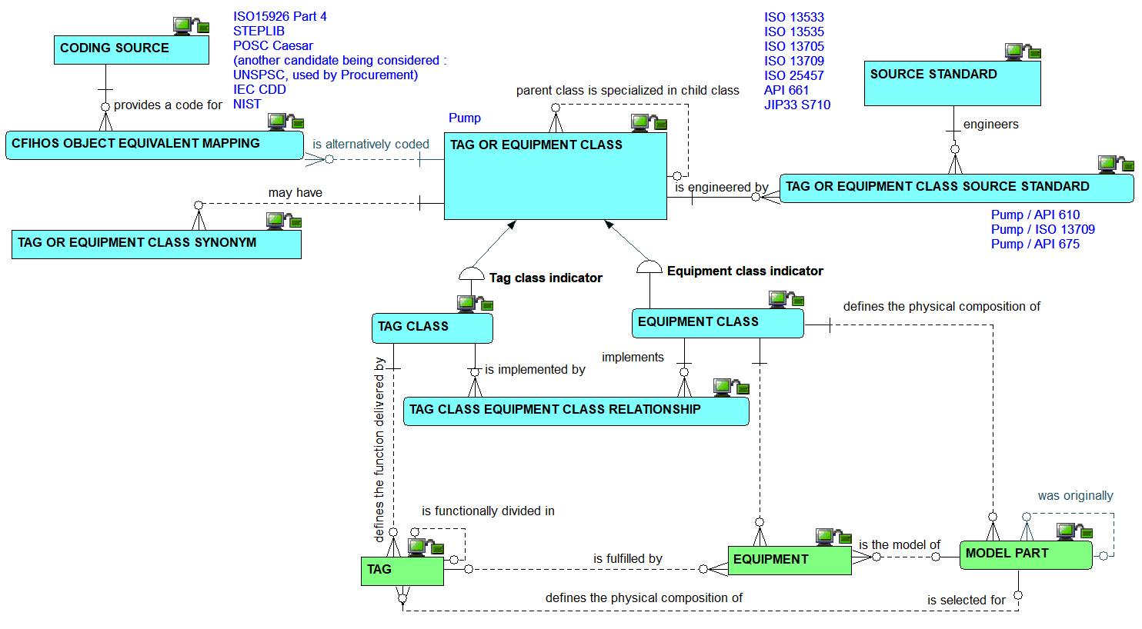
Classes : the relationships view

Slide 41
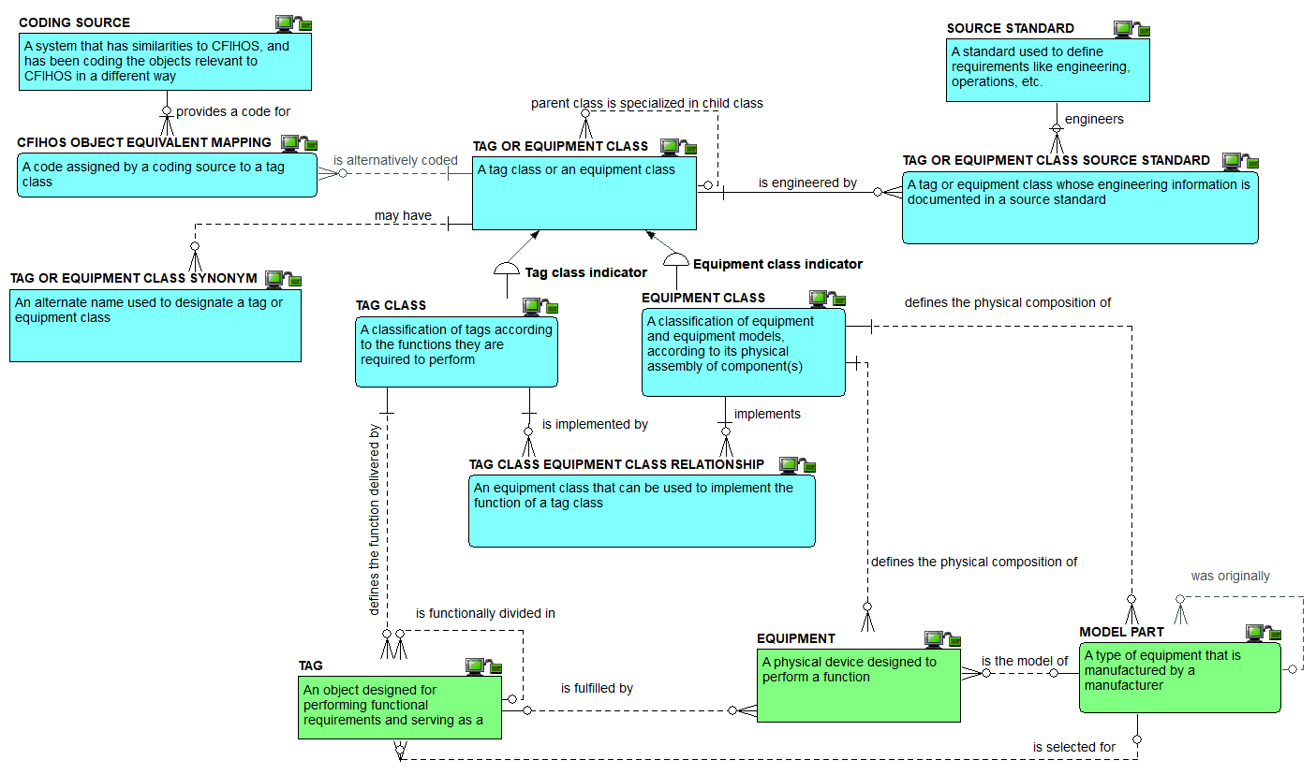
Classes: the definitions view

Slide 42
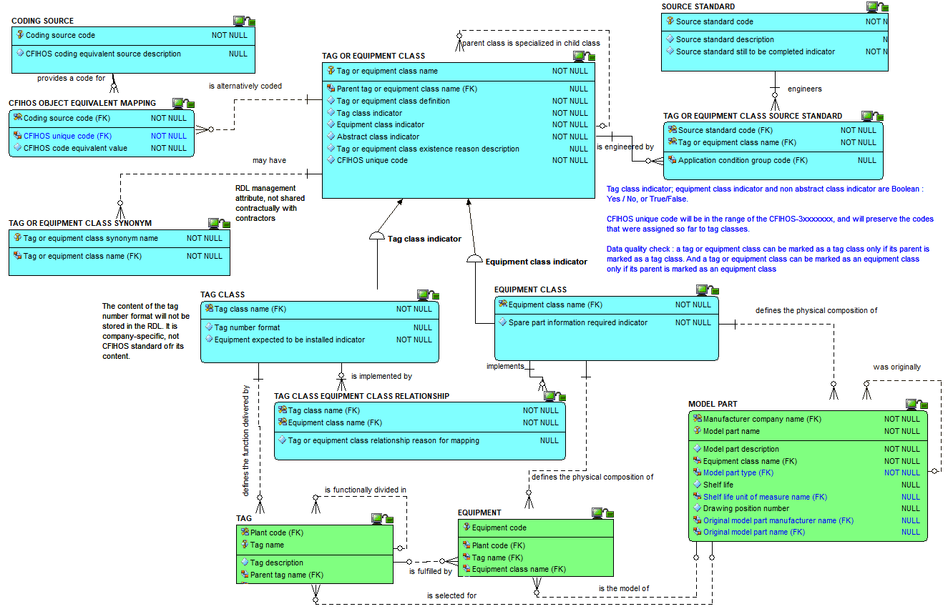
Classes: the attributes view

Slide 43
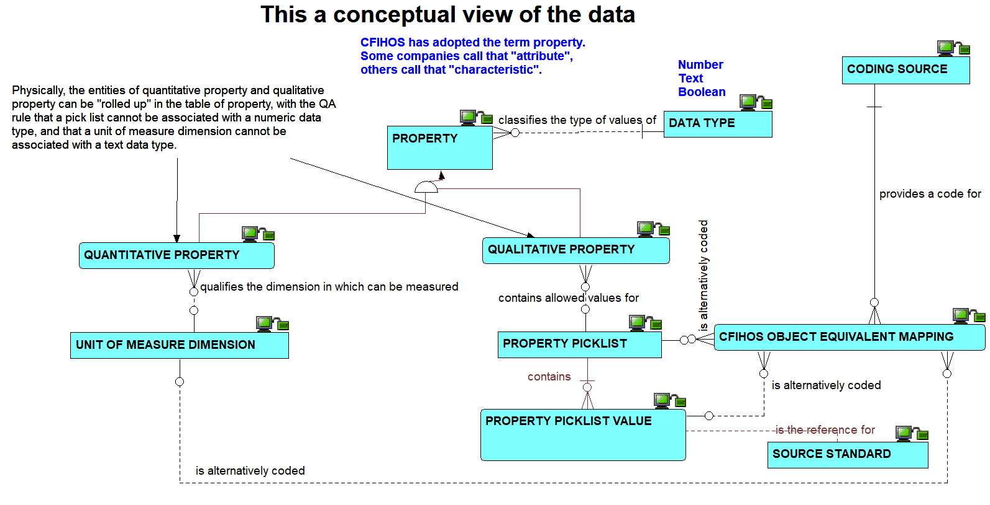
Properties: the conceptual view on relationships

Slide 44
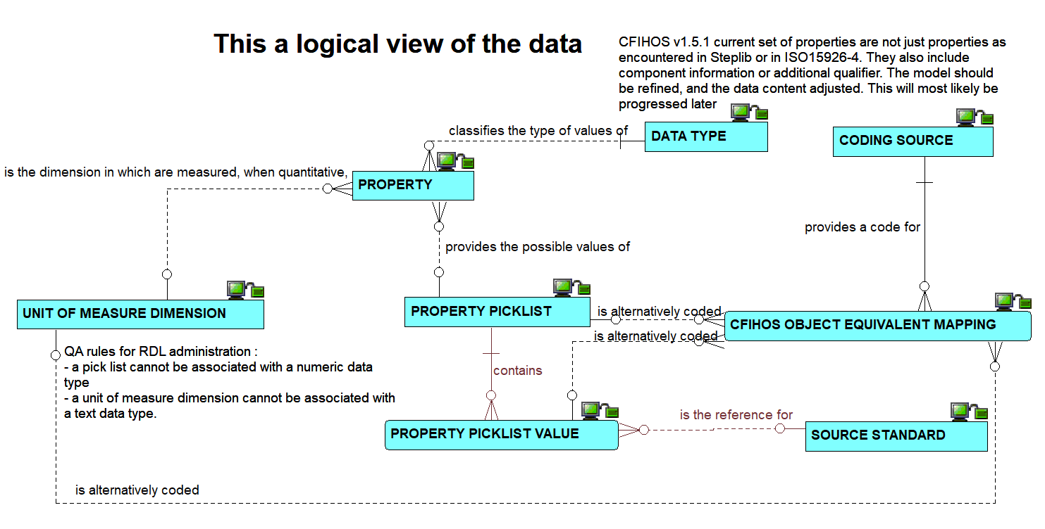
Properties: the logical view on relationships

Slide 45
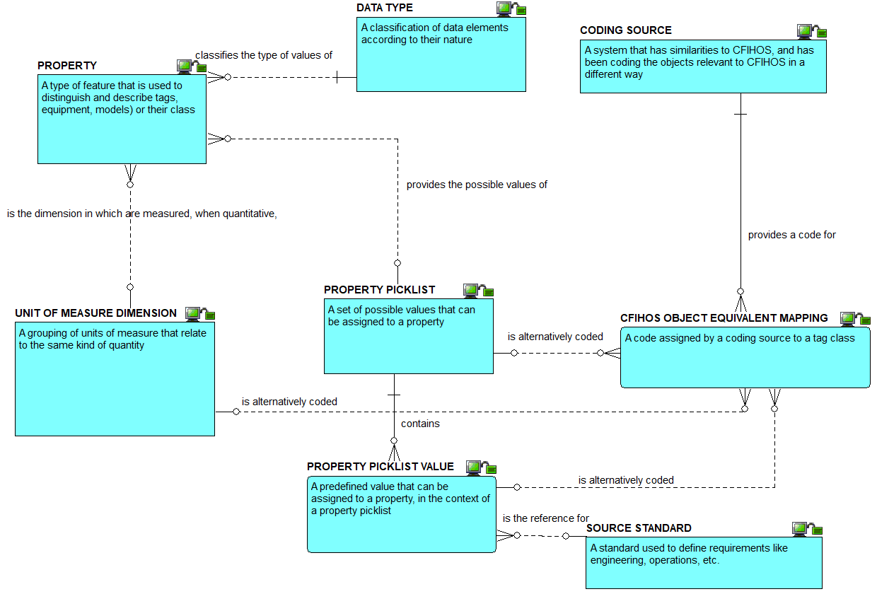
Properties : the definitions view

Slide 46
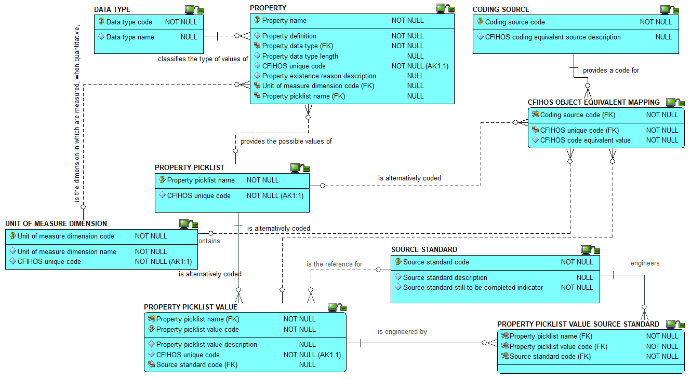
Properties : the attributes view

Slide 47
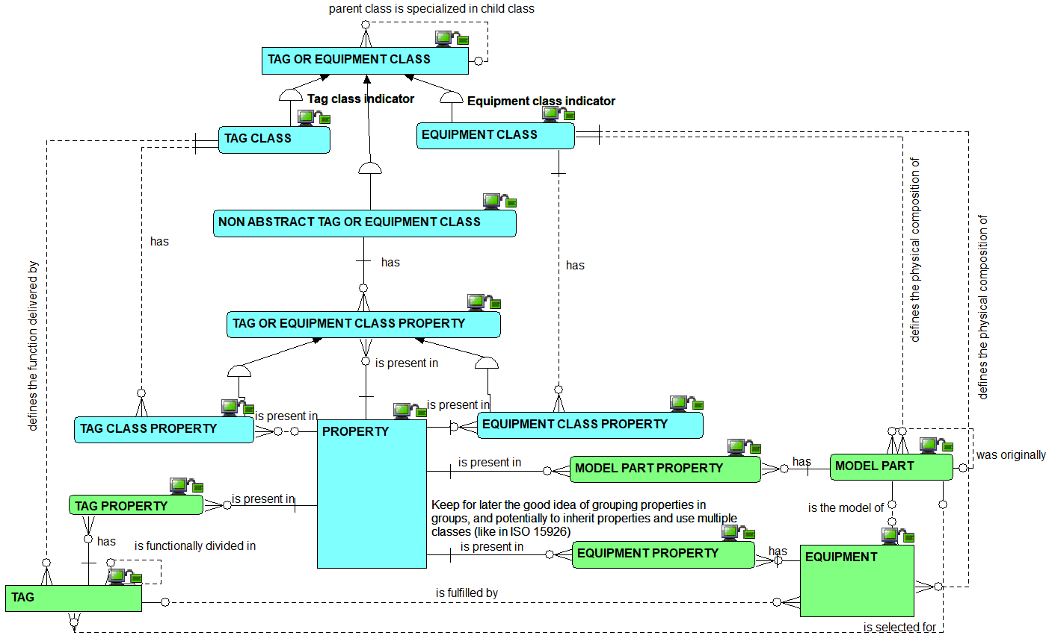
Property use : the relationships view

Slide 48
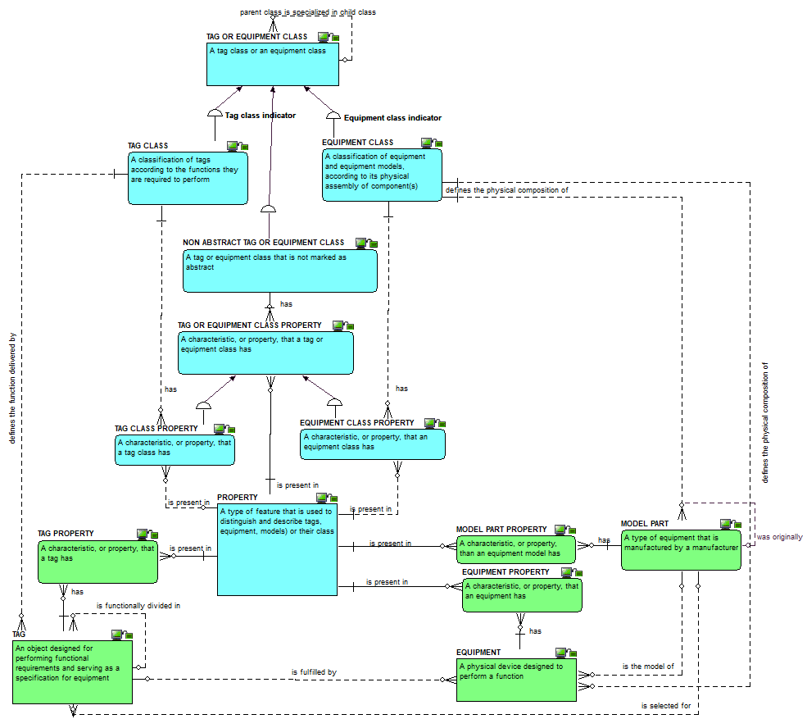
Property use : the definitions view

Slide 49
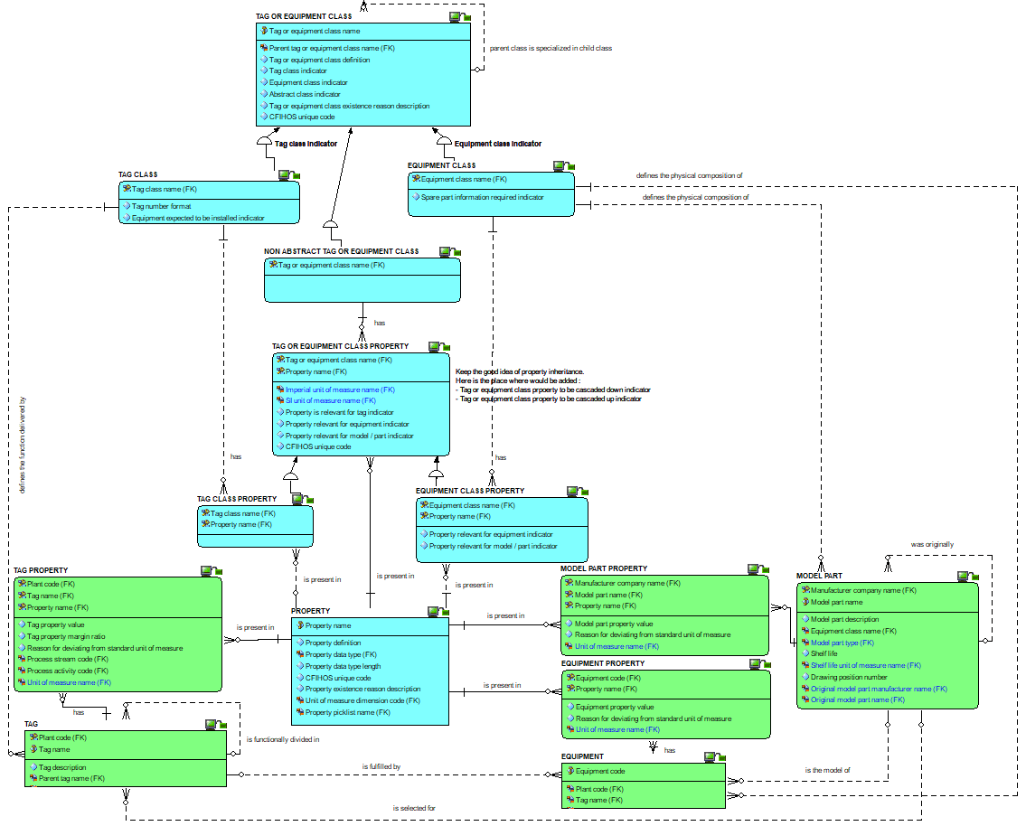
Property use :
the attributes
view

Slide 50
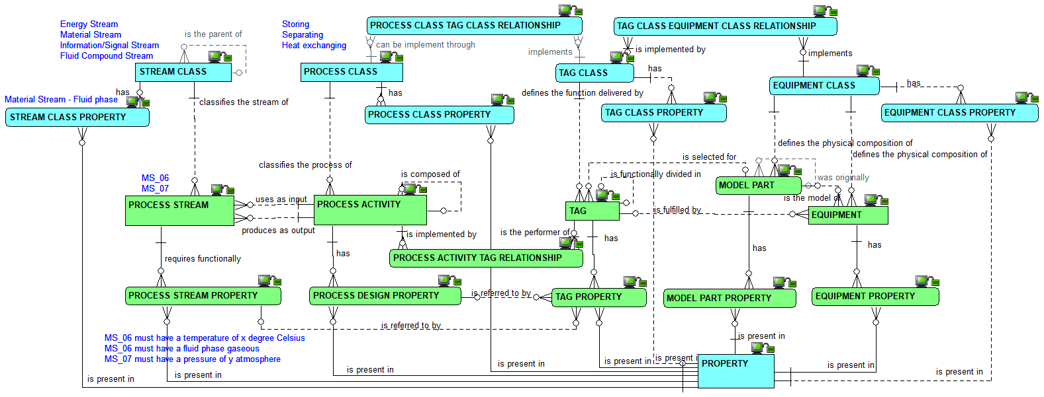
Process activity and stream, their class and their properties: the relationships view

Slide 51
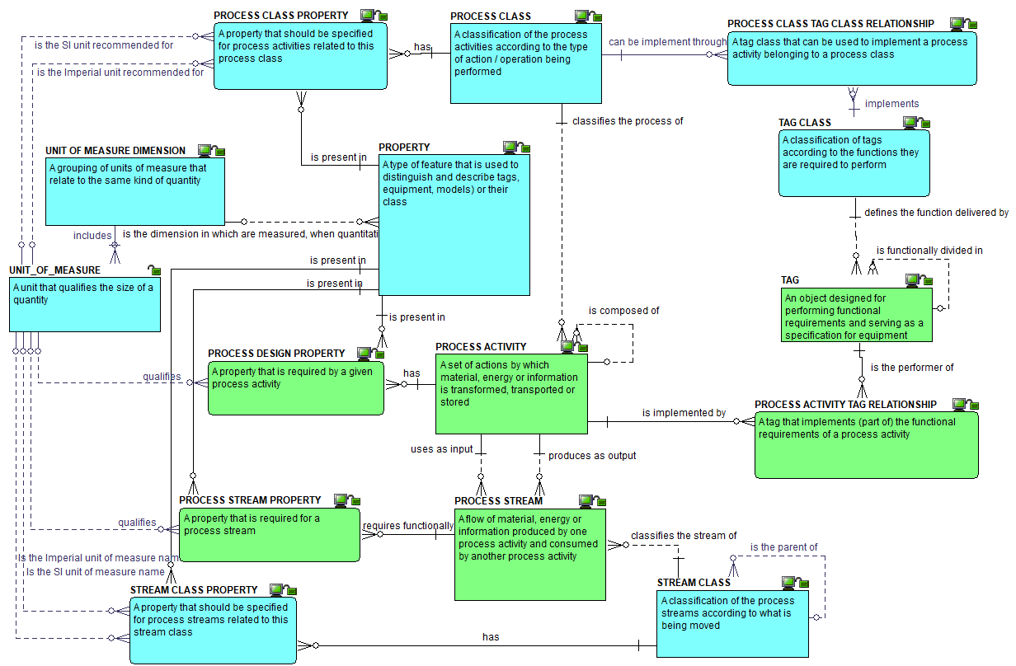
Process
activity and
stream,
their class
and their
properties:
the
definitions
view

Slide 52
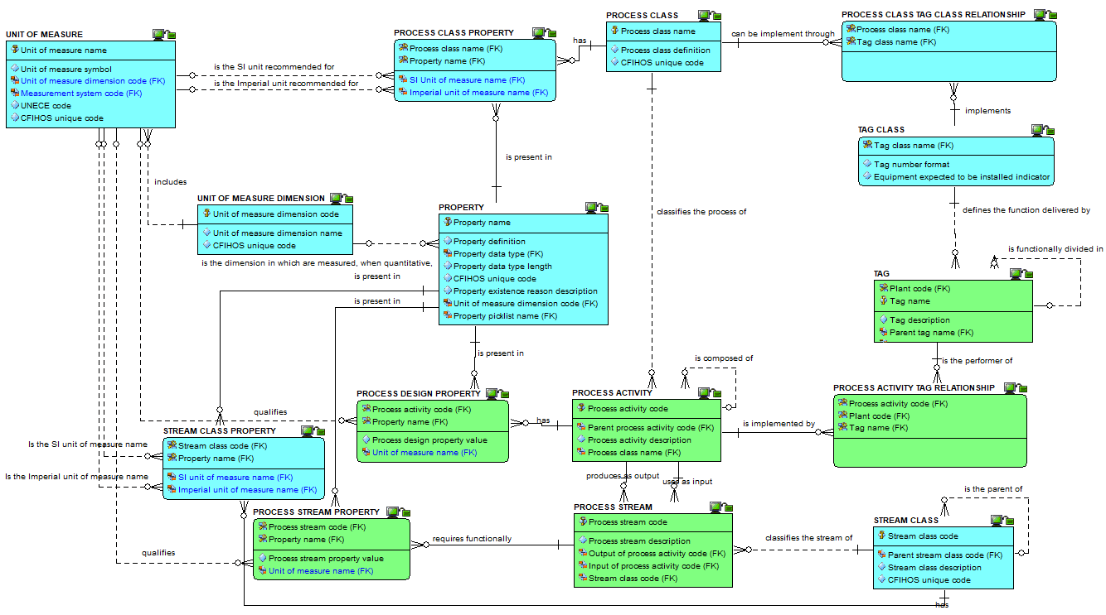
Process activity
and stream,
their class and
their properties:
the attributes
view

Slide 53
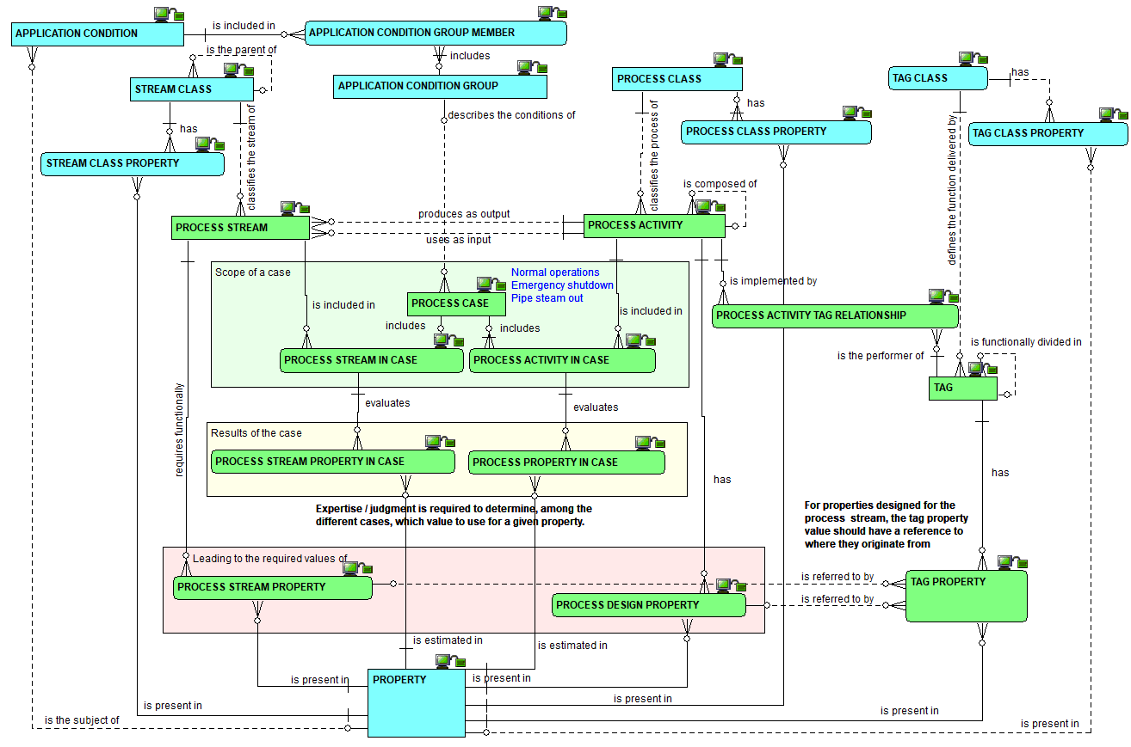
Cases : the
Relationships
view

Slide 54
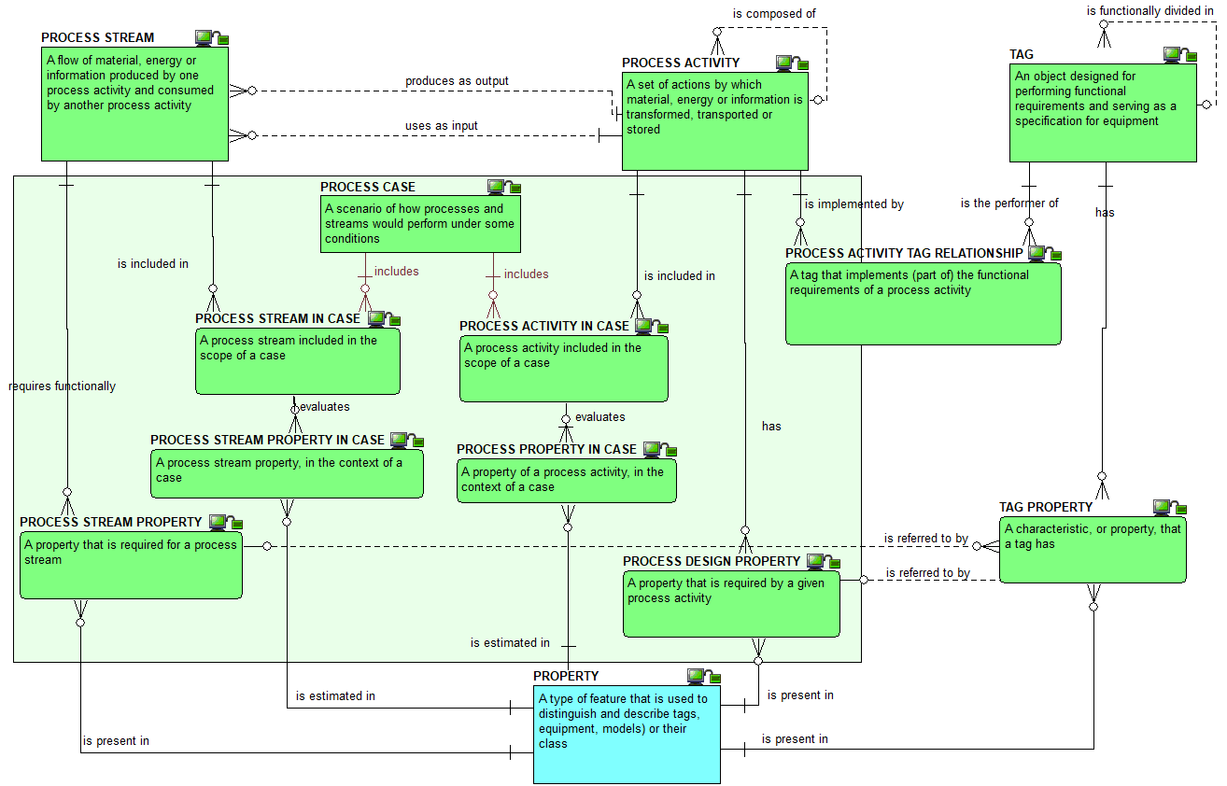
Cases : the
definitions
view

Slide 55

Cases : the attributes view

Slide 56

Properties, classes and units of measure : the relationships view

Slide 57

Properties, classes and units of measure : the definitions view

Slide 58

Properties, classes and units of measure : the attributes view

Slide 59

Property grouping and components attributes

Slide 60

Property grouping of TAG and
EQUIPMENT attributes view

Slide 61

Properties, tags, equipment and units of measure : the relationships view

Slide 62

Properties, classes and units of measure : the definitions view

Slide 63

Properties, classes and units of measure : the attributes view

Slide 64

Property grouping : the relationships view

Slide 65

Property grouping : the definitions view

Slide 66

Property grouping : the attributes view

Slide 67
Checkpoint 2 : Summary after review of the second third of the data model
As was

Slide 68

Checkpoint 2 : Summary after review of the second third of the data model
As is
Solid line for identifying relationships, dashed line for non identifying ones

Slide 69

Disciplines and document types : the relationships view

Slide 70

Disciplines and document types : the definitions view

Slide 71

Disciplines and
document types :
the attributes view

Slide 72

Discipline document type : zoom on the attributes

Slide 73

Document master : the relationships view

Slide 74

Document master : the definitions view

Slide 75

Document master : the attributes view

Slide 76

Document revision : the relationships view

Slide 77

Document revision : the simplified relationships view

Slide 78

Document revision :
the definitions view

Slide 79

Document revision : the attributes view

Slide 80

Document revision : zoom on the attributes

Slide 81
Checkpoint 3 : Summary after review of the third third of the data model
As was

Slide 82

Checkpoint 3 : Summary after review of the third third of the data model
As is
Solid line for identifying relationships, dashed line for non identifying ones

Slide 83

JIP33: the relationships view

Slide 84

How to link tag or equipment classes to source standards : the relationships view

Slide 85

How to link tag or equipment classes to source standards : the definitions view

Slide 86

How to link tag or equipment classes to source standards : the attributes view

Slide 87

Source standard document and data requirements : the relationships view

Slide 88

Source standard document and data requirements : the relationships view

Slide 89

Source standard document and data requirements : the definitions view

Slide 90

Source standard document and data requirements : the definitions view

Slide 91

Source standard document and data requirements : the attributes view

Slide 92

Source standard document and data requirements : the attributes view

Slide 93

From the source standard document and data requirements to the purchase order - the relationships view (1/4)

Slide 94

From the source standard document and data requirements to the purchase order - the relationships view (2/4)

Slide 95

From the source standard document and data requirements to the purchase order - the relationships view (3/4)

Slide 96

Purchase order VDDRs: the relationships view – the case of the tag

Slide 97

Purchase order VDDRs: the relationships view – the case of the model

Slide 98

From the source standard document and data requirements to the purchase order - the relationships view (4/4)

Slide 99

From the source standard document and data requirements to the purchase order - the relationships view (4/4) – including views

Slide 100

Purchase order VDDRs: the relationships view

Slide 101

Purchase order VDDRs: the definitions view

Slide 102

Purchase order VDDRs: the attributes view

Slide 103

Checkpoint 4 : Summary of the vendor document and data requirements
As is (no as was)
Solid line for identifying relationships, dashed line for non identifying ones

Slide 104

Overview of the whole model

Slide 105

Overview of tag or equipment class relationships

Slide 106

Overview of CFIHOS alternate code mapping capabilities

Slide 107

Overview of pick lists

Slide 108
VIEWS
Explanation of how to build the RDL Views included in the Core RDL.
See Views for CFIHOS CORE RDL V1.docx for more details

Slide 109

The relationship between the logical model and the CSV files :
1) tag and equipment class

Slide 110

The relationship between the logical model and the CSV files :
2) tag and equipment class property

Slide 111

The relationship between the logical model and the CSV files :
3) Property, pick list and unit of measure

Slide 112

The relationship between the logical model and the CSV files :
4) Discipline and document type

Slide 113

The relationship between the logical model and the CSV files :
5) Document requirement per class

Slide 114

The relationship between the logical model and the CSV files :
6) IOGP JIP33 Information requirements specifications

