Slide 1
CFIHOS Data Model
C-DM-001 version 1.5.1
CFIHOS 1.5.1 © 2023 by IOGP is licensed under Attribution 4.0 International. To view a copy of this license, visit http://creativecommons.org/licenses/by/4.0/

Slide 2

Notes
This page provides some explanation of how to read the data model. The tool used to generate the drawings is ER Studios and so some of the conventions are driven by that tool. As a result this page does not try to provide a comprehensive legend but highlights key points the user should be aware of.
Indicates a subtype. A subtype is a sub-grouping of the entities in an entity type that is meaningful to the organization and that shares common attributes or relationships distinct from other subgroups. Subtypes inherit all supertype attributes. The parent entity is indicated via the arrow. By convention subtypes do not have a relationship verb.
The significance of dashed vs solid relationship lines is due to the notation selected in ER Studios. For optional relationships, IE (Crows Feet ) uses dashed relationship lines, whereas the Martin notation uses solid lines for all relationships.
vs

Slide 3
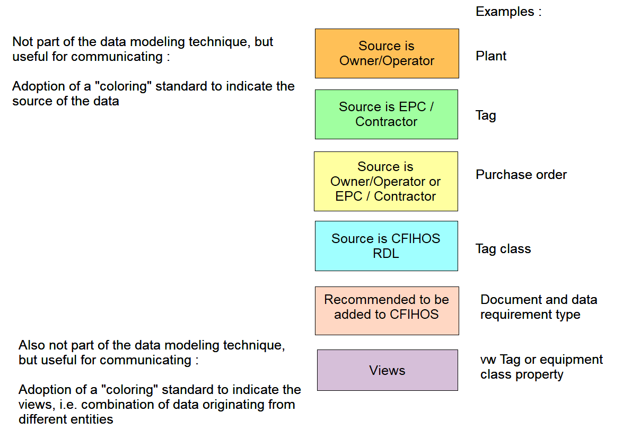

Slide 4
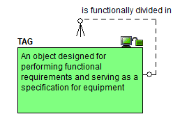
Starting point : the tag

Slide 5
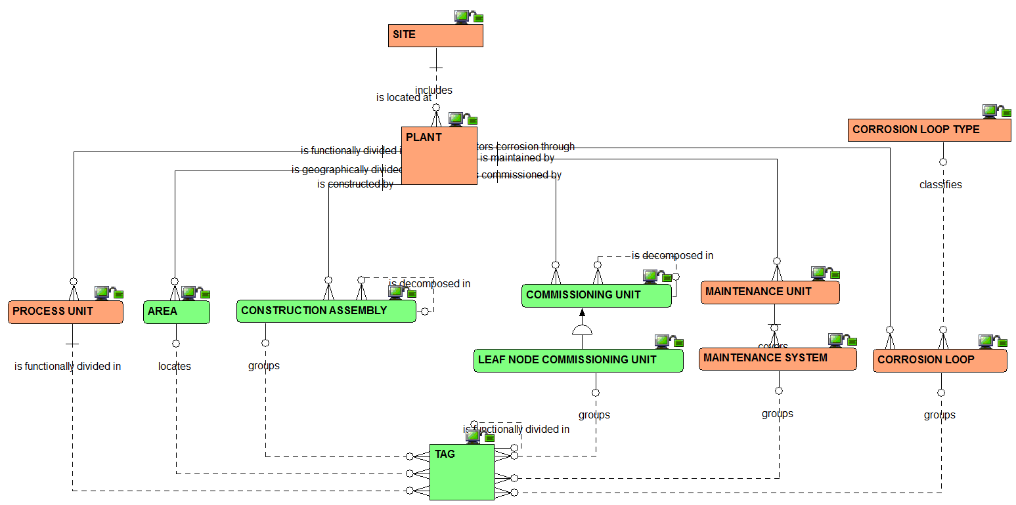
Plant breakdown structure : the relationships view

Slide 6
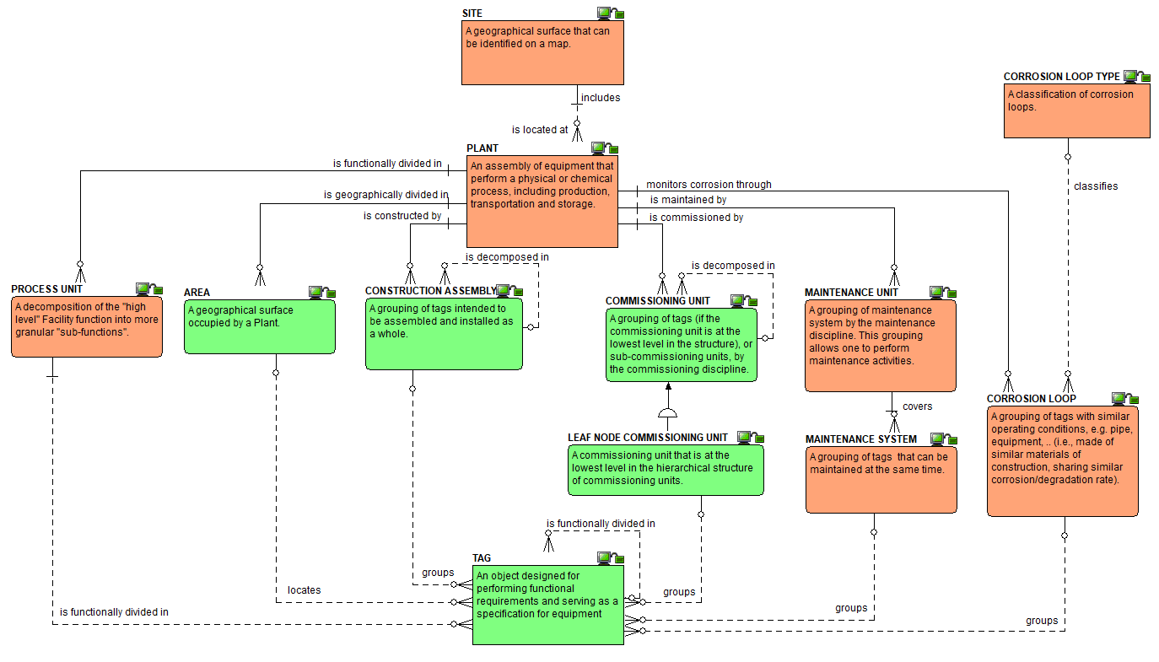
Plant breakdown structure :
the definitions view

Slide 7
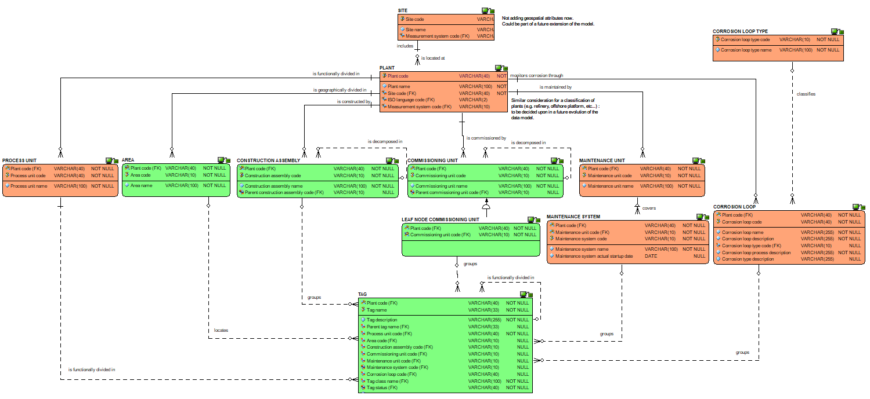
Plant breakdown structure : the attributes view

Slide 8
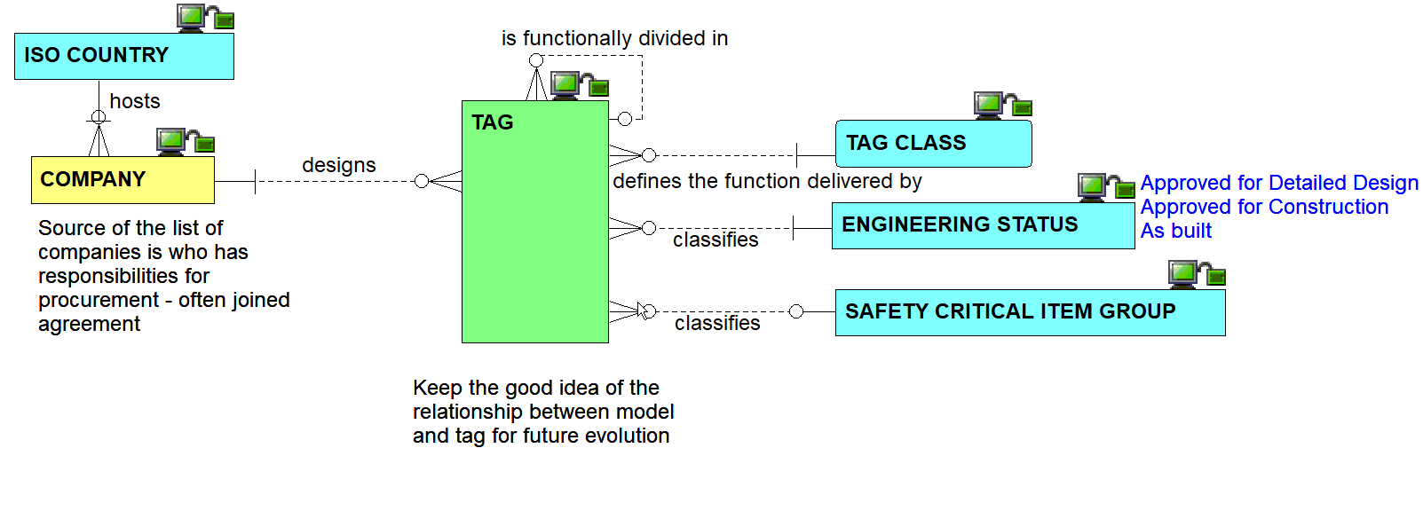
Other tag inbound relationships view

Slide 9
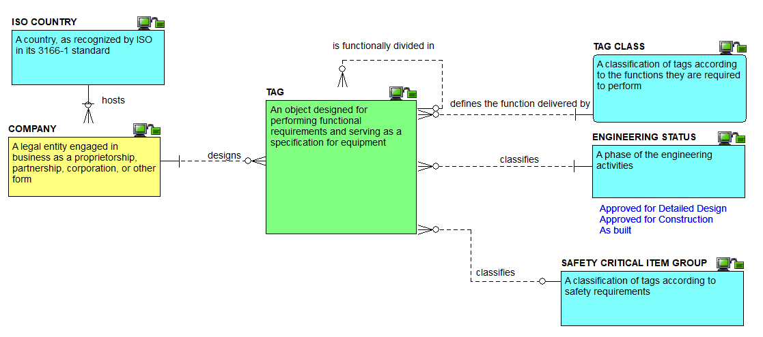
Other tag inbound definitions view

Slide 10
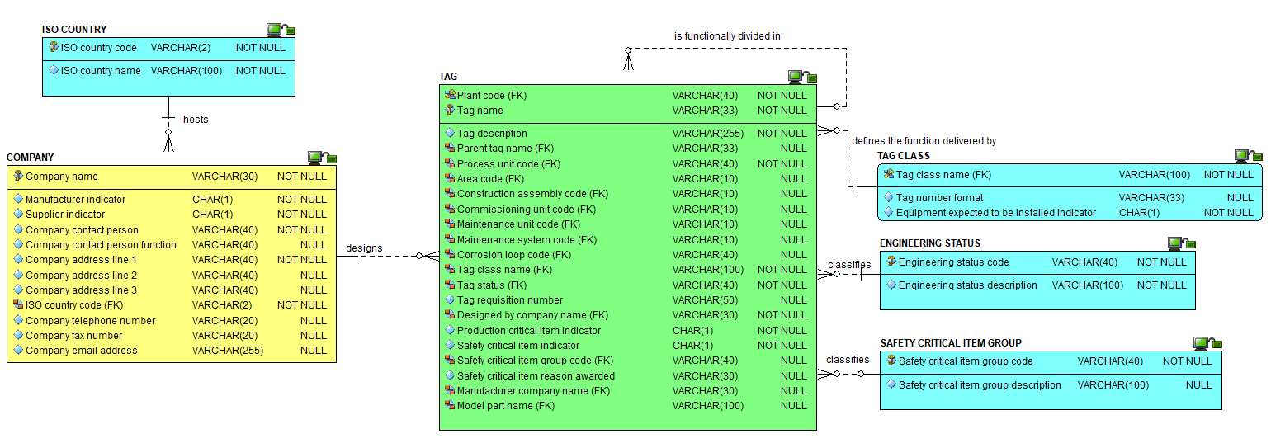
Other tag inbound attributes view

Slide 11
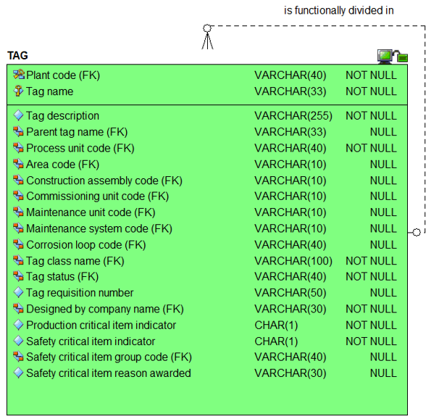
The tag attributes view

Slide 12
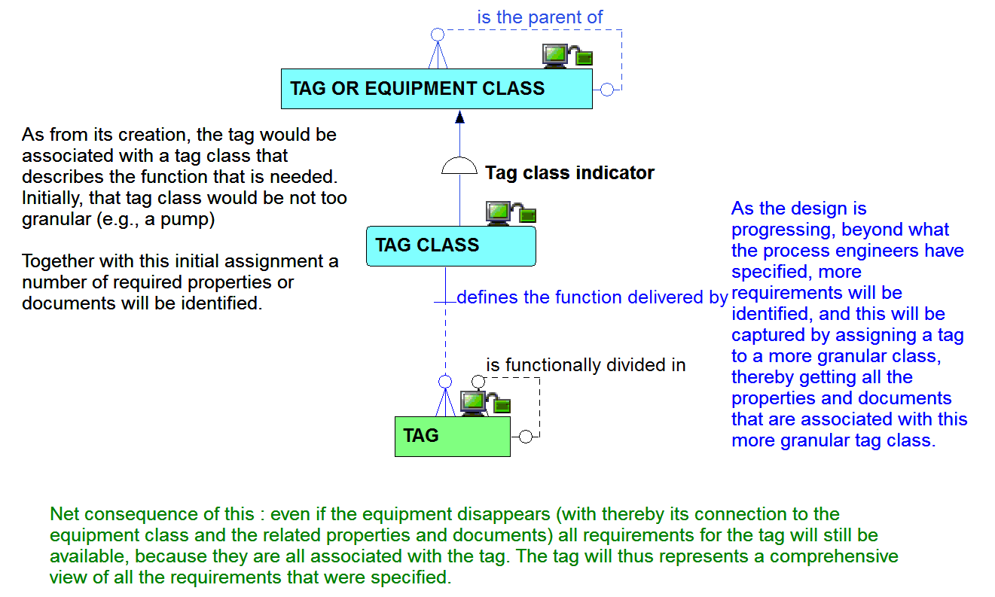
Tag and its relationship to tag class

Slide 13
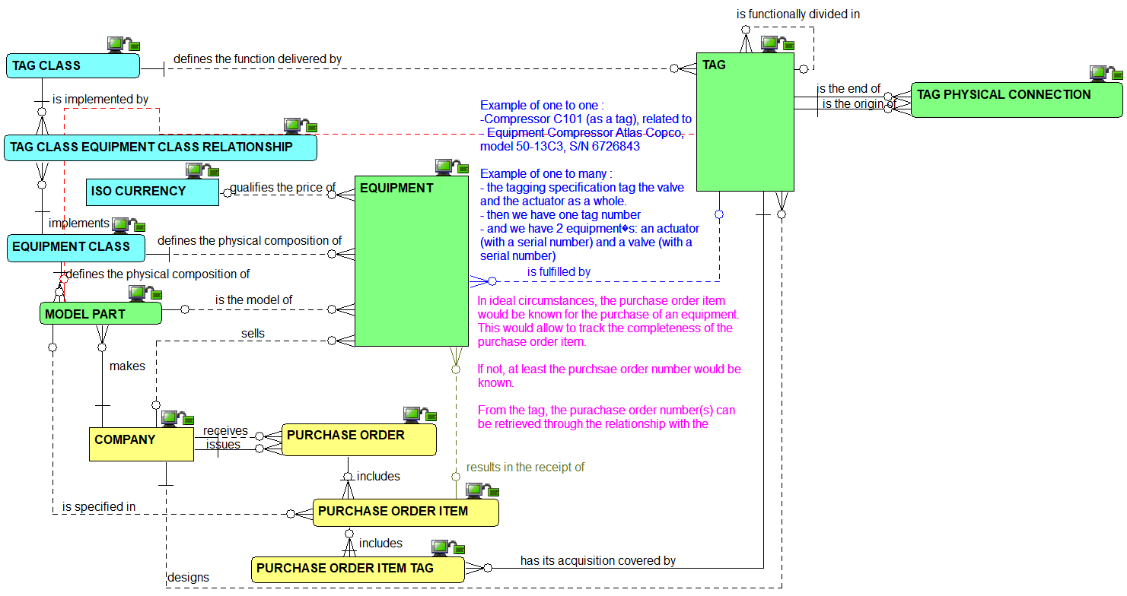
Tag to equipment : the relationships view

Slide 14
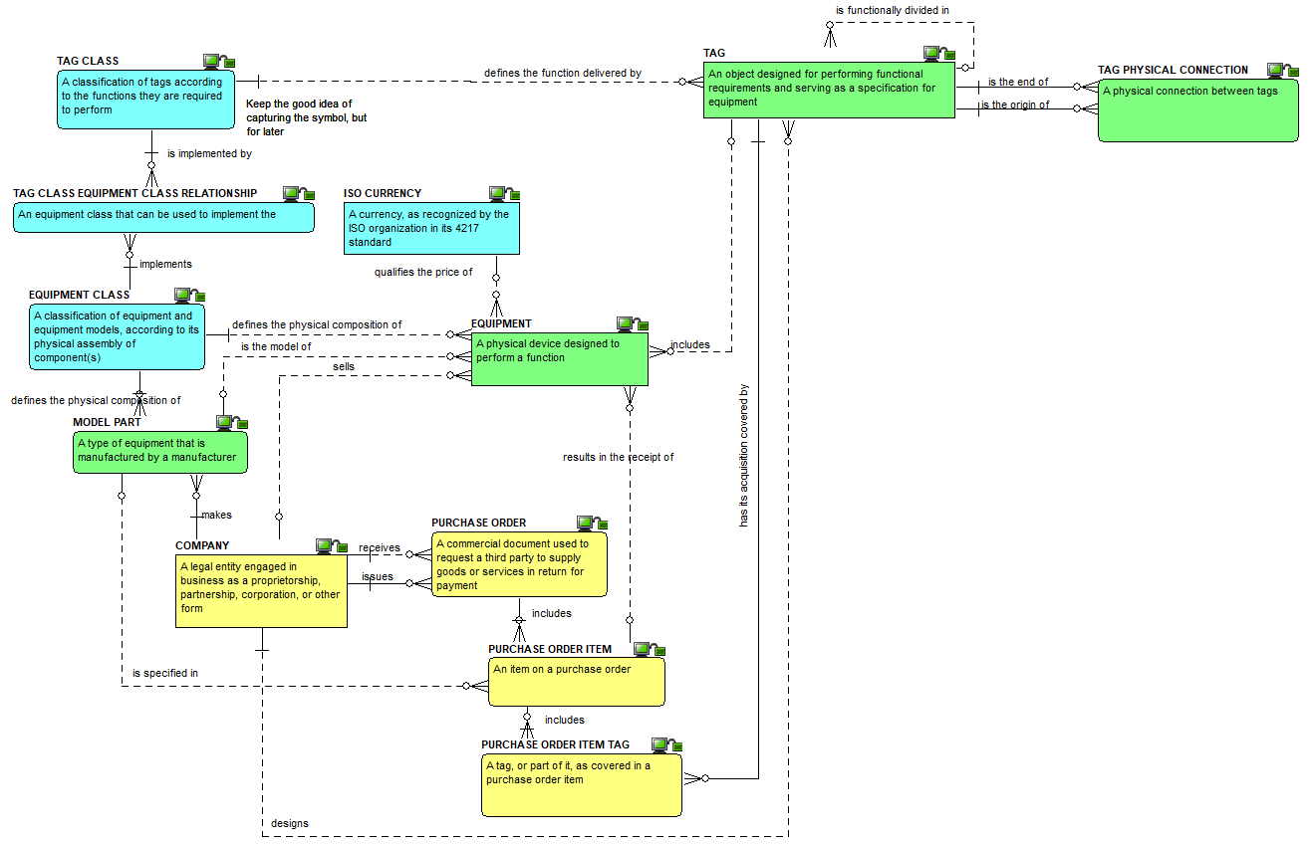

Tag to equipment : the definitions view

Slide 15
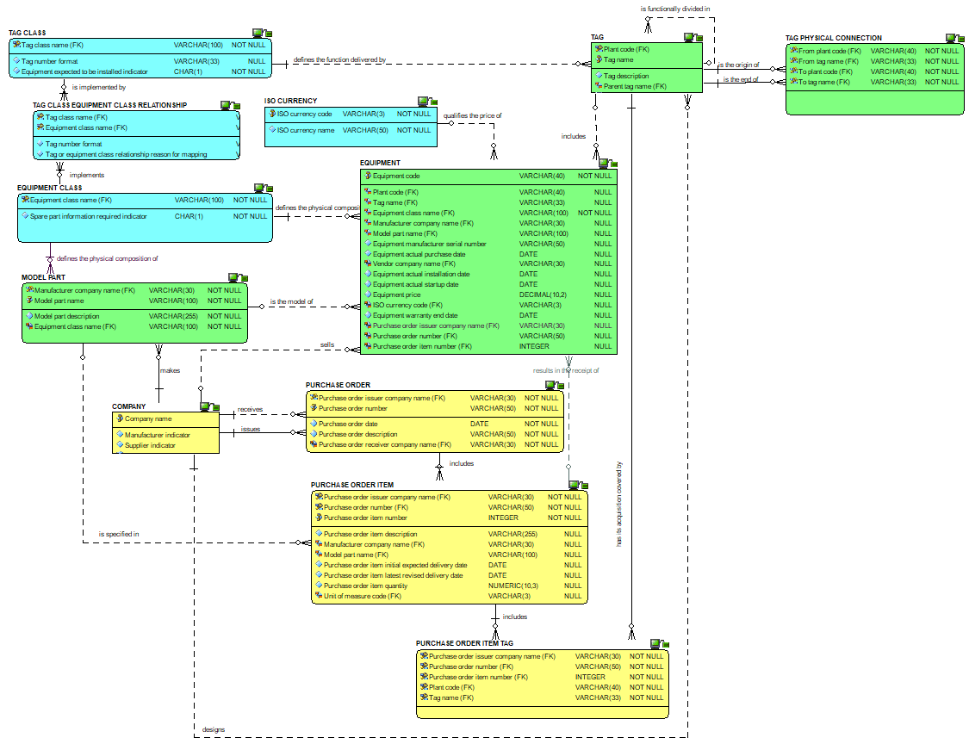
Tag to equipment : the attributes view

Slide 16
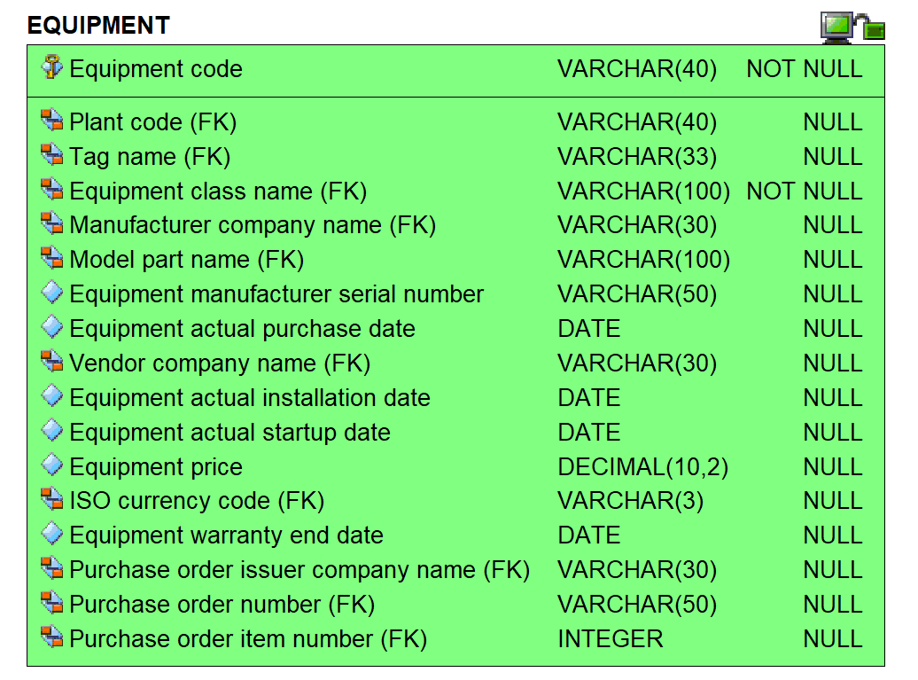
Equipment attributes view

Slide 17
Checkpoint 1 : Summary after review of the first third of the data model
As was

Slide 18
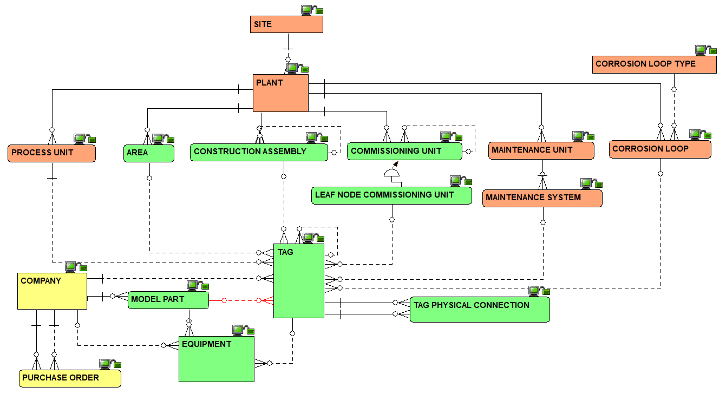
Checkpoint 1 : Summary after review of the first third of the data model
As is
Solid line for identifying relationships, dashed line for non identifying ones

Slide 19
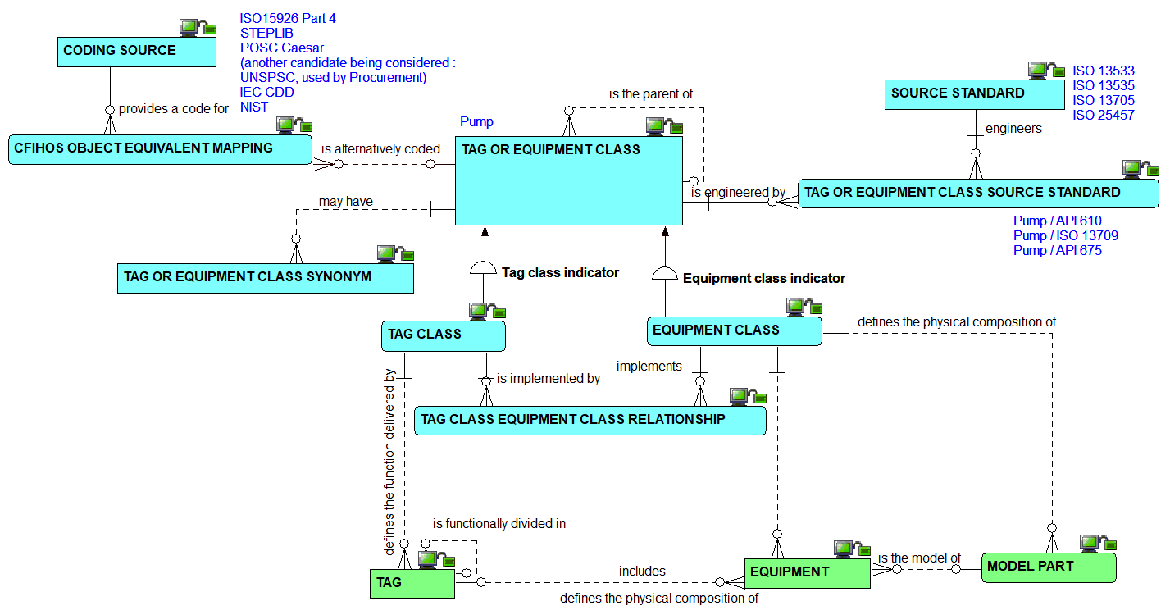
Classes : the relationships view

Slide 20
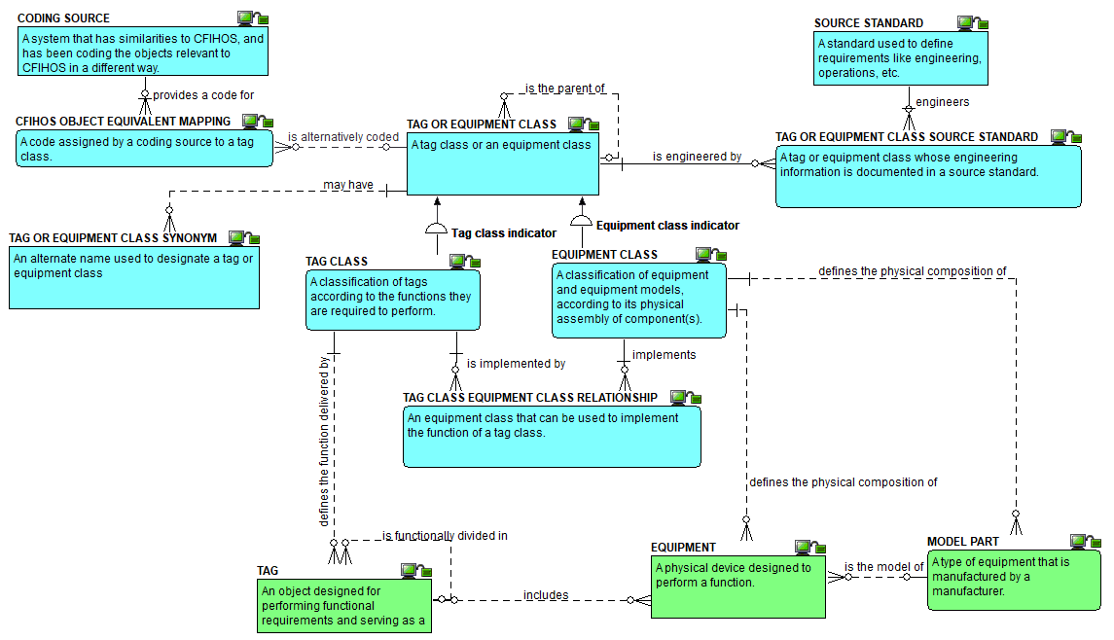
Classes: the definitions view

Slide 21
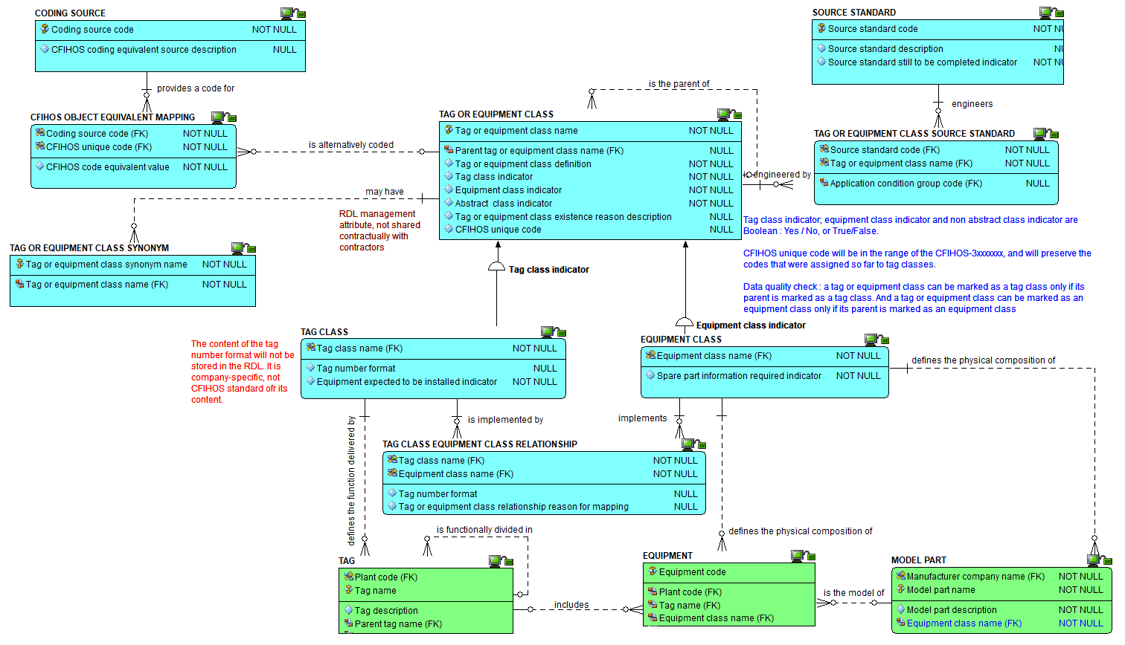
Classes: the attributes view

Slide 22
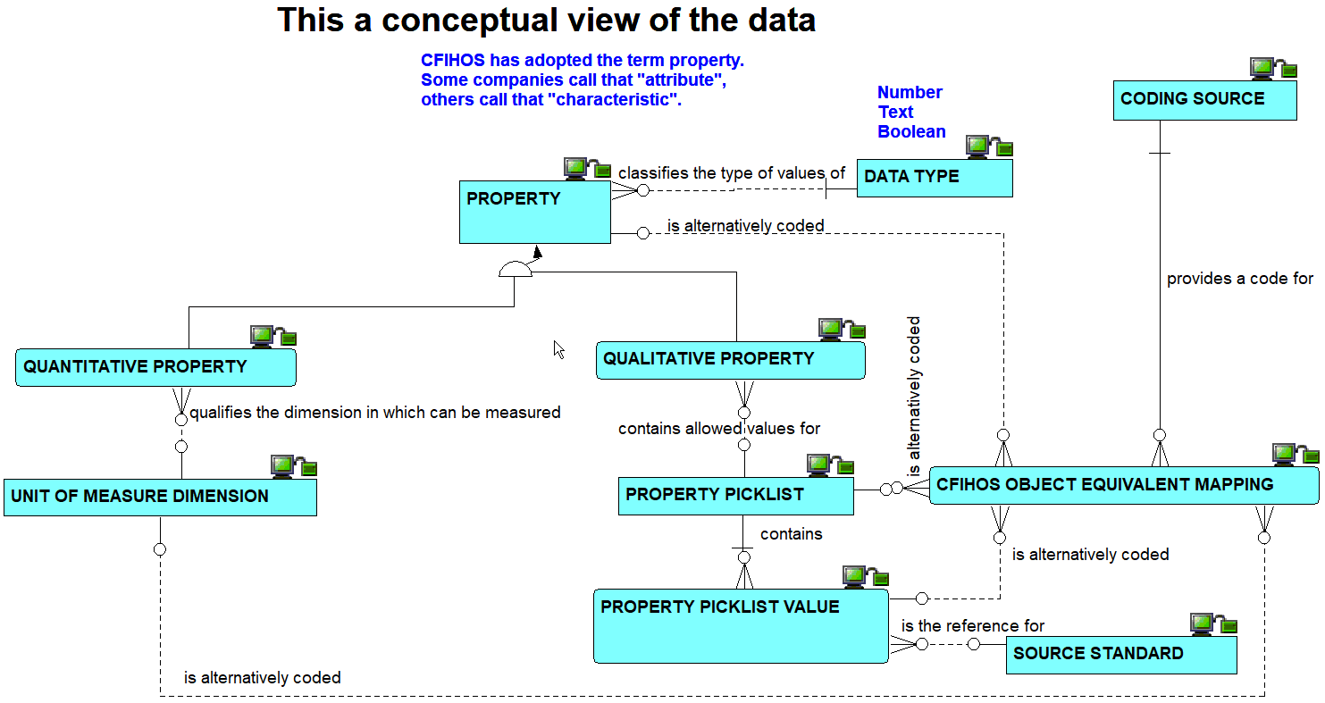
Properties: the conceptual view on relationships

Slide 23
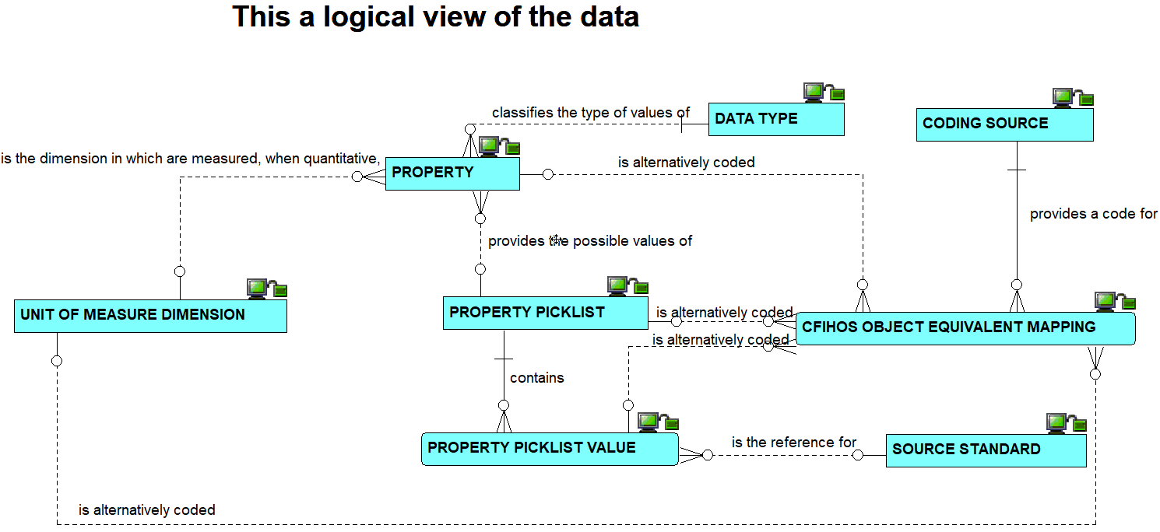
Properties: the logical view on relationships

Slide 24
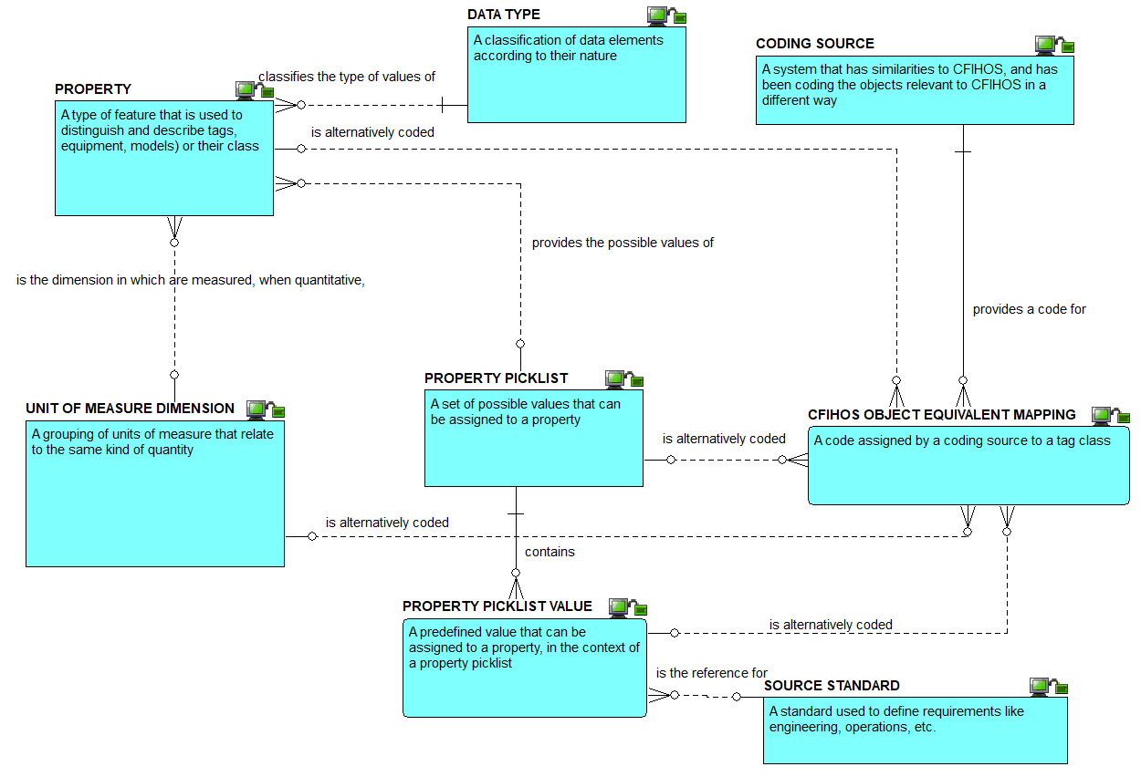
Properties : the definitions view

Slide 25
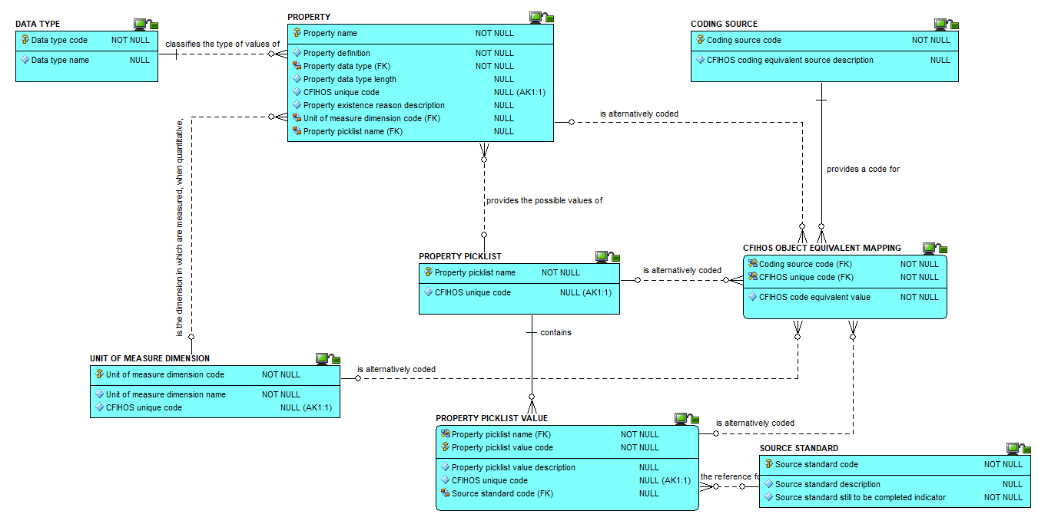
Properties : the attributes view

Slide 26
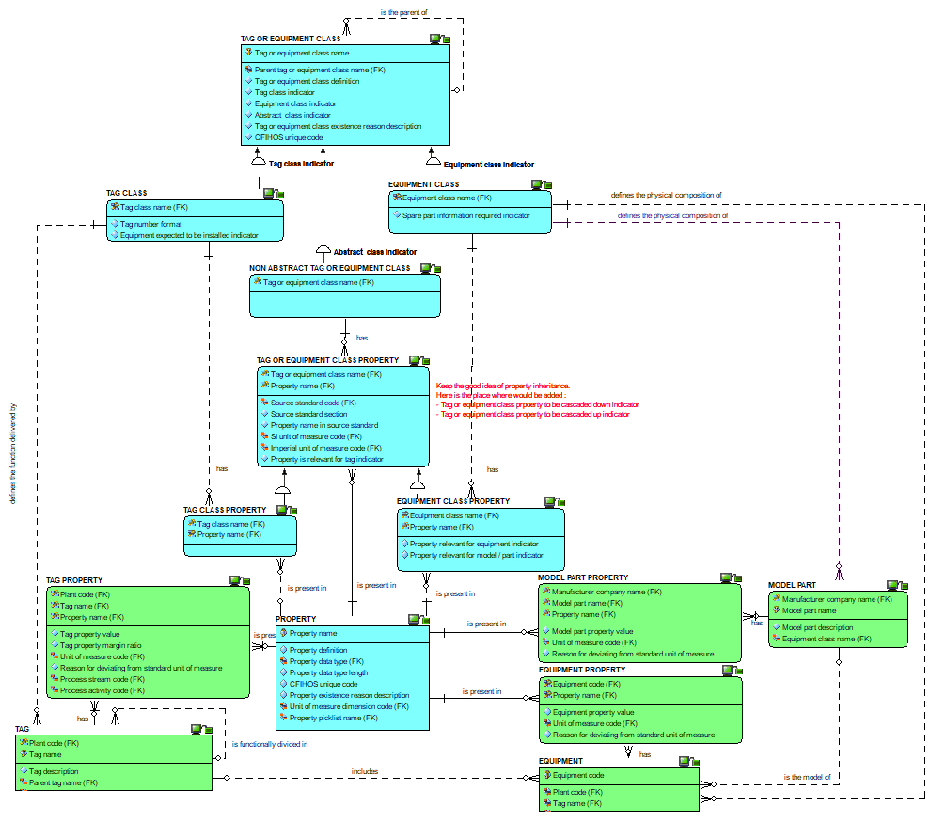
Property use : the attributes view

Slide 27
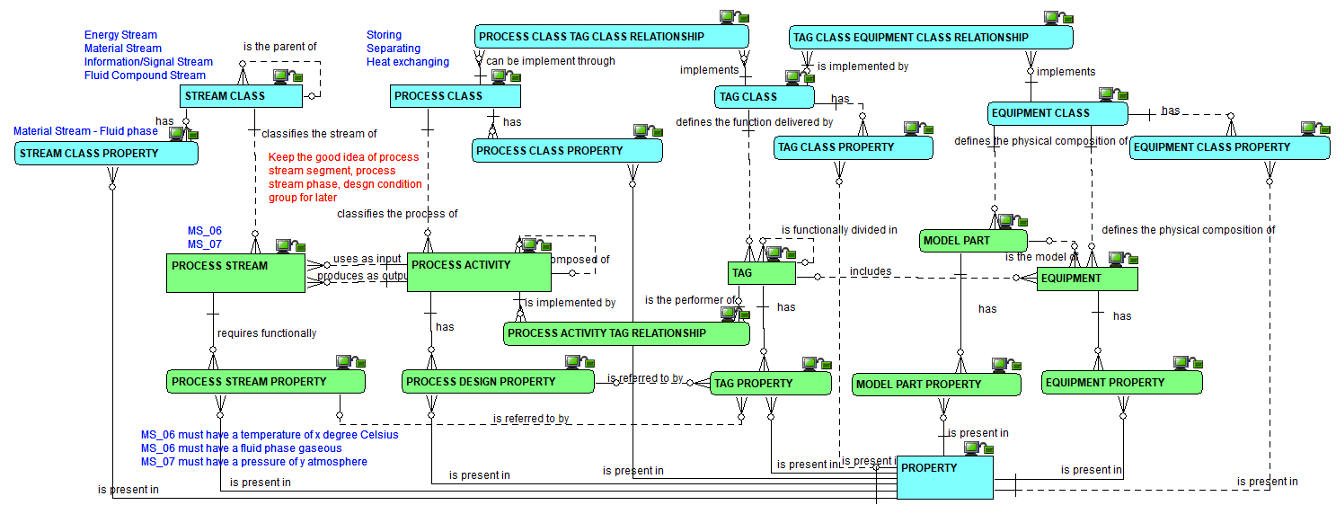
Process activity and stream, their class and their properties: the relationships view

Slide 28
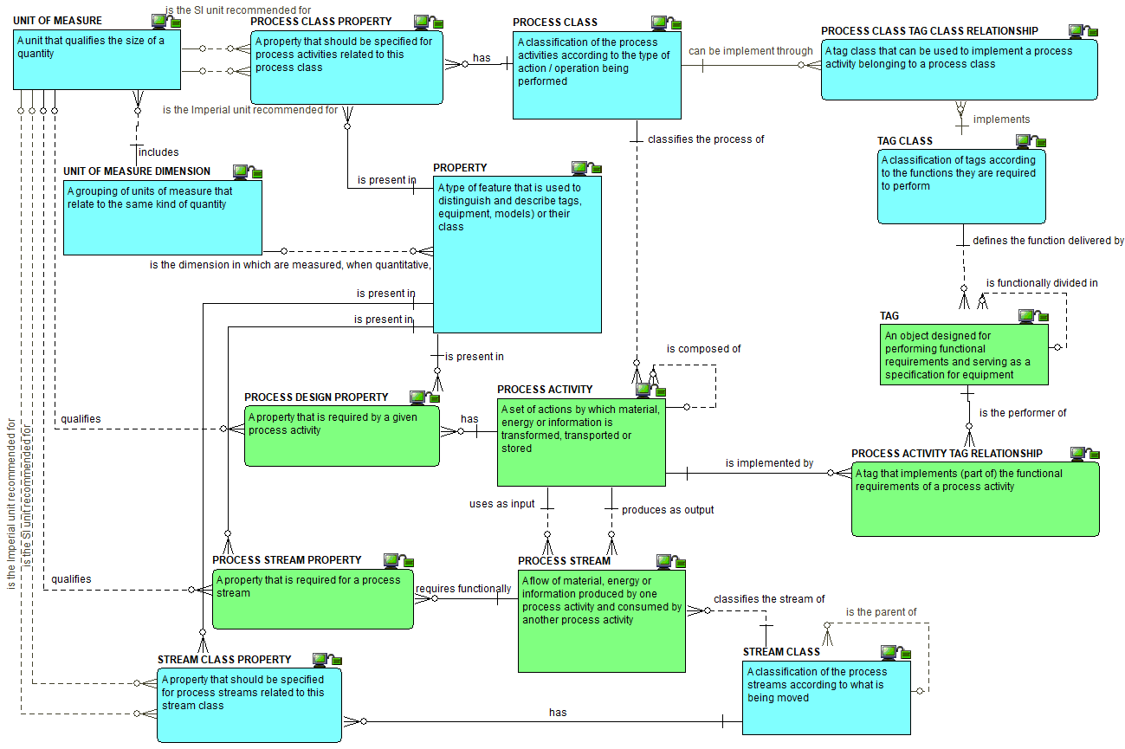
Process
activity and
stream,
their class
and their
properties:
the
definitions
view

Slide 29
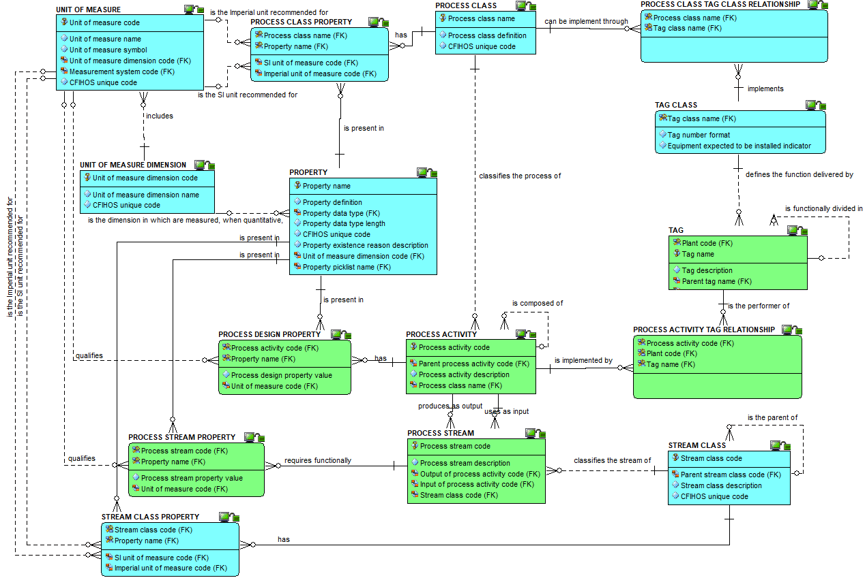
Process activity
and stream,
their class and
their properties:
the attributes
view

Slide 30
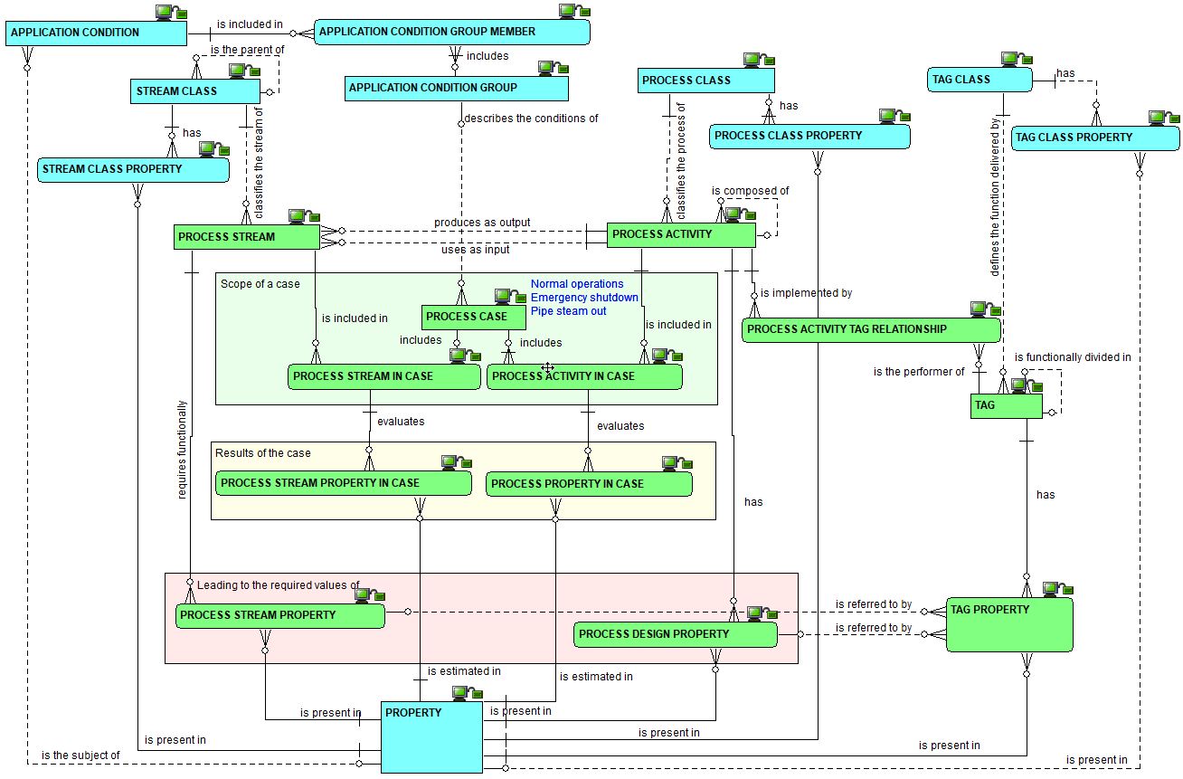
Cases : the
relationships
view

Slide 31
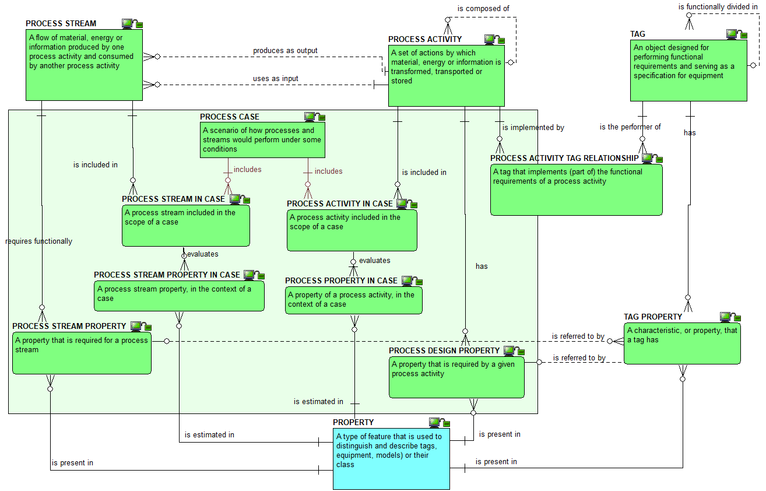
Cases : the
definitions
view

Slide 32
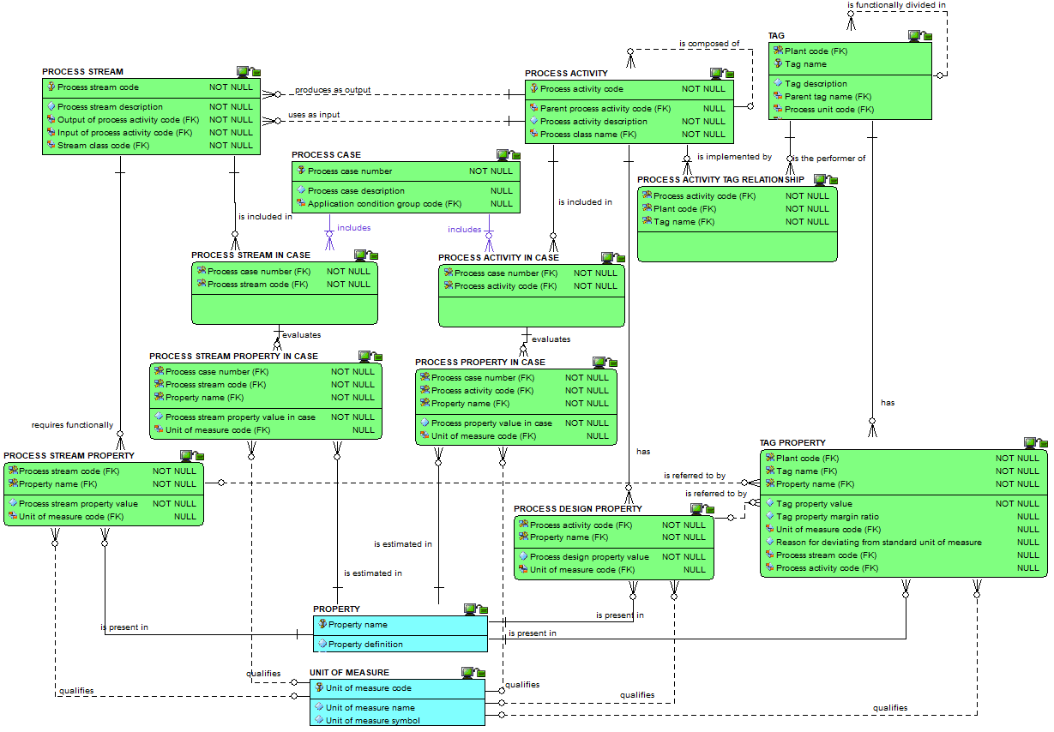
Cases : the attributes view

Slide 33
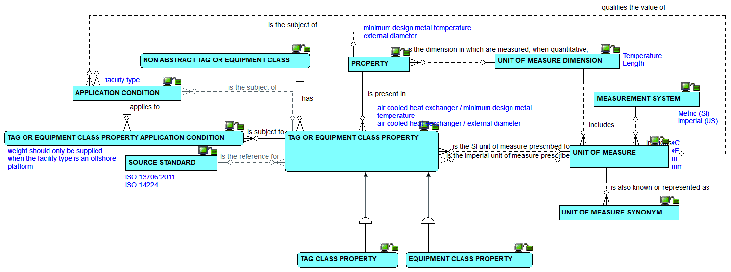
Properties, classes and units of measure : the relationships view

Slide 34
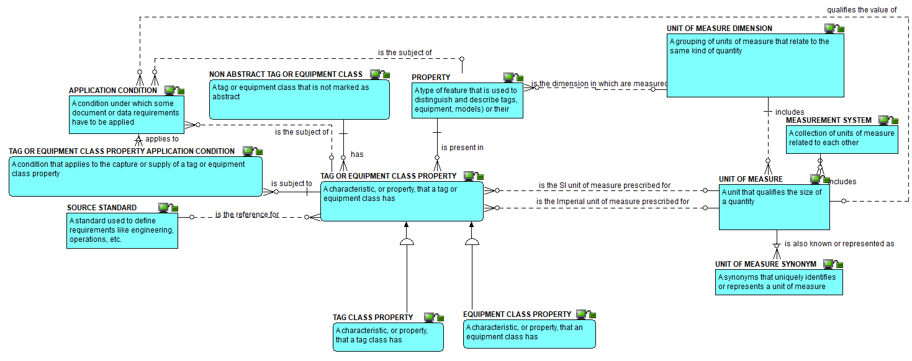
Properties, classes and units of measure : the definitions view

Slide 35
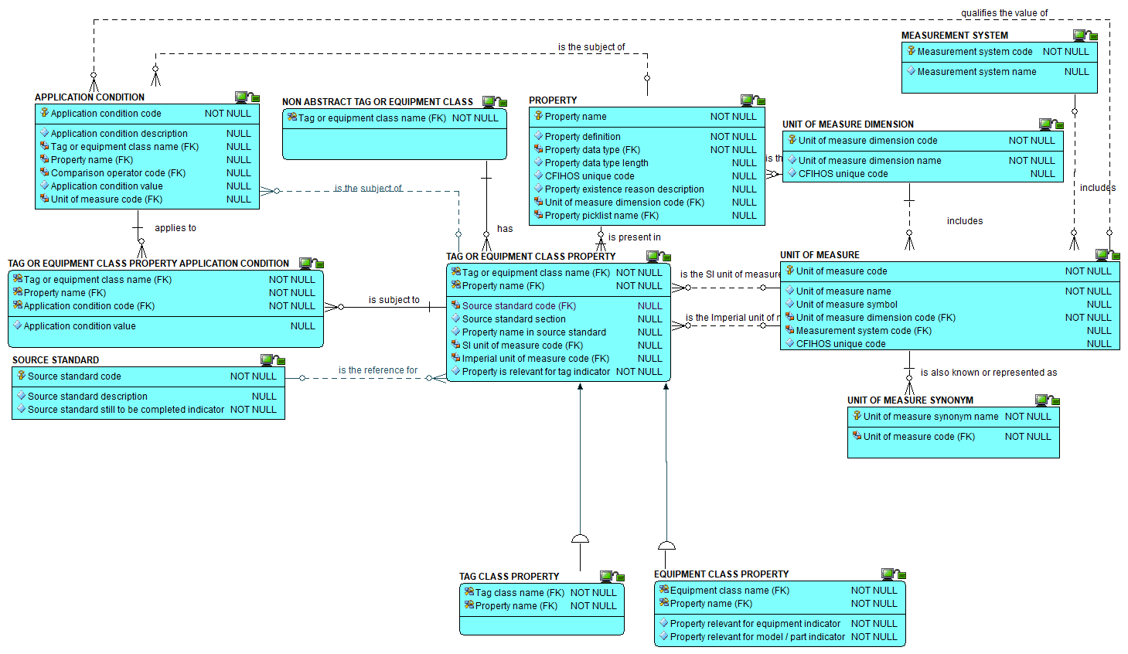
Properties, classes and units of measure : the attributes view

Slide 36
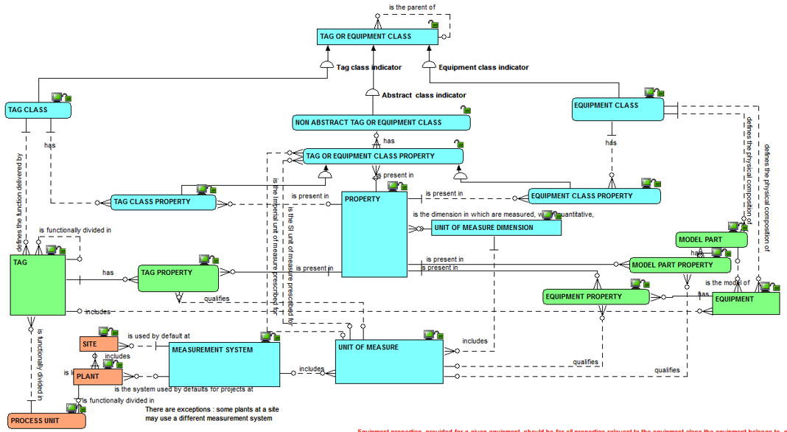
Properties, tags, equipment and units of measure : the relationships view

Slide 37
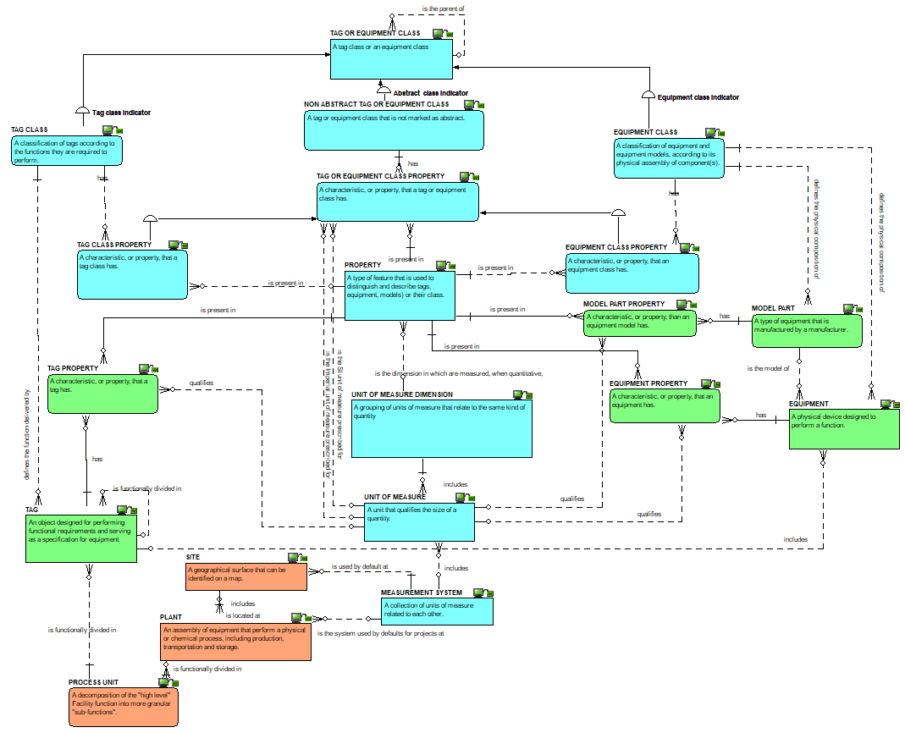
Properties, classes and units of measure : the definitions view

Slide 38
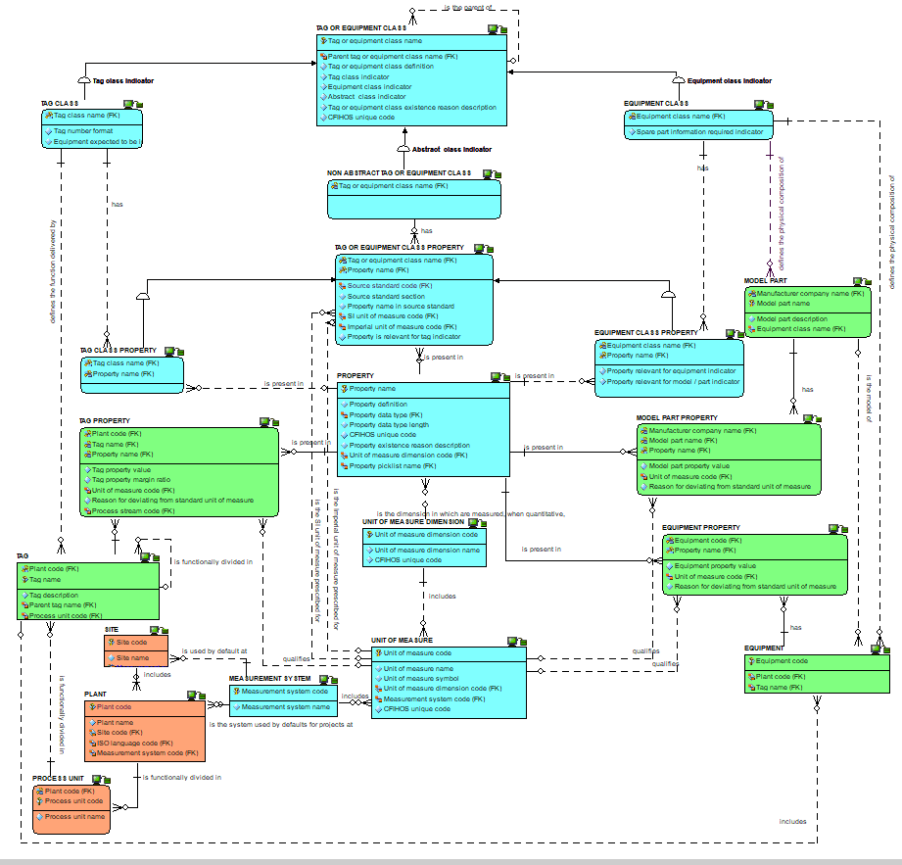
Properties, classes and units of measure : the attributes view

Slide 39
Checkpoint 2 : Summary after review of the second third of the data model
As was

Slide 40
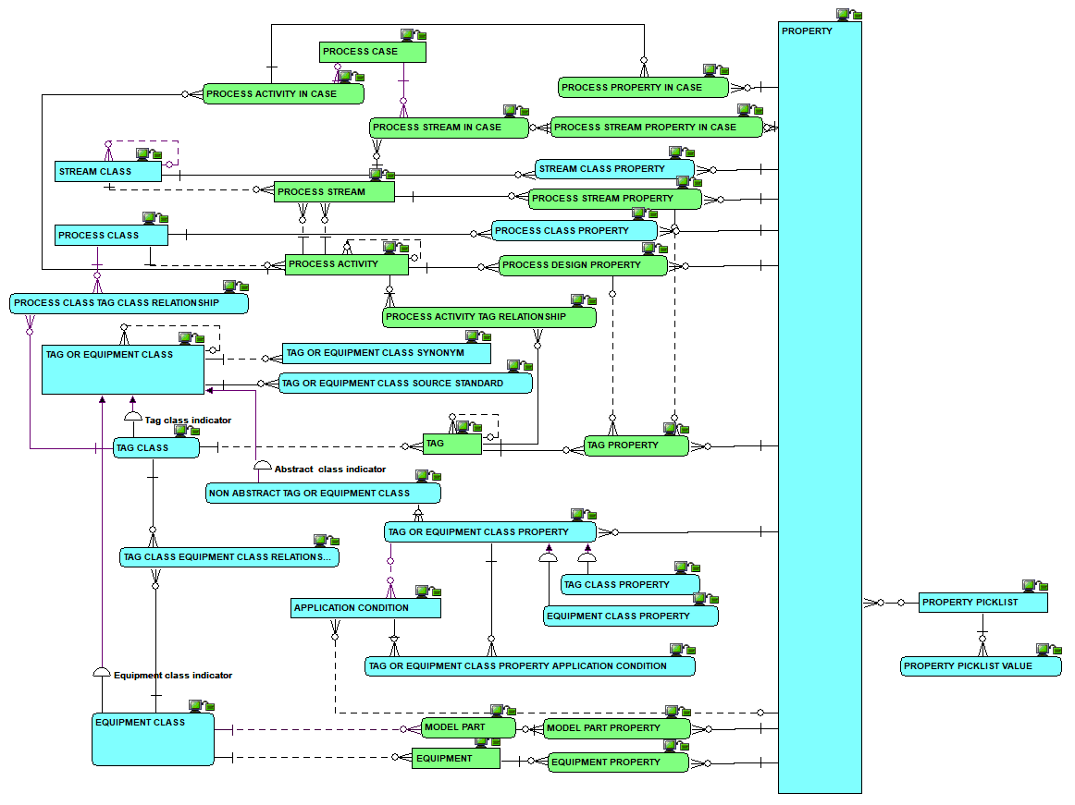
Checkpoint 2 : Summary after review of the second third of the data model
As is
Solid line for identifying relationships, dashed line for non identifying ones

Slide 41
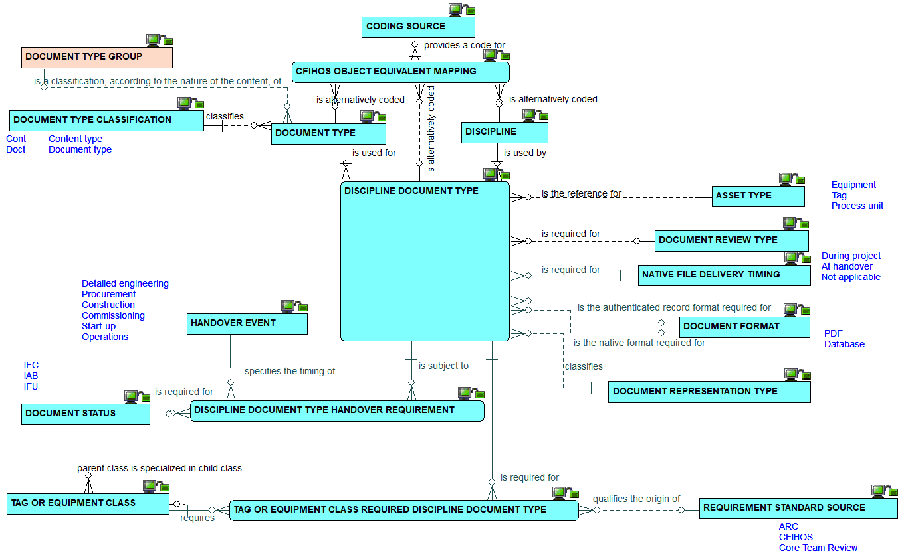
Disciplines and document types : the relationships view

Slide 42
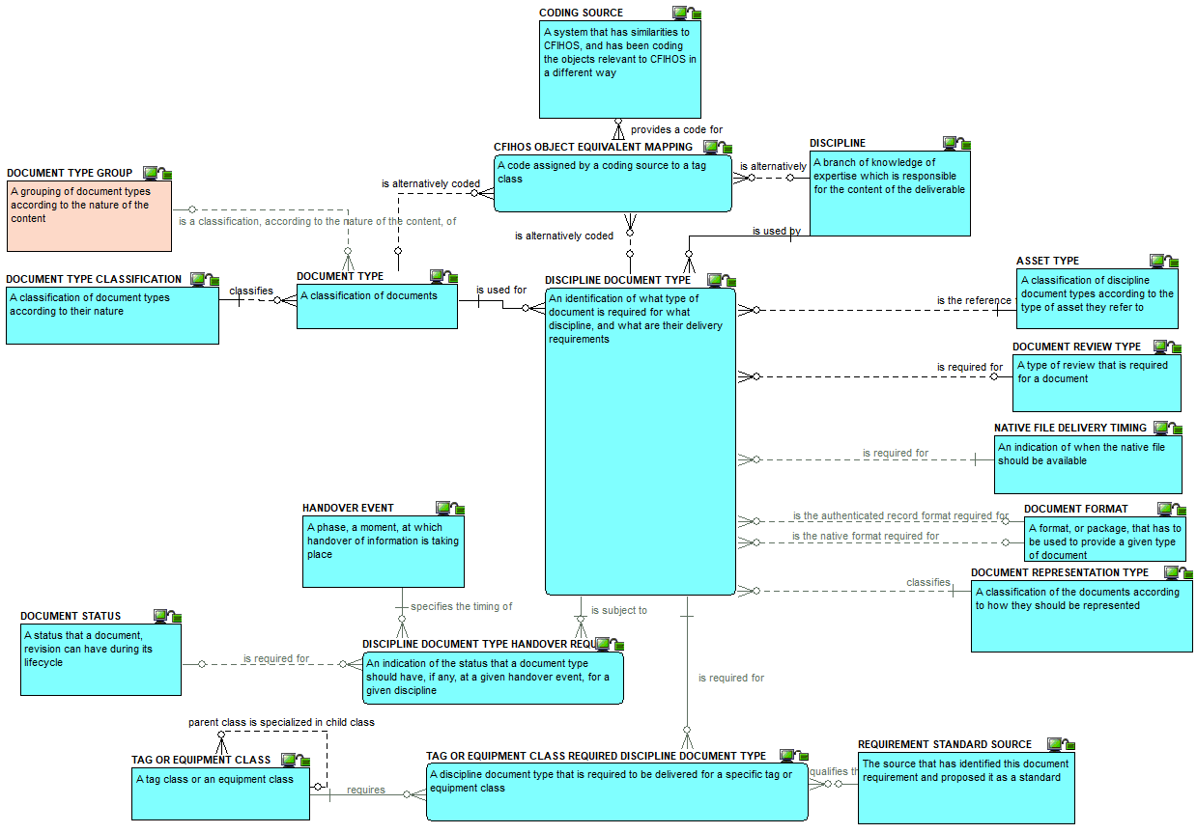
Disciplines and document types : the definitions view

Slide 43
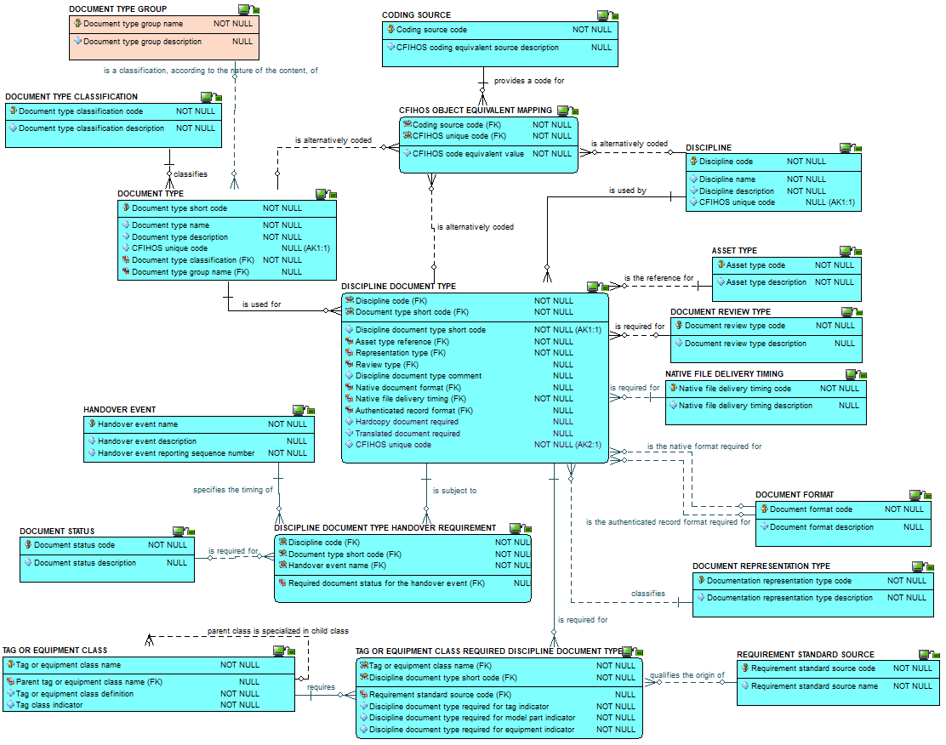
Disciplines and
document types :
the attributes view

Slide 44
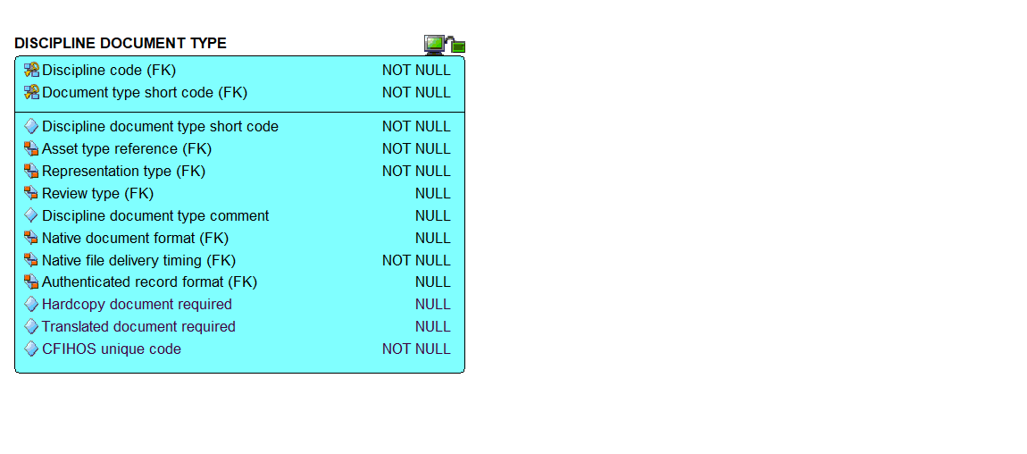
Discipline document type : zoom on the attributes

Slide 45
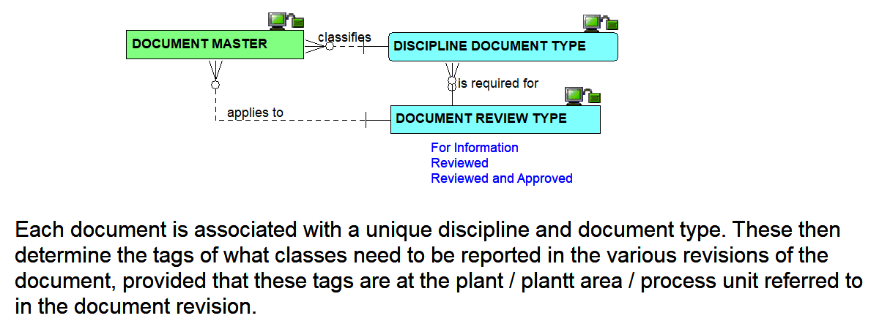
Document master : the relationships view

Slide 46
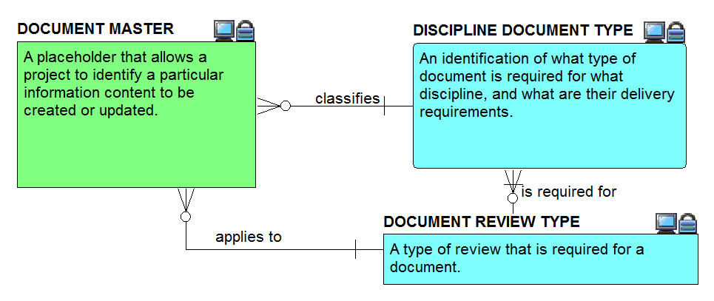
Document master : the definitions view

Slide 47
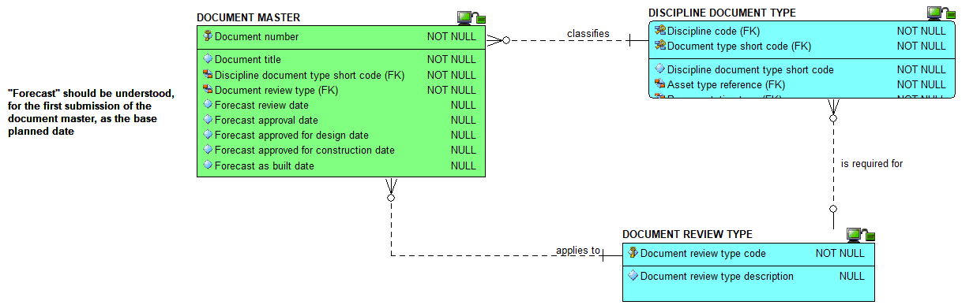
Document master : the attributes view

Slide 48
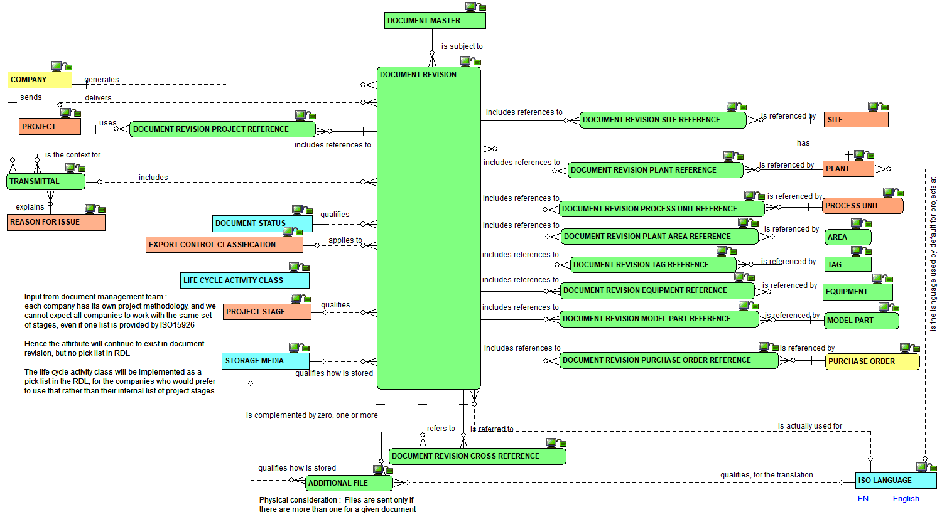
Document revision : the relationships view

Slide 49
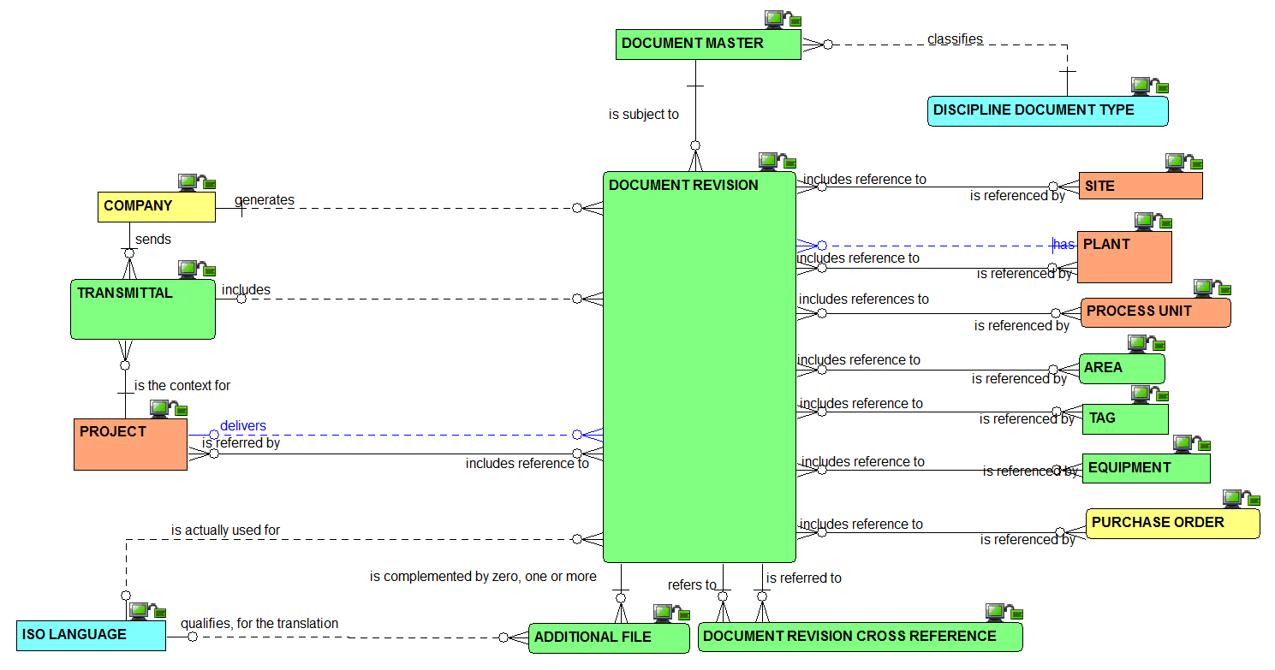
Document revision : the simplified relationships view

Slide 50
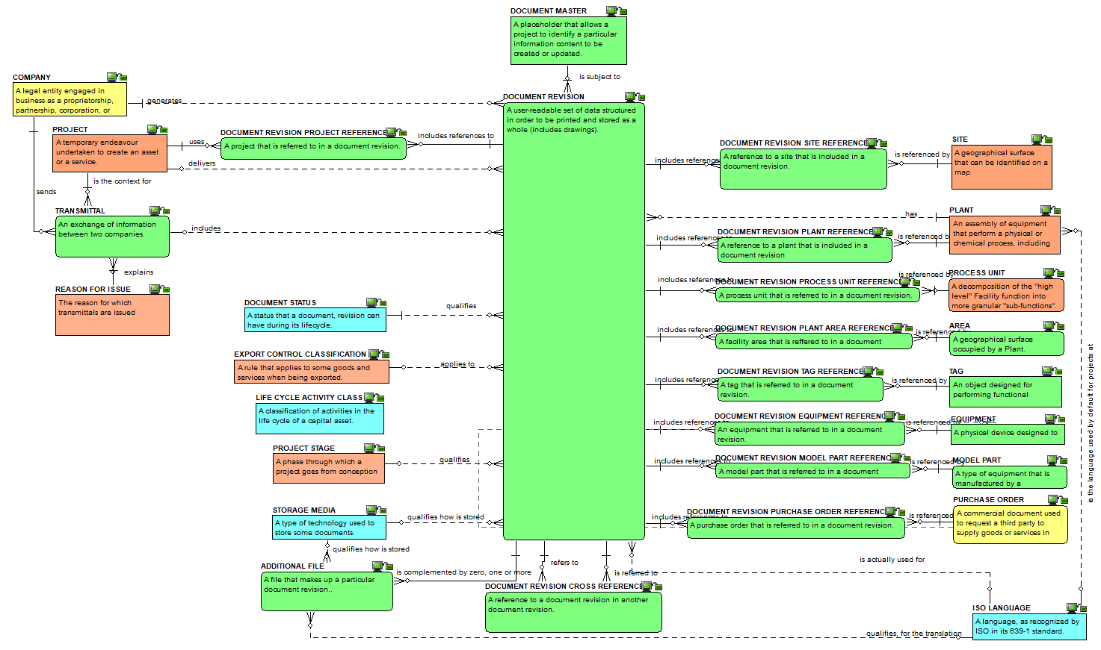
Document revision : the definitions view

Slide 51
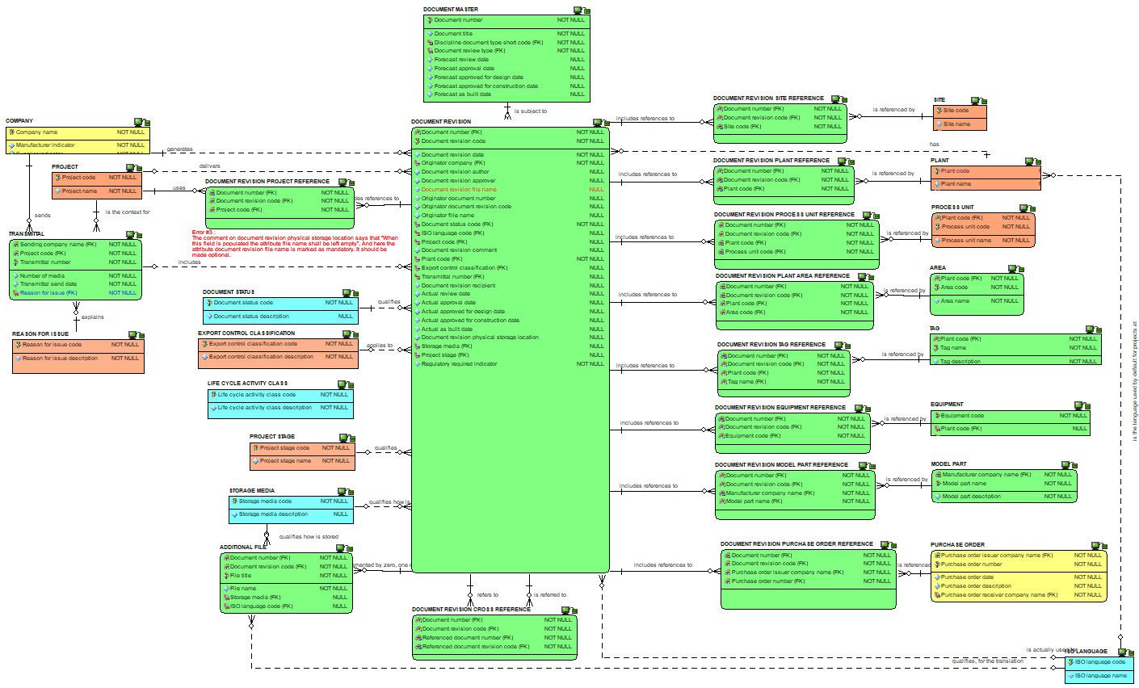
Document revision : the attributes view

Slide 52
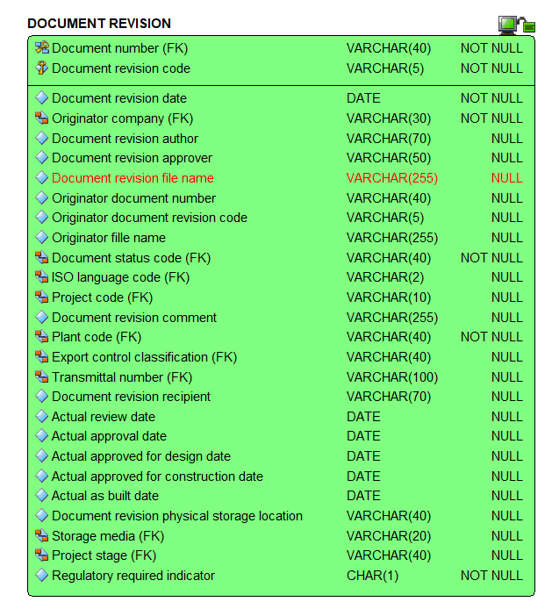
Document revision : zoom on the attributes

Slide 53
Checkpoint 3 : Summary after review of the third third of the data model
As was

Slide 54
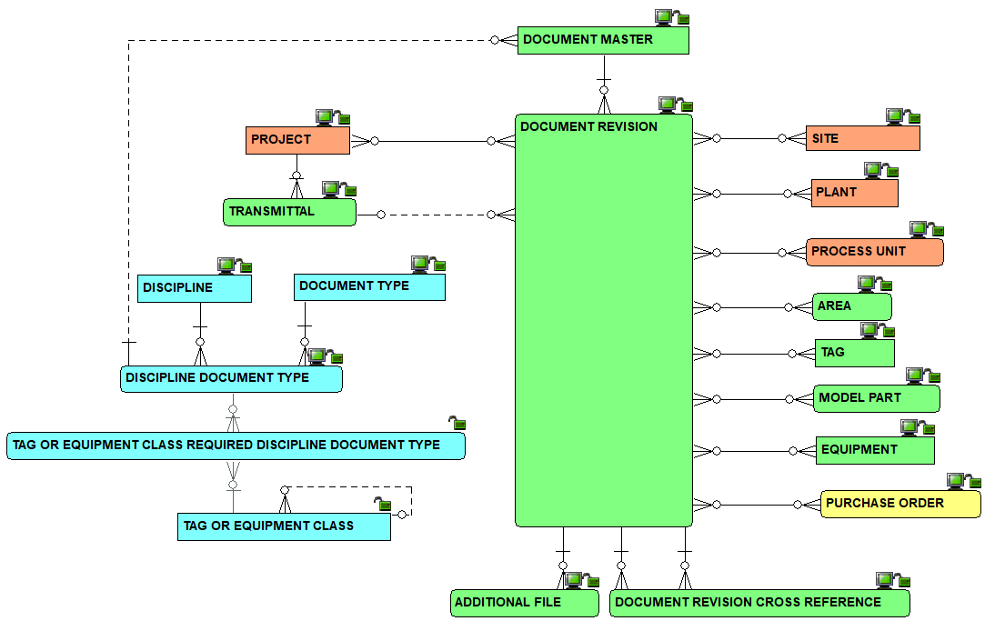
Checkpoint 3 : Summary after review of the third third of the data model
As is
Solid line for identifying relationships, dashed line for non identifying ones

Slide 55
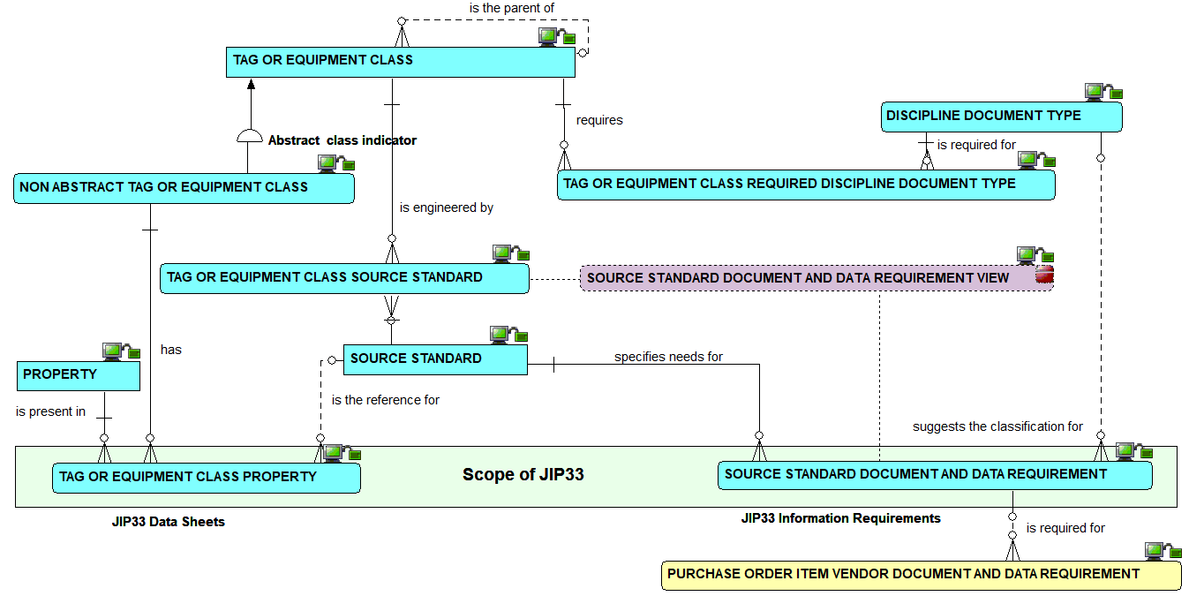
JIP33:
the relationships view – what JIP33 would add vs what is already present in CFIHOS data model

Slide 56

How to link tag or equipment classes to source standards : the relationships view

Slide 57

How to link tag or equipment classes to source standards : the definitions view

Slide 58

How to link tag or equipment classes to source standards : the attributes view

Slide 59

Source standard document and data requirements : the relationships view

Slide 60

Source standard document and data requirements : the relationships view

Slide 61

Source standard document and data requirements : the definitions view

Slide 62

Source standard document and data requirements : the definitions view

Slide 63

Source standard document and data requirements : the attributes view

Slide 64

Source standard document and data requirements : the attributes view

Slide 65

From the source standard document and data requirements to the purchase order - the relationships view (1/4)

Slide 66

From the source standard document and data requirements to the purchase order - the relationships view (2/4)

Slide 67

From the source standard document and data requirements to the purchase order - the relationships view (3/4)

Slide 68

Purchase order VDDRs: the relationships view – the case of the tag

Slide 69

Purchase order VDDRs: the relationships view – the case of the model

Slide 70

From the source standard document and data requirements to the purchase order - the relationships view (4/4)

Slide 71

From the source standard document and data requirements to the purchase order - the relationships view (4/4) – including views

Slide 72

Purchase order VDDRs: the relationships view

Slide 73

Purchase order VDDRs: the definitions view

Slide 74

Purchase order VDDRs: the attributes view

Slide 75

Checkpoint 4 : Summary of the vendor document and data requirements
Solid line for identifying relationships, dashed line for non identifying ones

Slide 76

Overview of the whole model

Slide 77

Overview of tag or equipment class relationships

Slide 78

Overview of CFIHOS alternate code mapping capabilities

Slide 79

Overview of pick lists

Slide 80

The relationship between the logical model and the CSV files :
1) tag and equipment class

Slide 81

The relationship between the logical model and the CSV files :
2) tag and equipment class property

Slide 82

The relationship between the logical model and the CSV files :
3) Property, pick list and unit of measure

Slide 83

The relationship between the logical model and the CSV files :
4) Discipline and document type

