Slide 1
CFIHOS Data Model
C-DM-001 version 1.5
CFIHOS 1.5 © 2021 by IOGP is licensed under Attribution 4.0 International. To view a copy of this license, visit http://creativecommons.org/licenses/by/4.0/

Slide 2
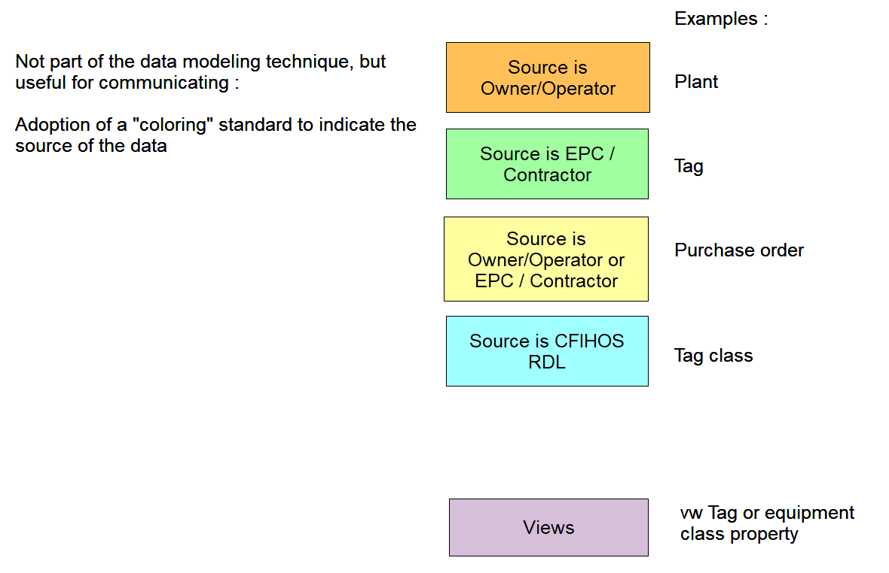

Slide 3
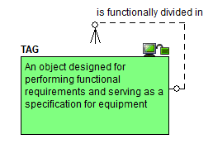
Starting point : the tag

Slide 4
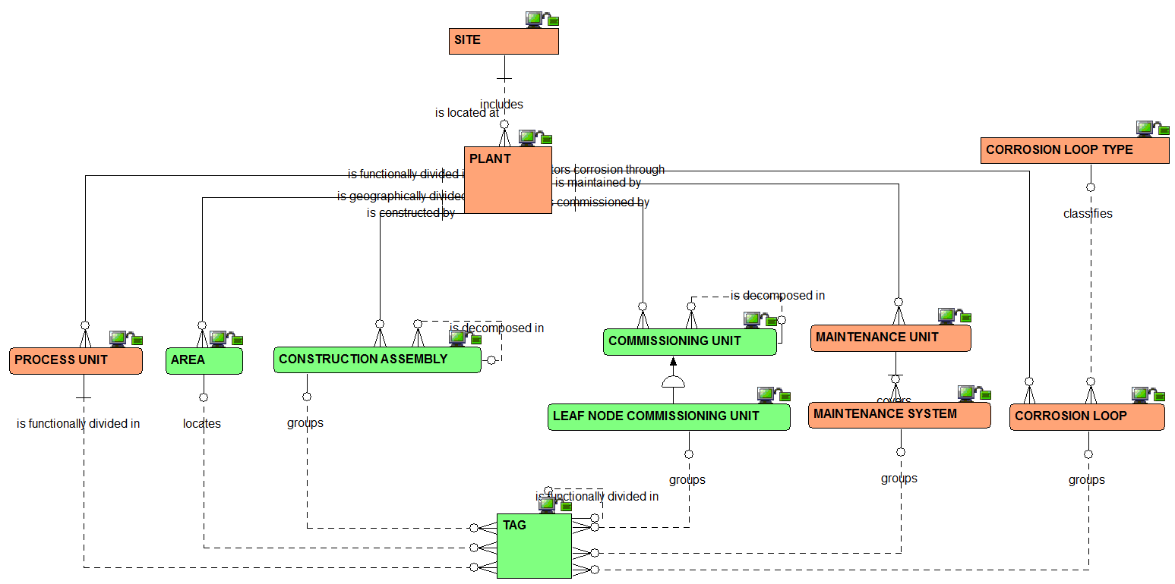
Plant breakdown structure : the relationships view

Slide 5
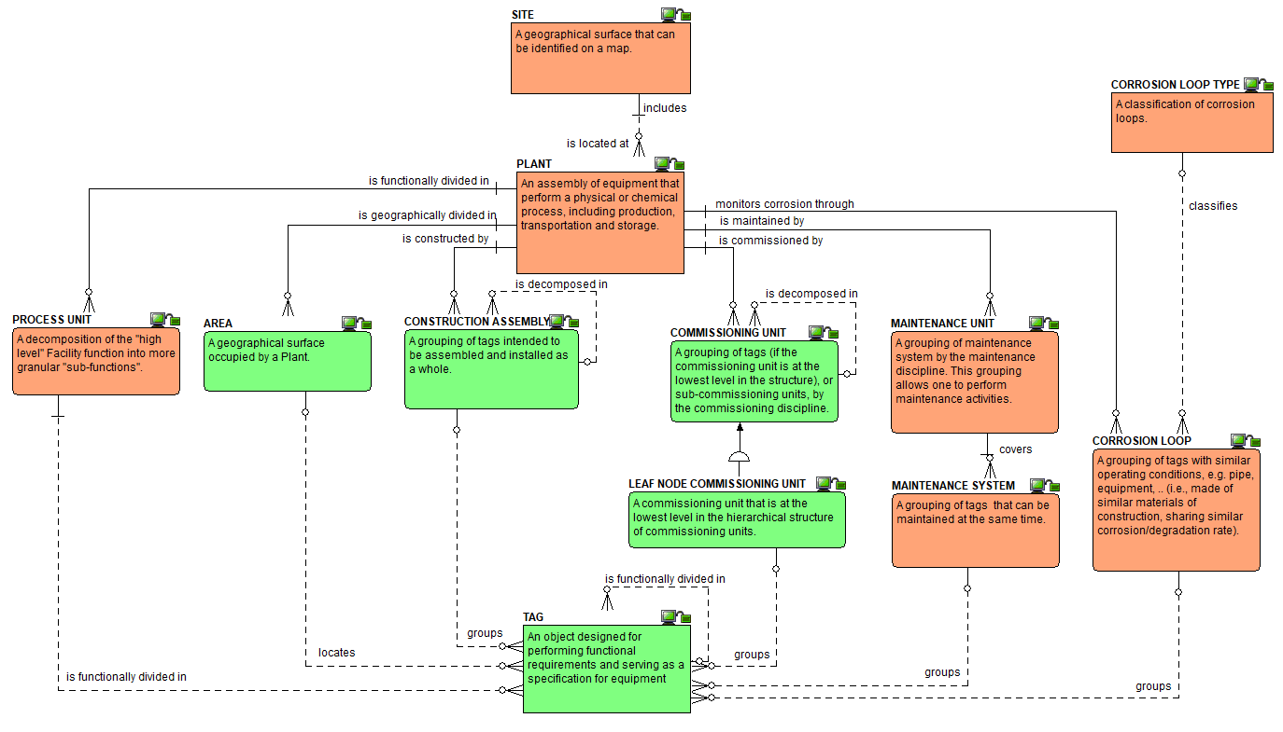
Plant breakdown structure :
the definitions view

Slide 6
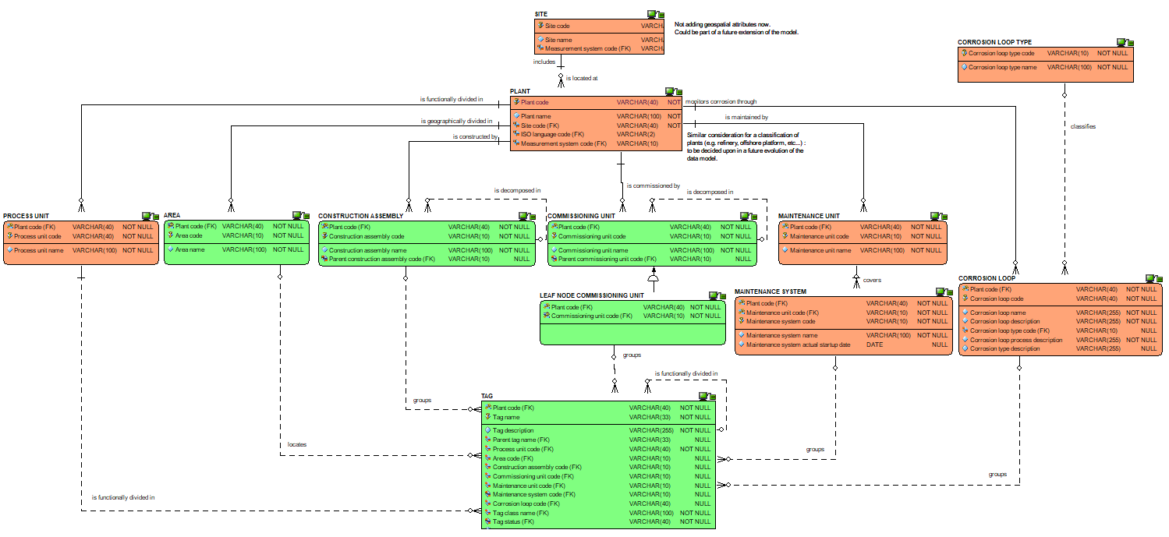
Plant breakdown structure : the attributes view

Slide 7
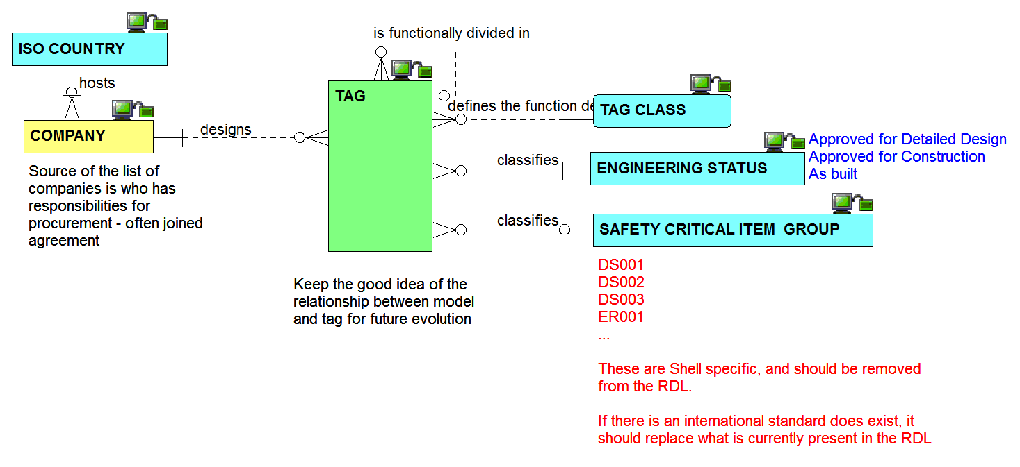
Other tag inbound relationships view

Slide 8
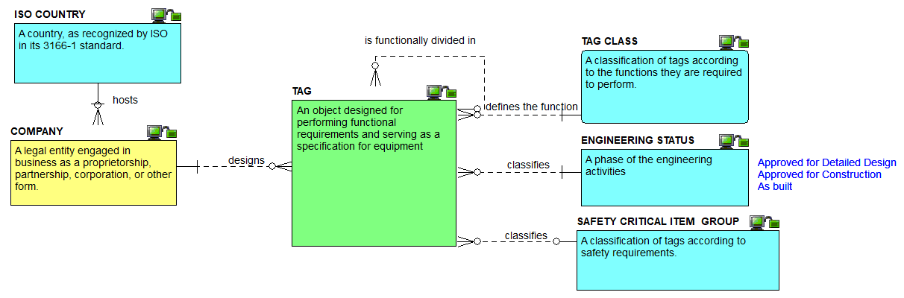
Other tag inbound definitions view

Slide 9
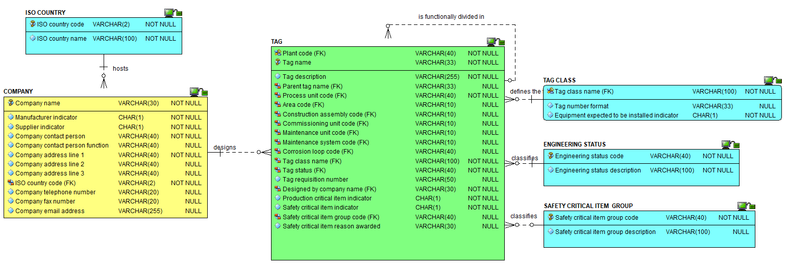
Other tag inbound attributes view

Slide 10
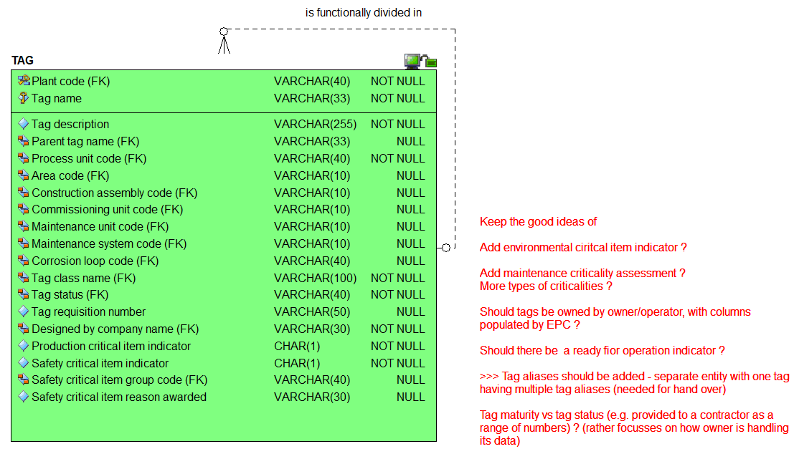
The tag attributes view

Slide 11
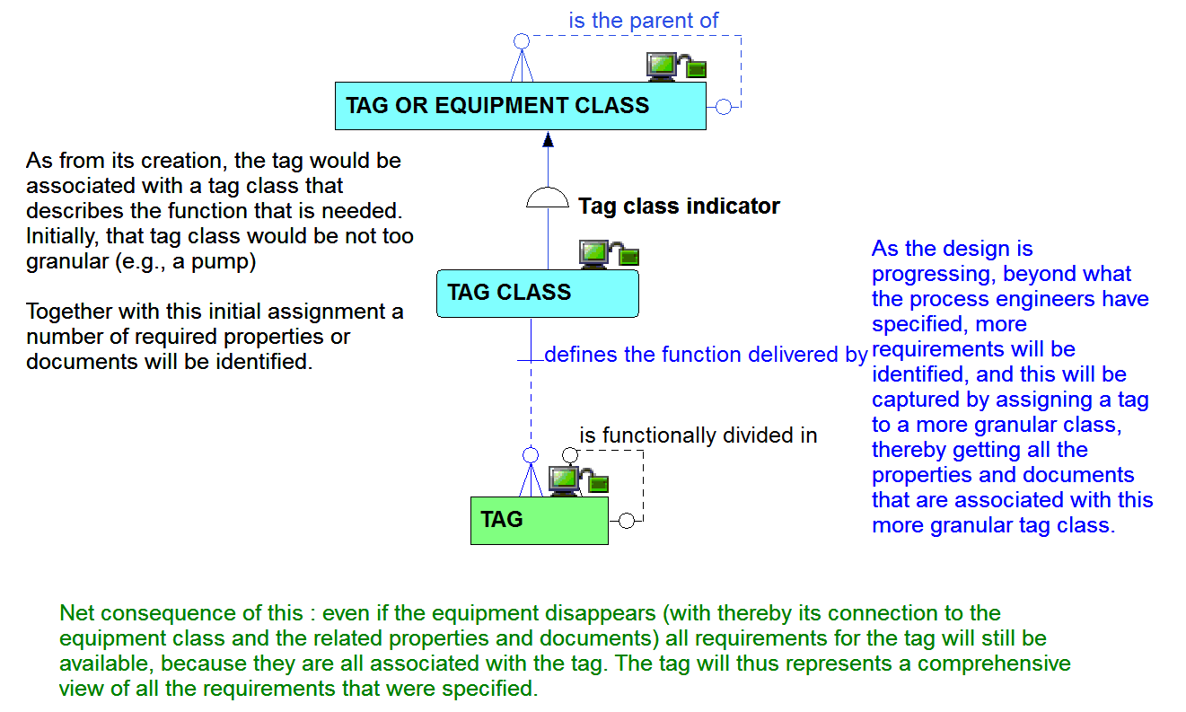
Tag and its relationship to tag class

Slide 12
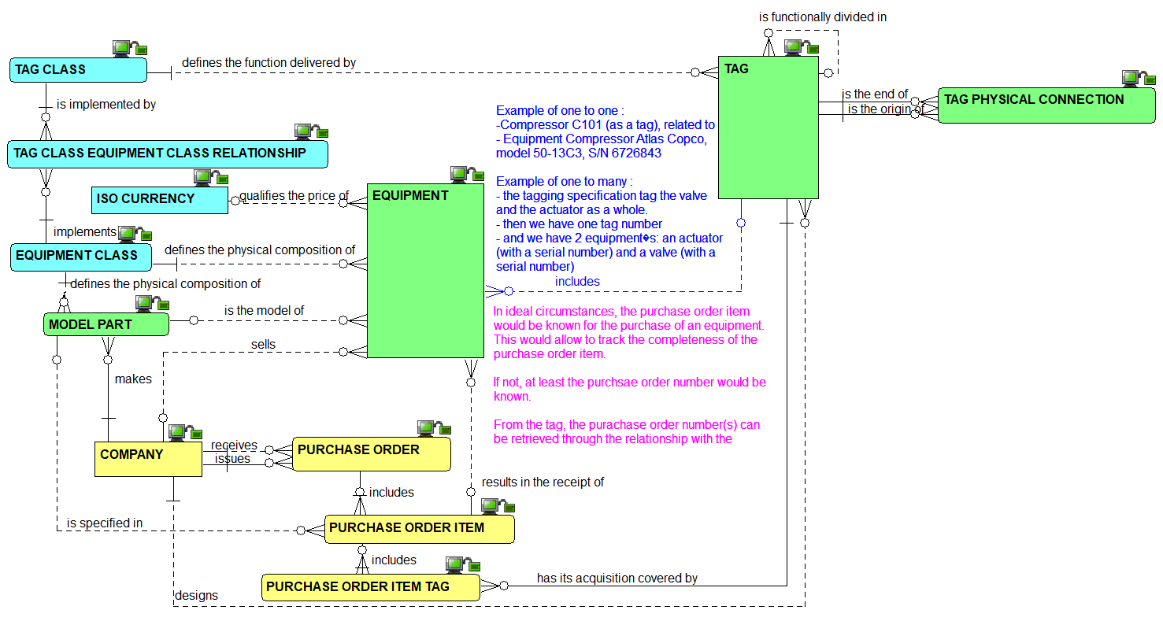
Tag to equipment : the relationships view

Slide 13
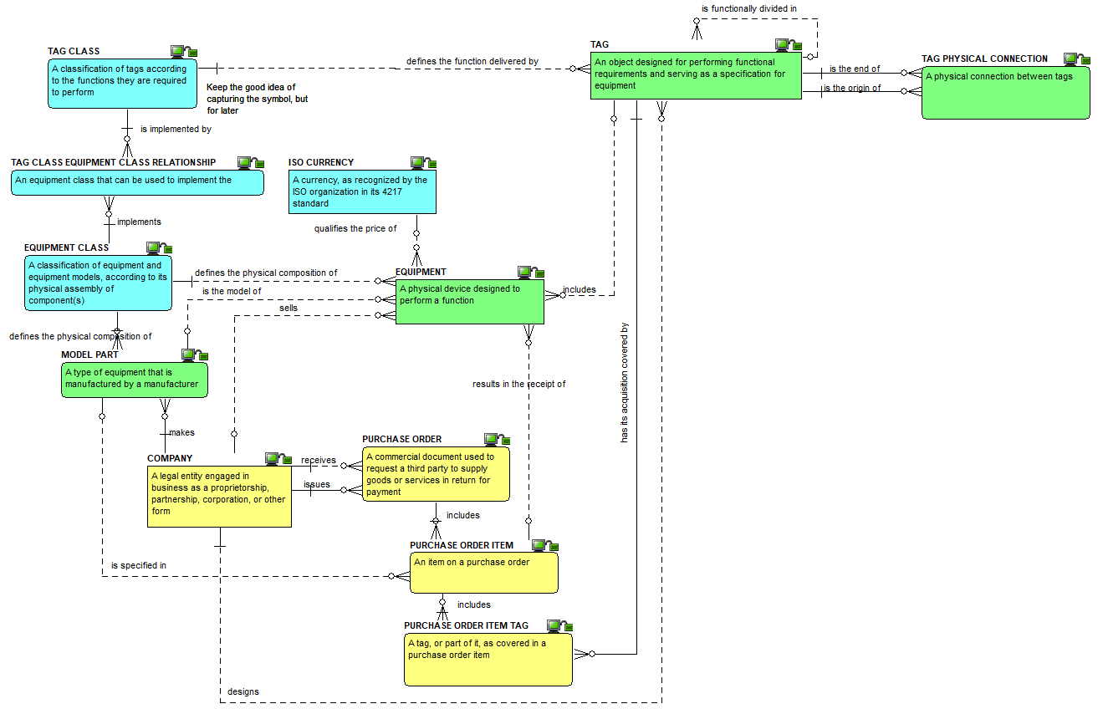
Tag to equipment : the definitions view

Slide 14
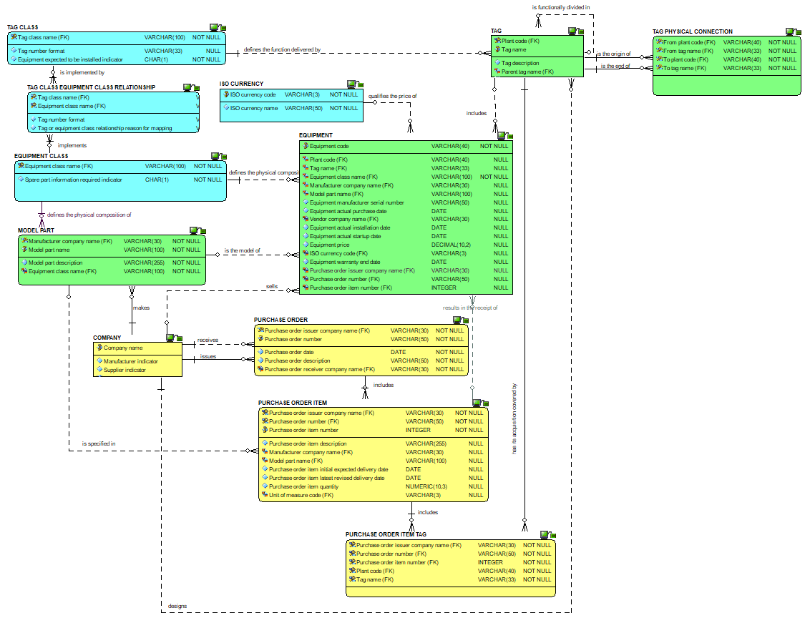
Tag to equipment : the attributes view

Slide 15
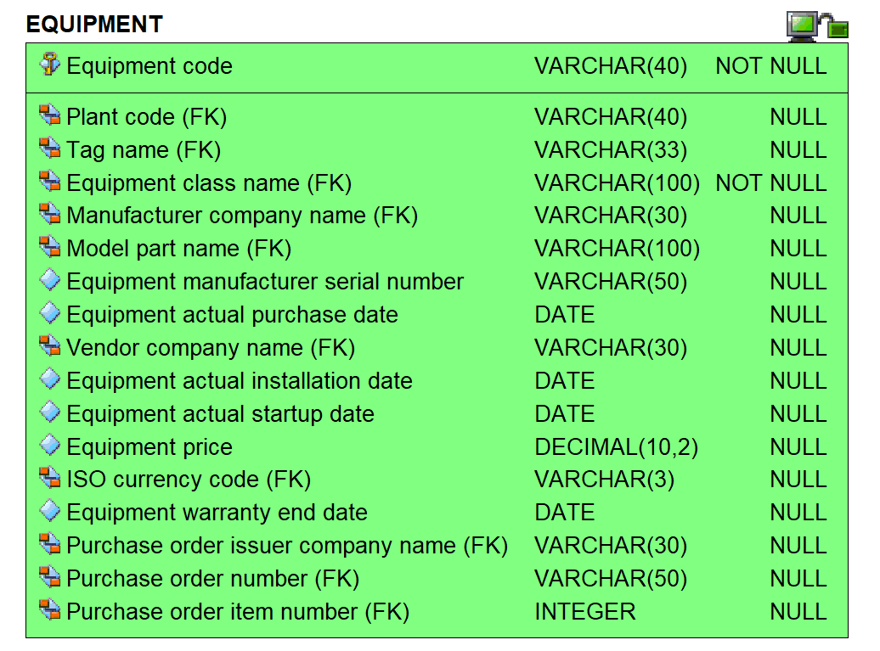
Equipment attributes view

Slide 16
Checkpoint 1 : Summary after review of the first third of the data model
As was

Slide 17
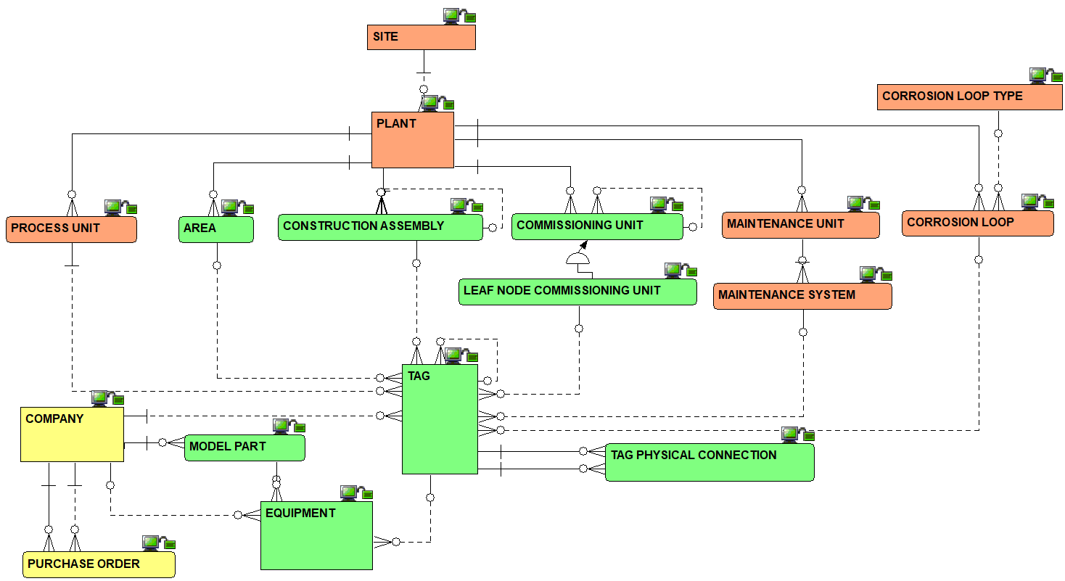
Checkpoint 1 : Summary after review of the first third of the data model
As is
Solid line for identifying relationships, dashed line for non identifying ones

Slide 18
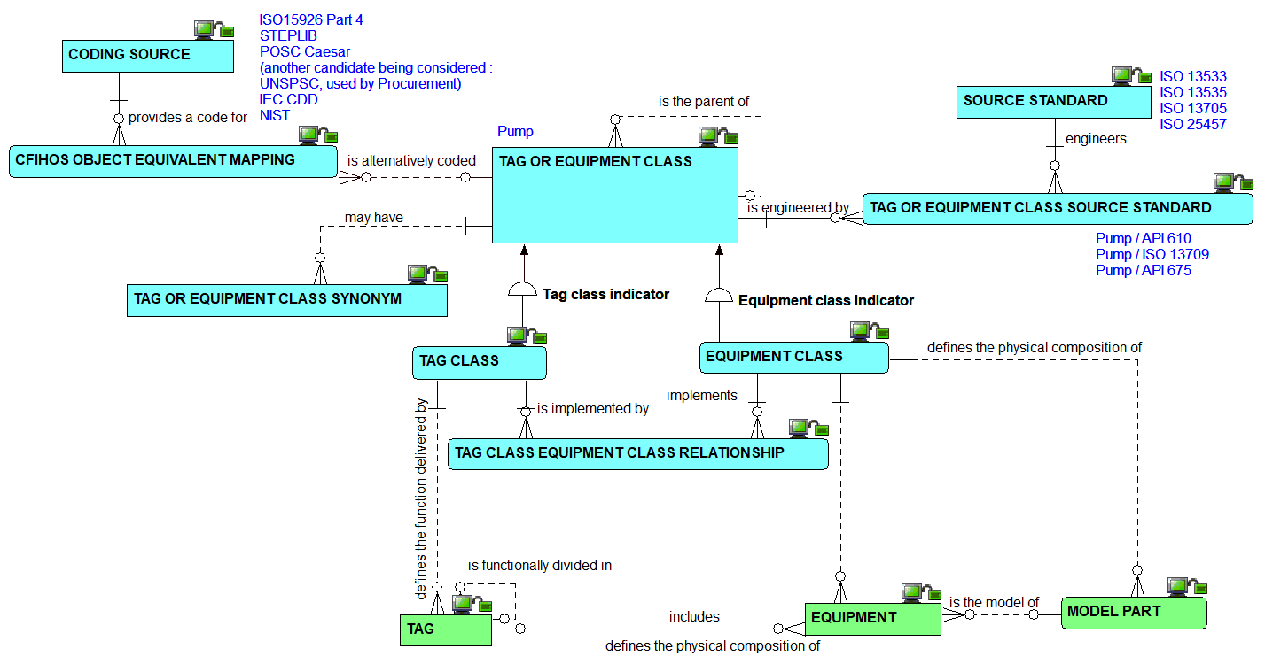
Classes : the relationships view

Slide 19
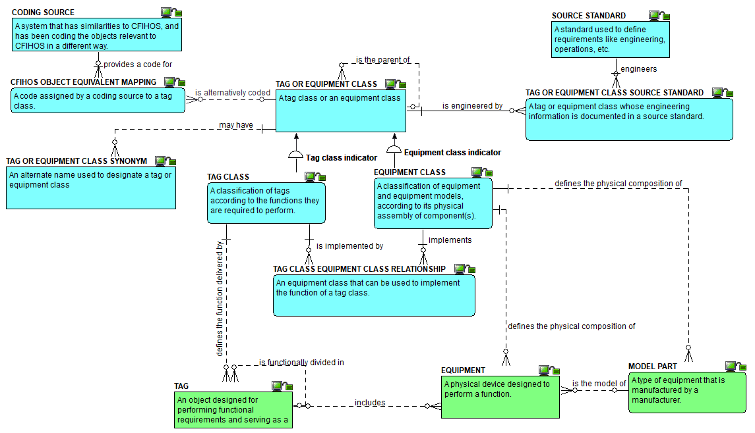
Classes: the definitions view

Slide 20
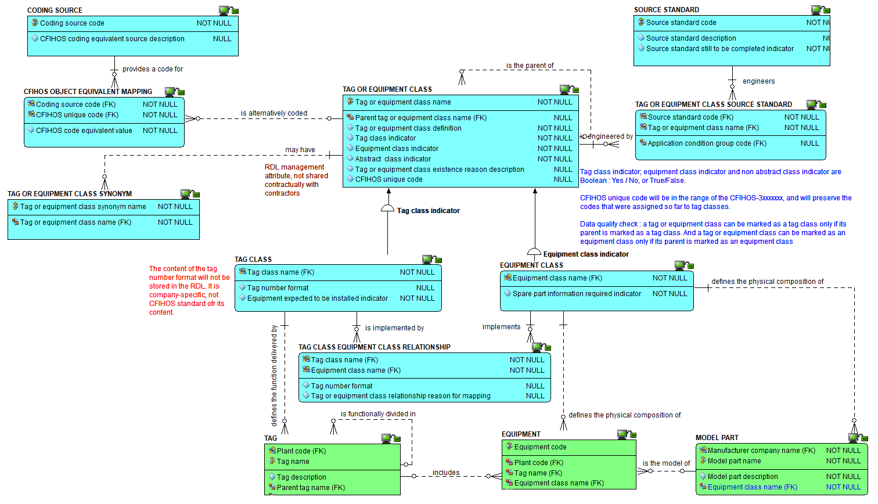
Classes: the attributes view

Slide 21
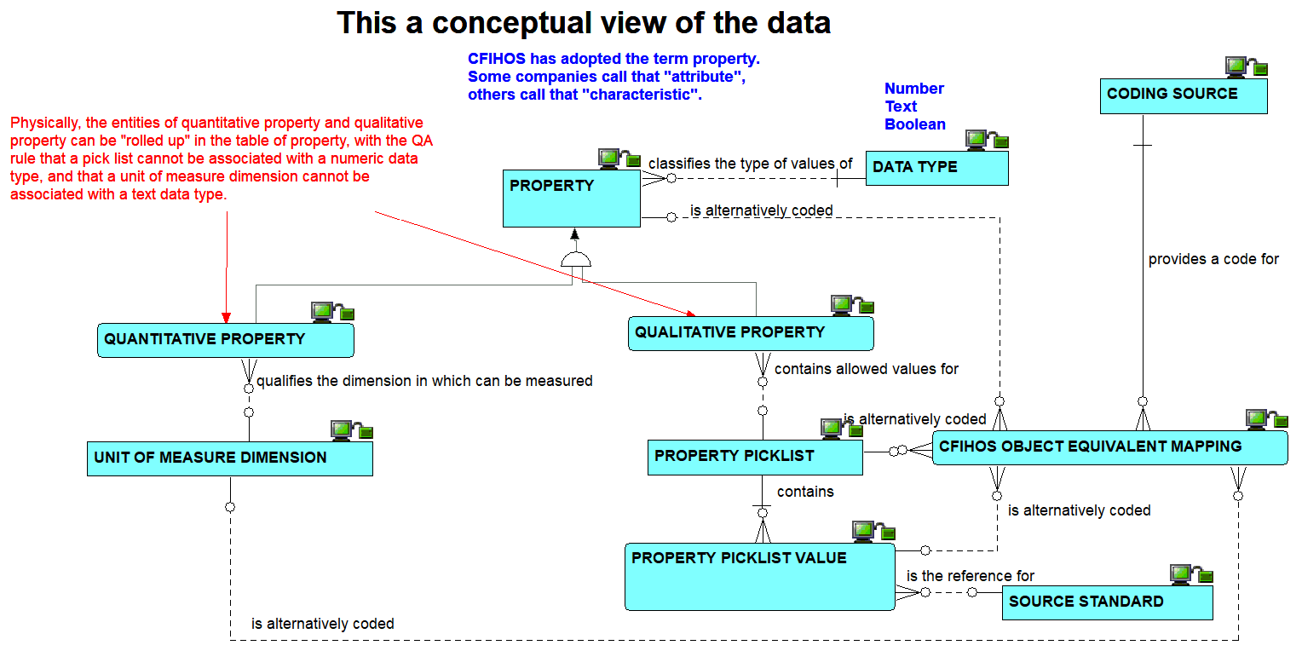
Properties: the conceptual view on relationships

Slide 22
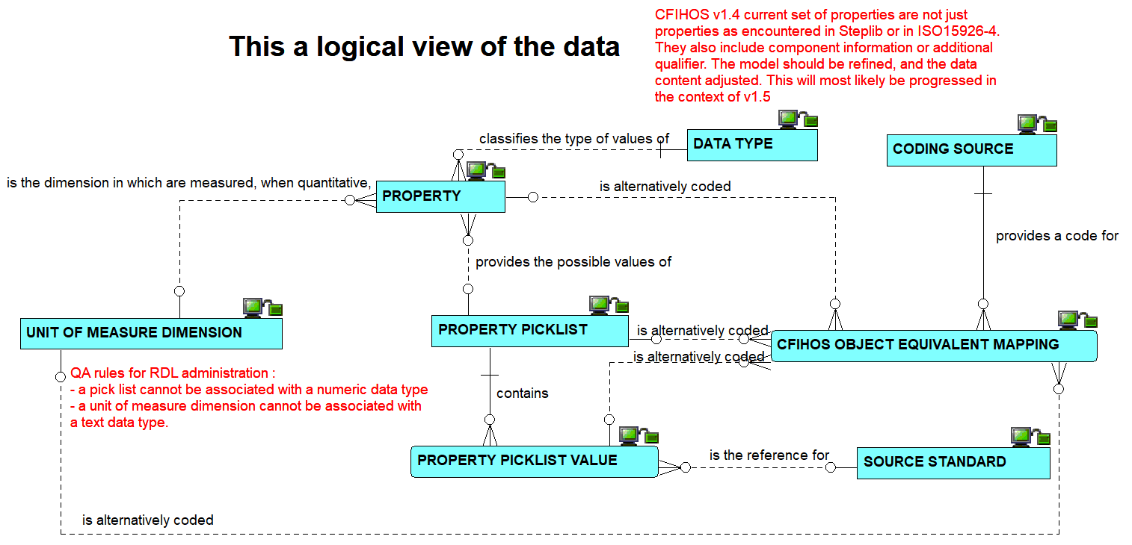
Properties: the logical view on relationships

Slide 23
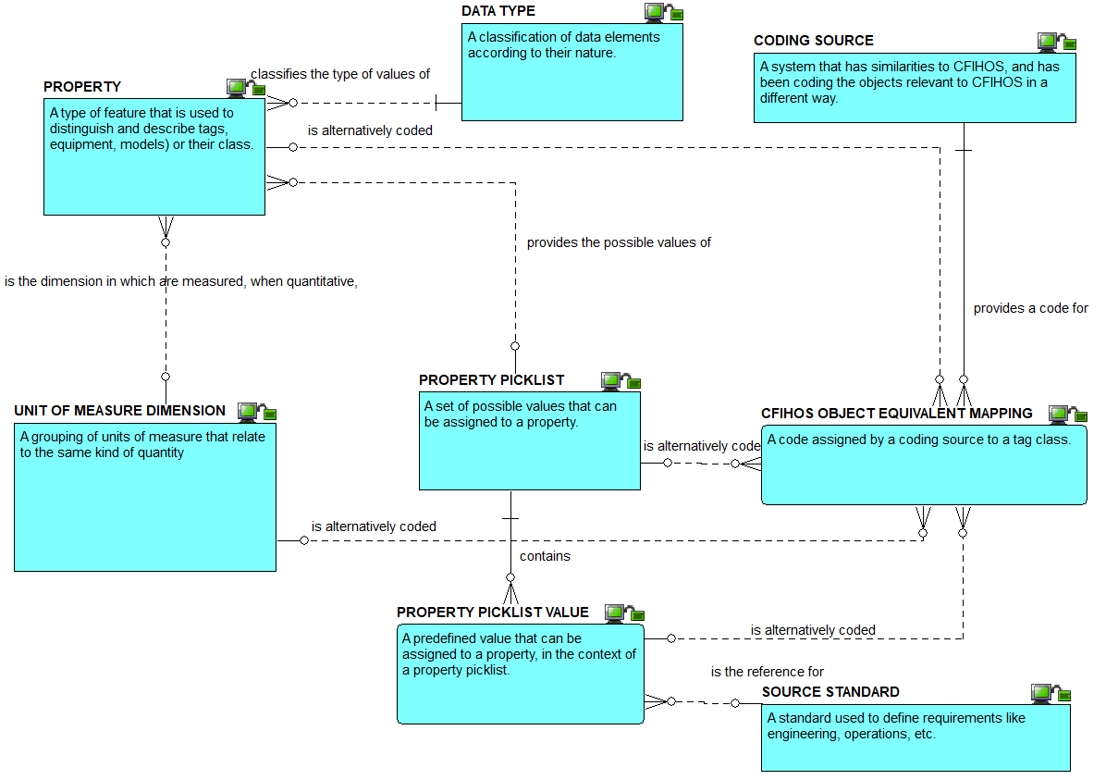
Properties : the definitions view

Slide 24
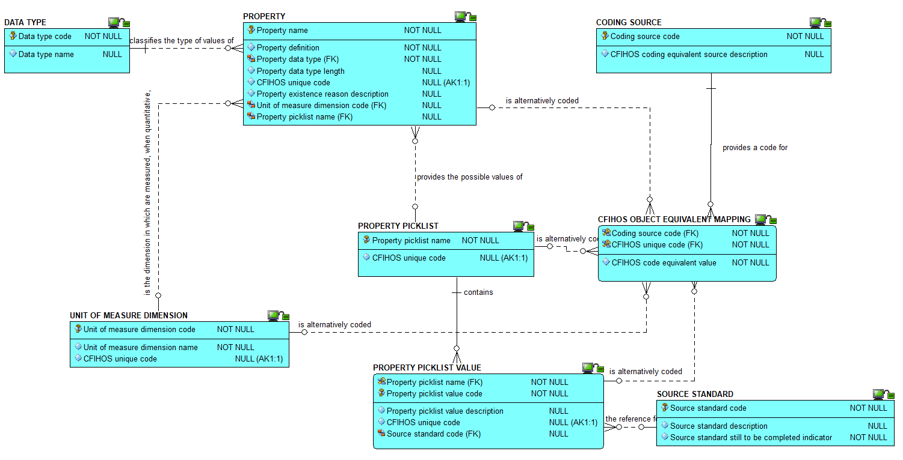
Properties : the attributes view

Slide 25
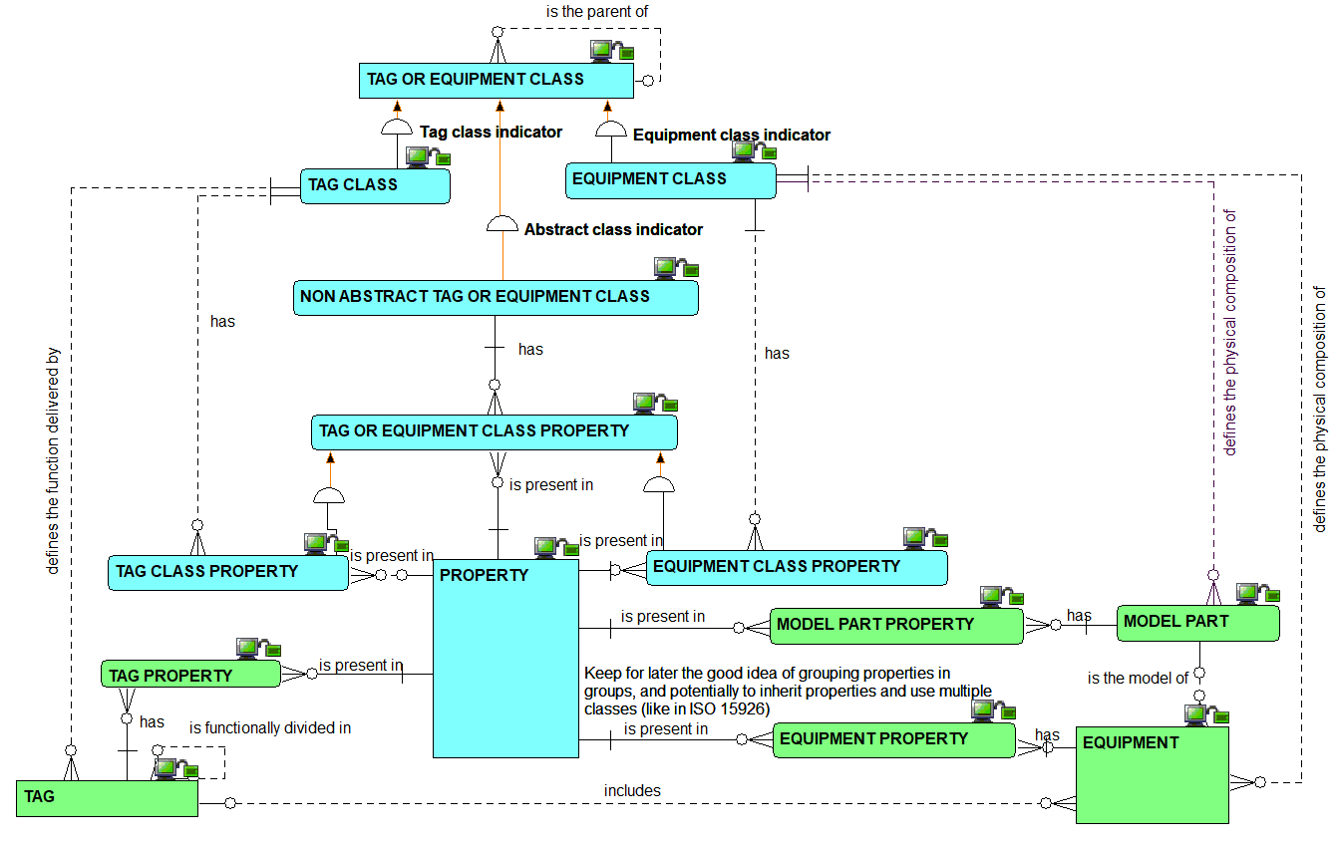
Property use : the relationships view

Slide 26
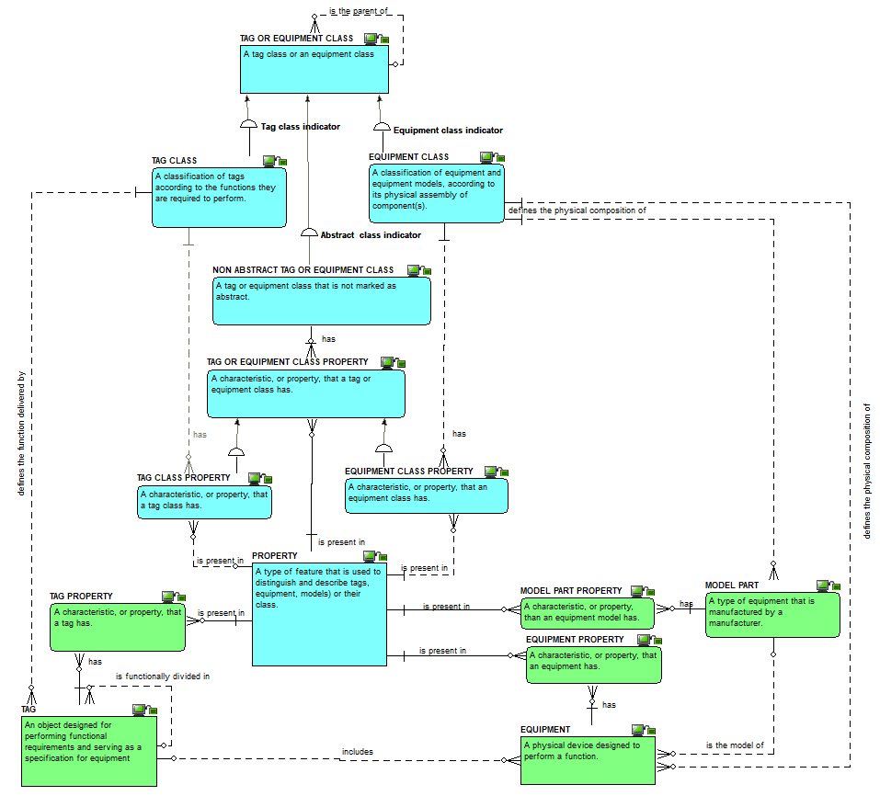
Property use : the definitions view

Slide 27
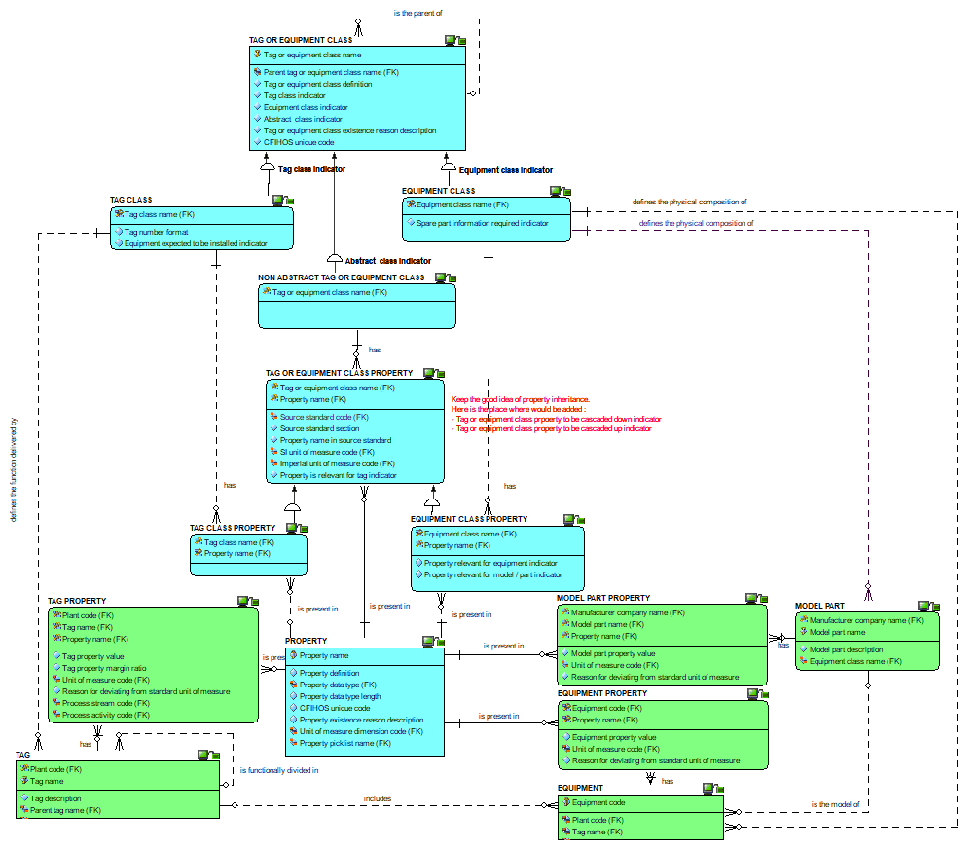
Property use : the attributes view

Slide 28
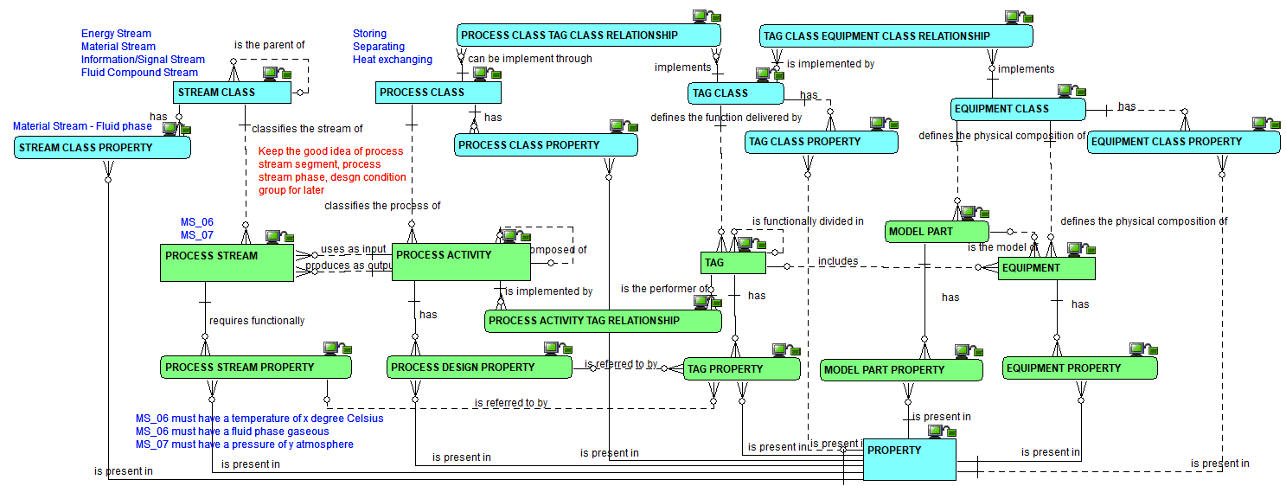
Process activity and stream, their class and their properties: the relationships view

Slide 29
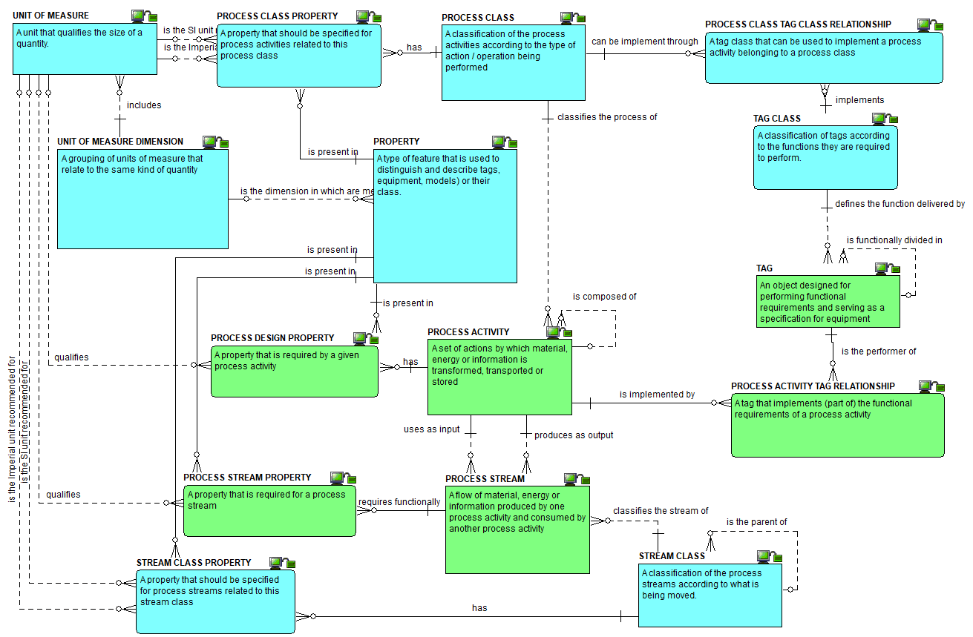
Process activity and stream, their class and their properties: the definitions view

Slide 30
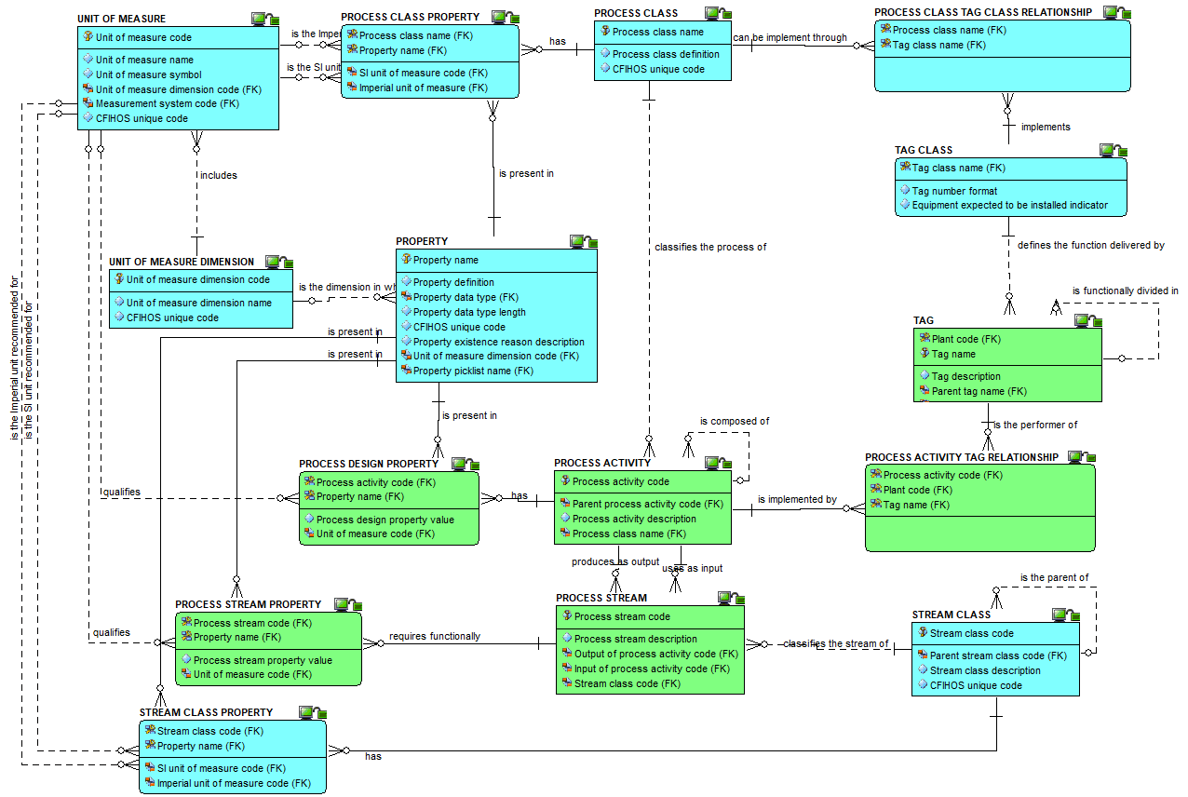
Process activity and stream, their class and their properties: the attributes view

Slide 31
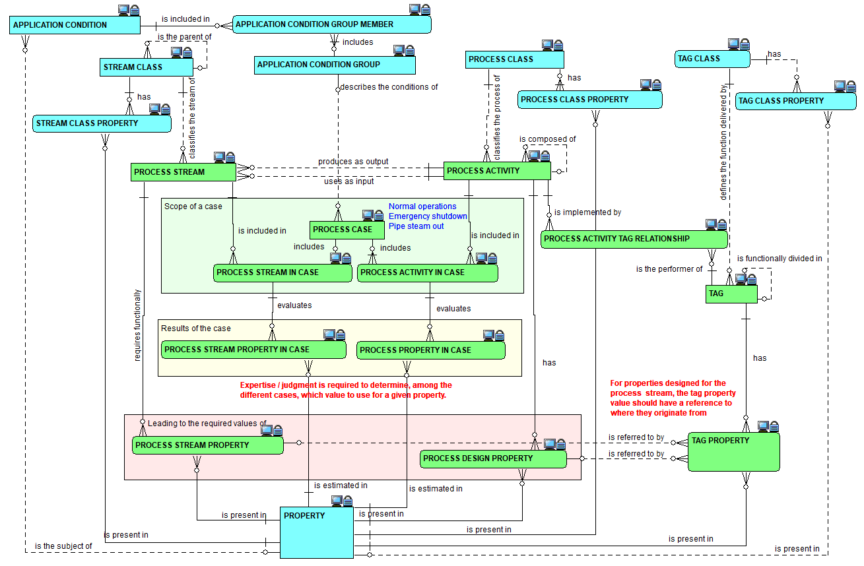
Cases : the relationships view

Slide 32
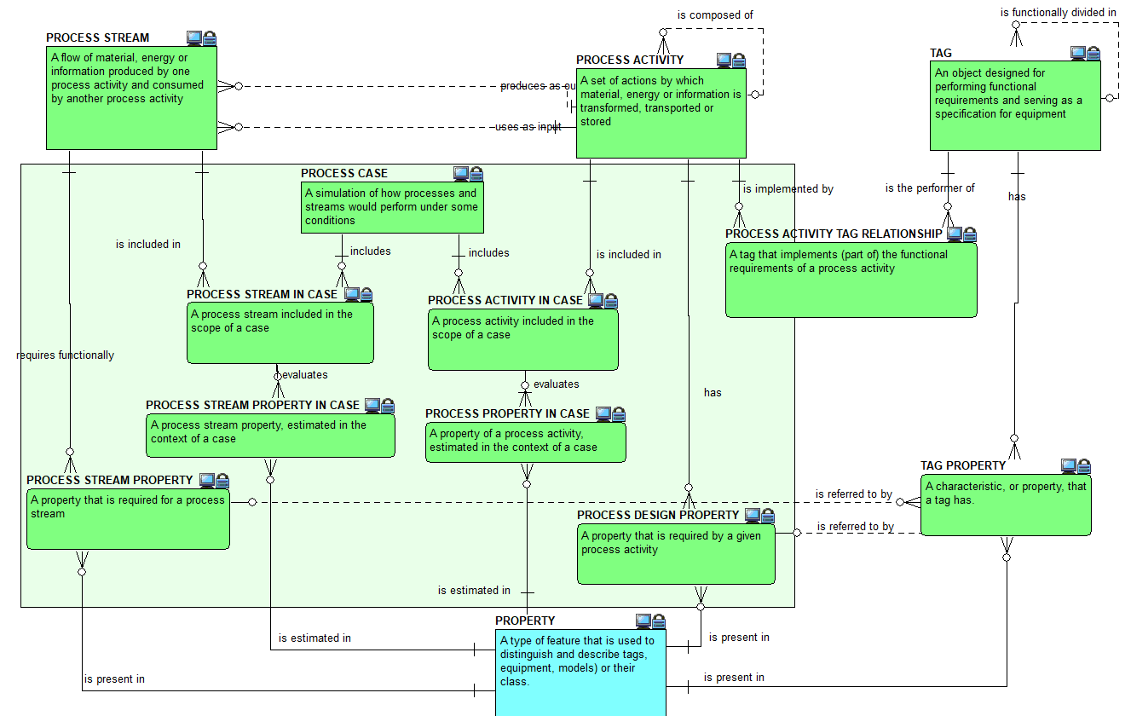
Cases : the definitions view

Slide 33
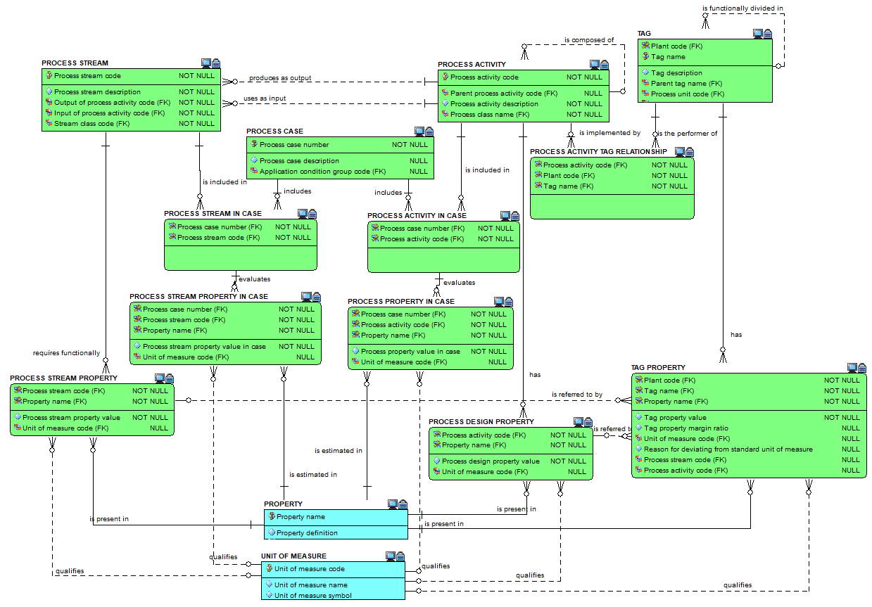
Cases : the attributes view

Slide 34
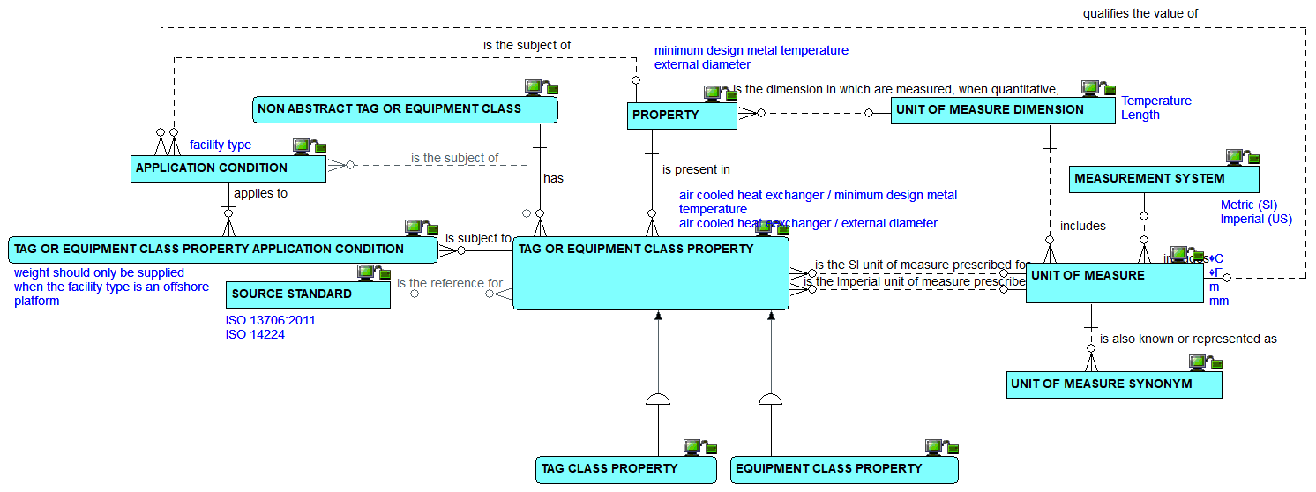
Properties, classes and units of measure : the relationships view

Slide 35
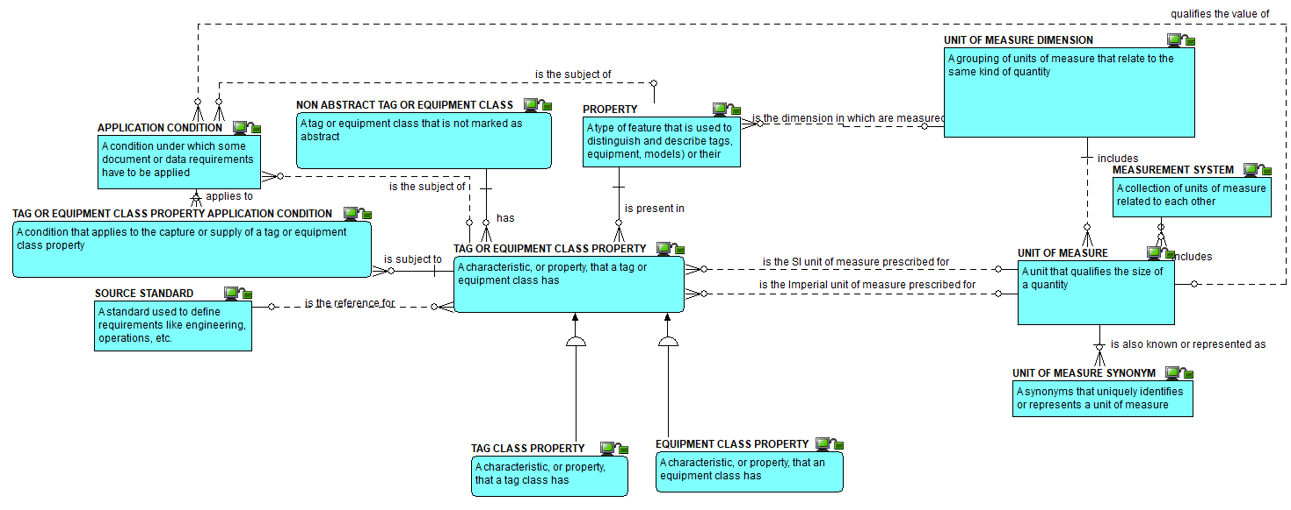
Properties, classes and units of measure : the definitions view

Slide 36
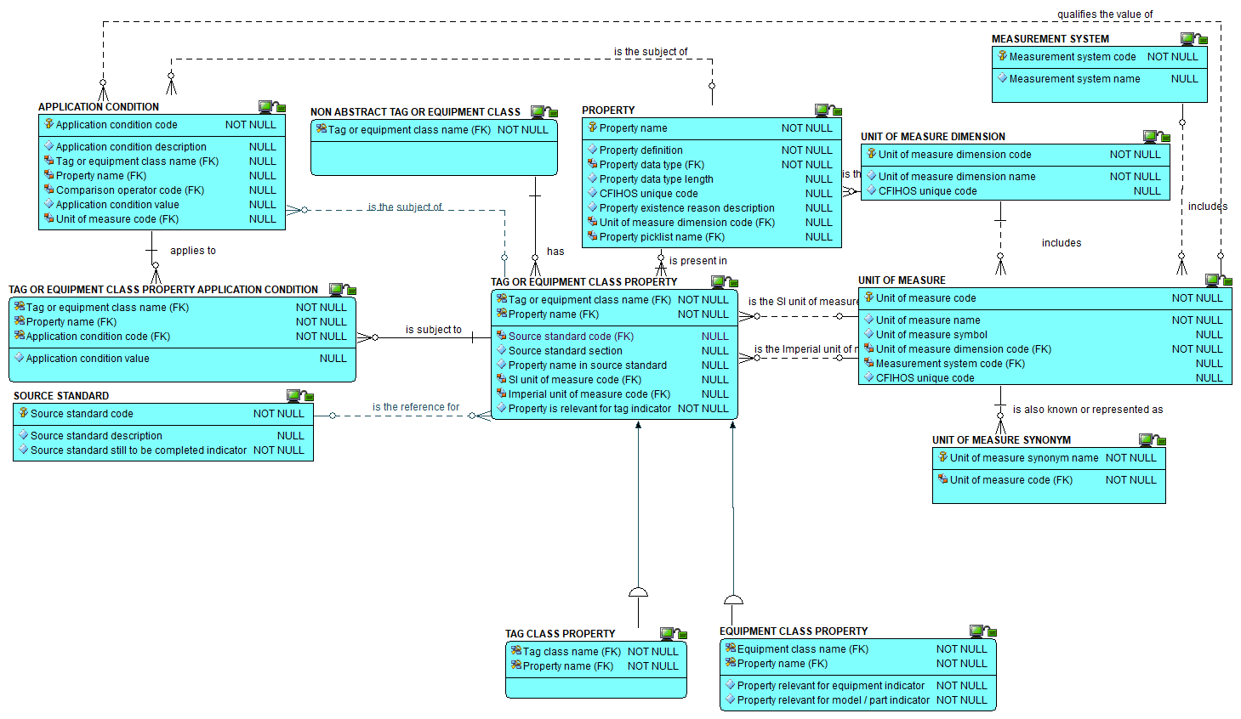
Properties, classes and units of measure : the attributes view

Slide 37
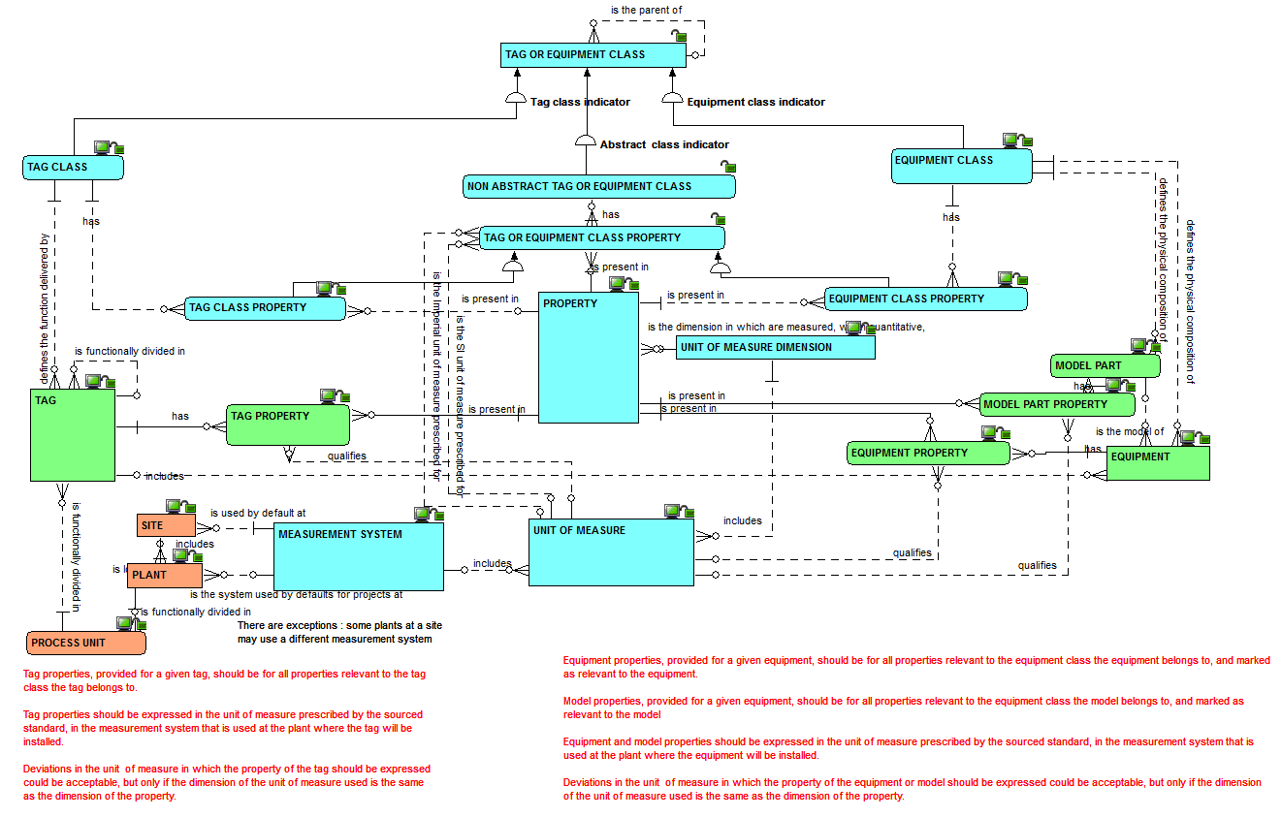
Properties, tags, equipment and units of measure : the relationships view

Slide 38
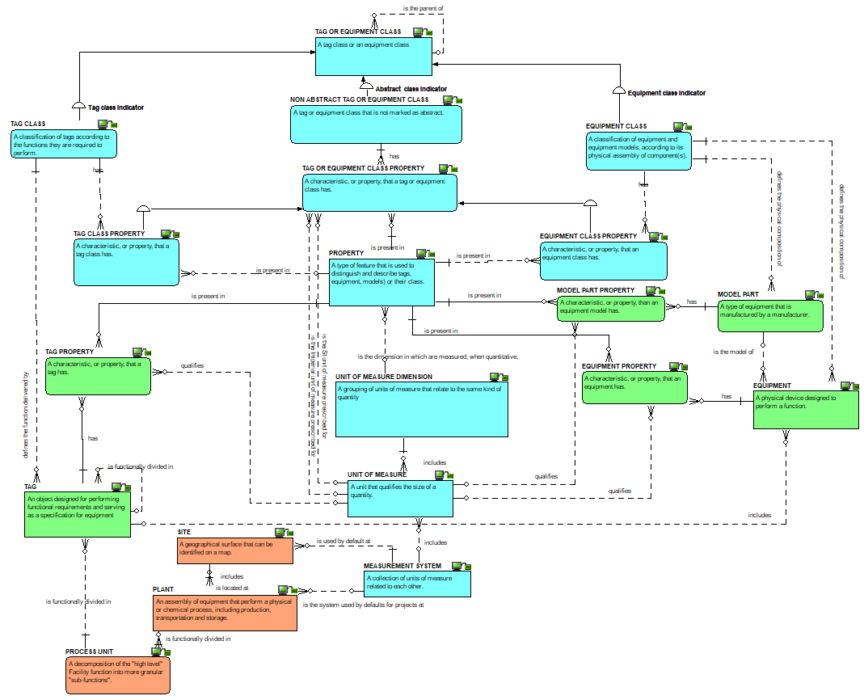
Properties, classes and units of measure : the definitions view

Slide 39
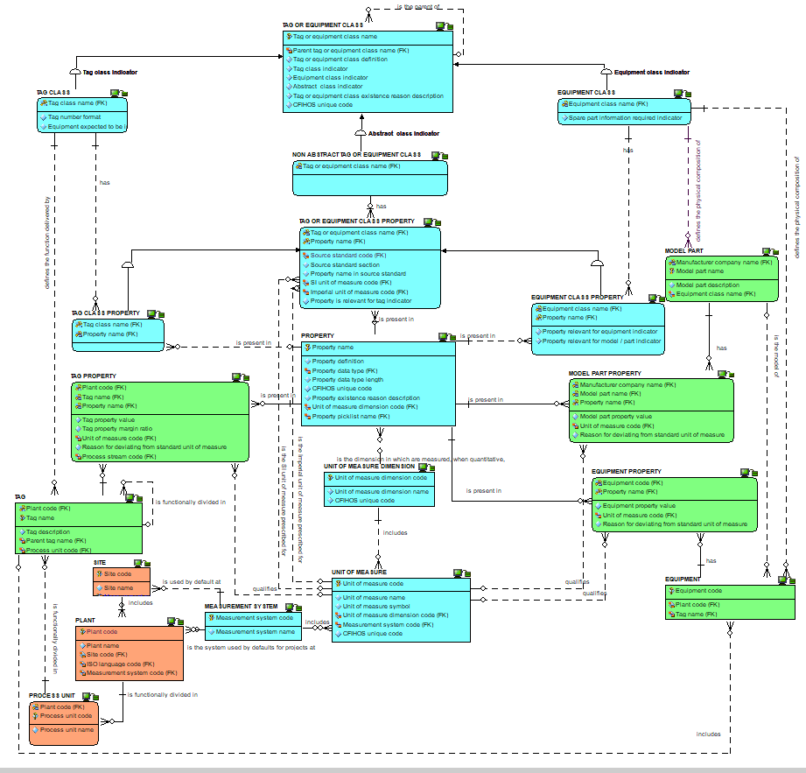
Properties, classes and units of measure : the attributes view

Slide 40
Checkpoint 2 : Summary after review of the second third of the data model
As was

Slide 41
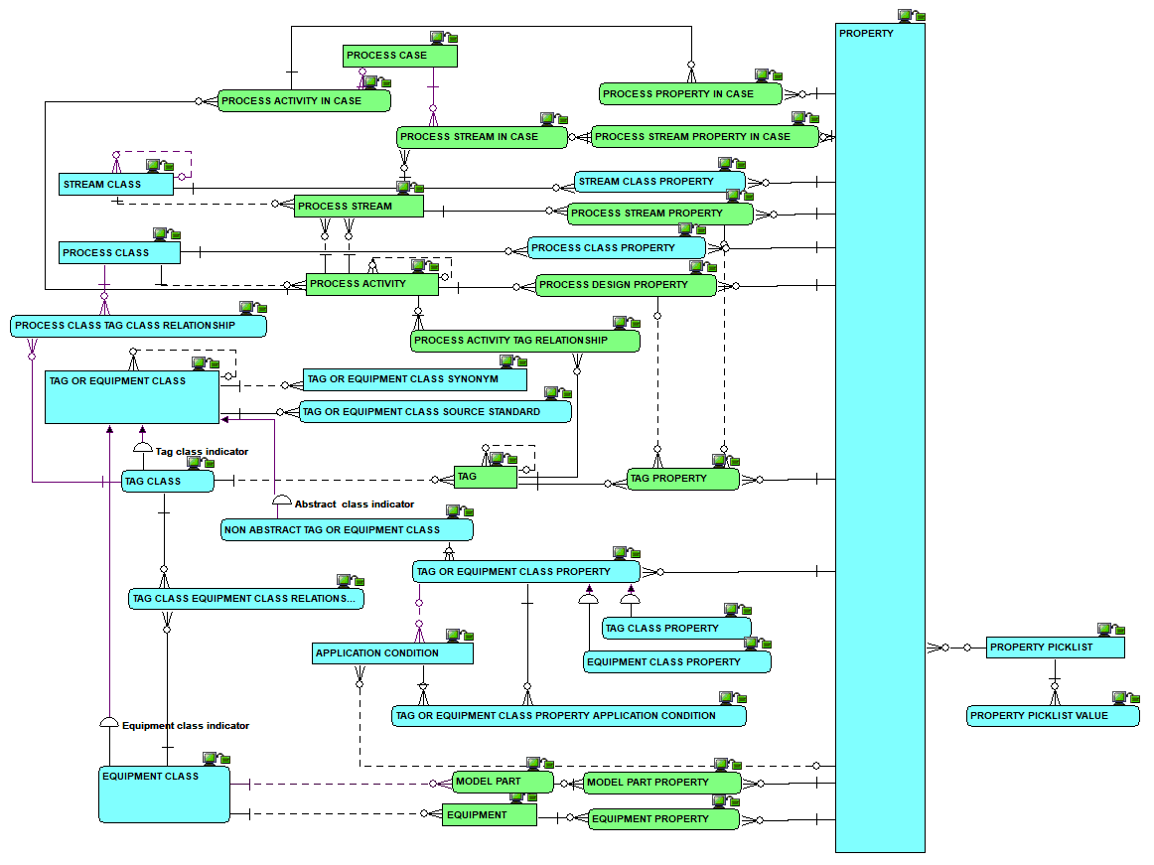
Checkpoint 2 : Summary after review of the second third of the data model
As is
Solid line for identifying relationships, dashed line for non identifying ones

Slide 42
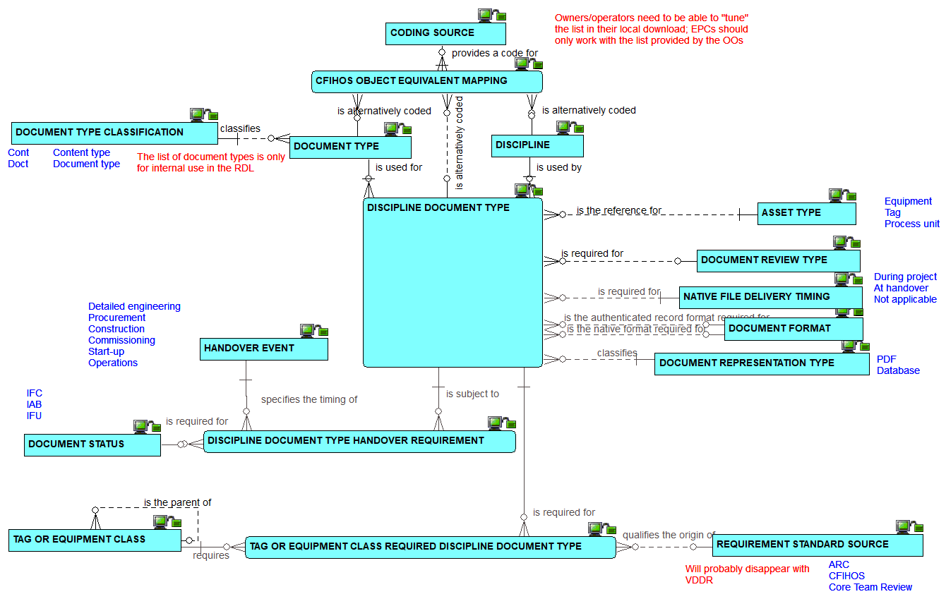
Disciplines and document types : the relationships view

Slide 43
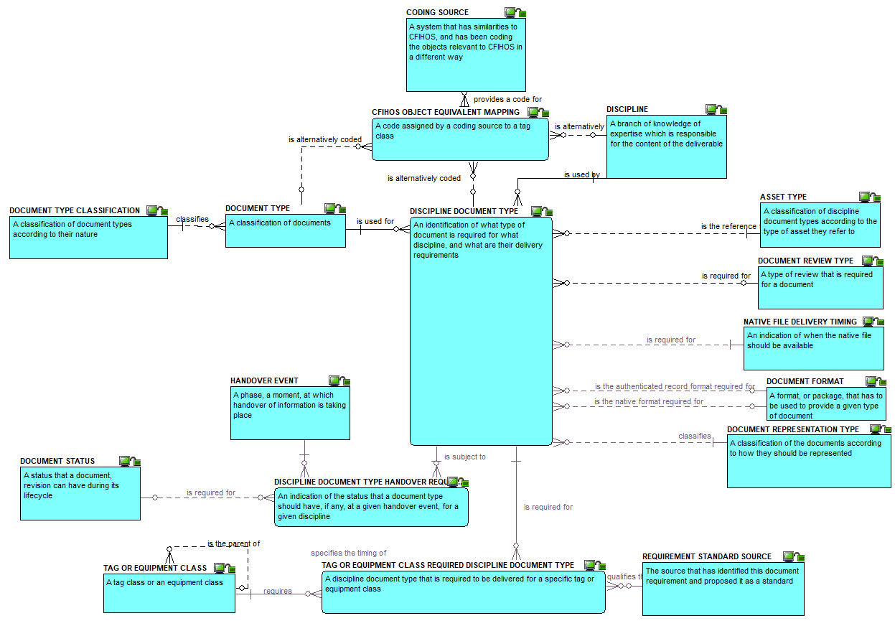
Disciplines and document types : the definitions view

Slide 44
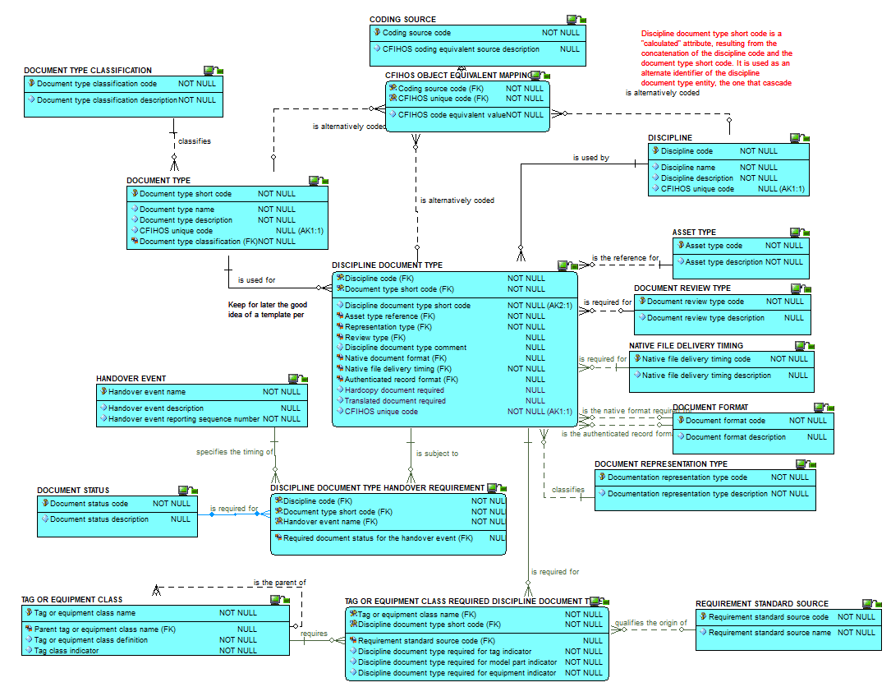
Disciplines and document types : the attributes view

Slide 45
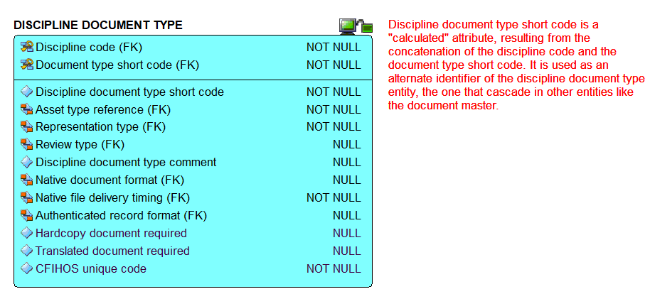
Discipline document type : zoom on the attributes

Slide 46
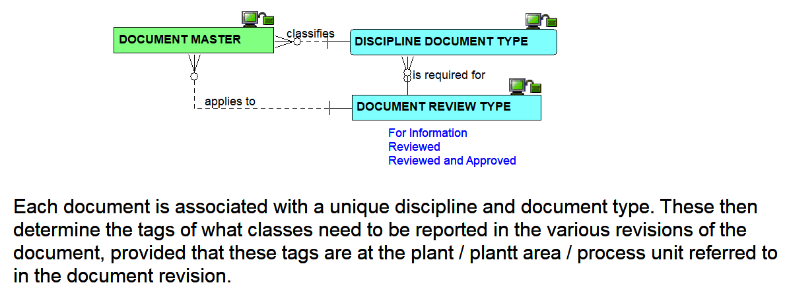
Document master : the relationships view

Slide 47
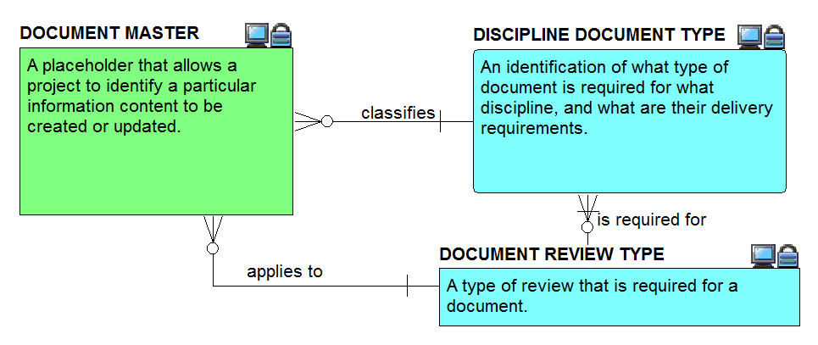
Document master : the definitions view

Slide 48
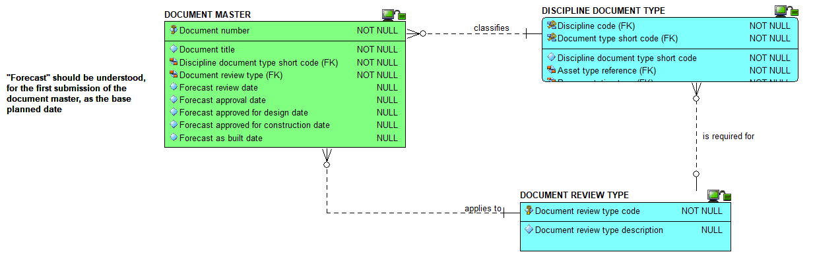
Document master : the attributes view

Slide 49
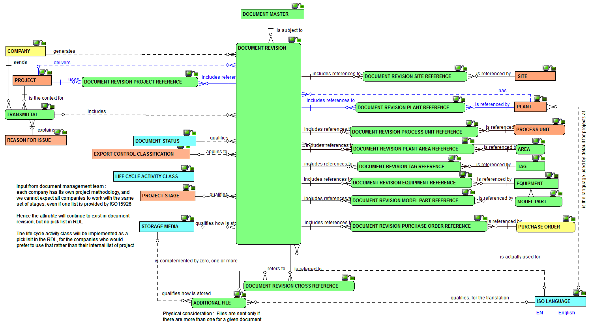
Document revision : the relationships view

Slide 50
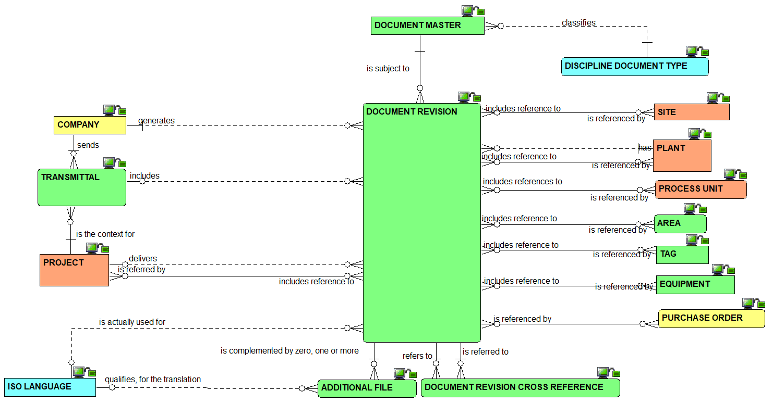
Document revision : the simplified relationships view

Slide 51
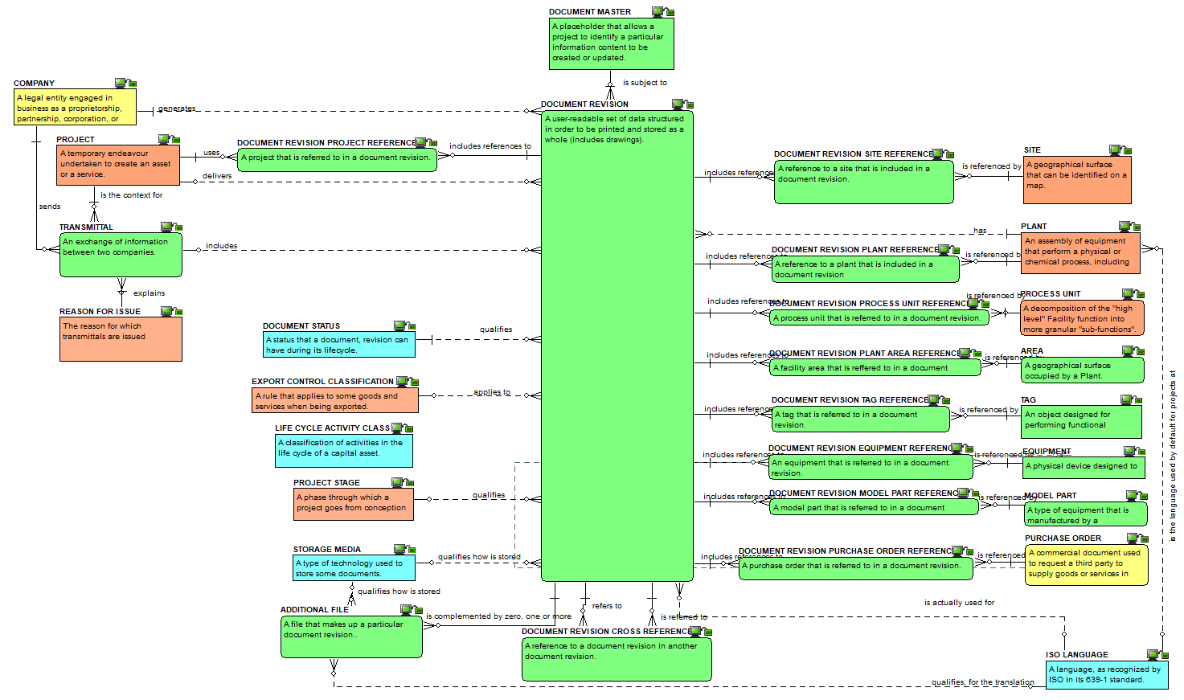
Document revision : the definitions view

Slide 52
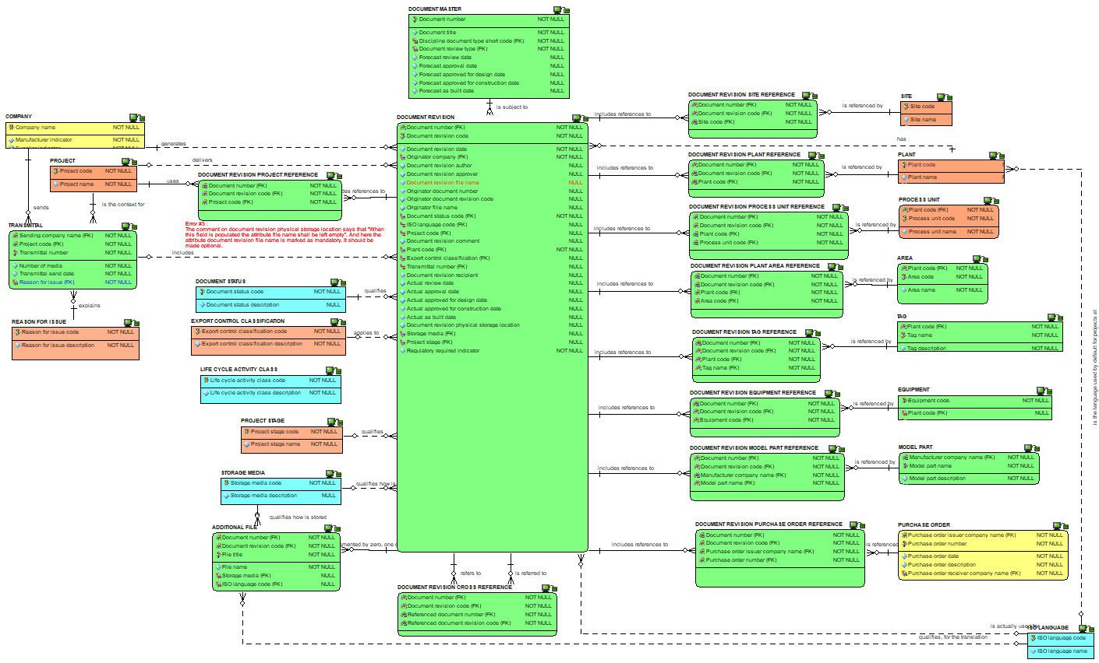
Document revision : the attributes view

Slide 53
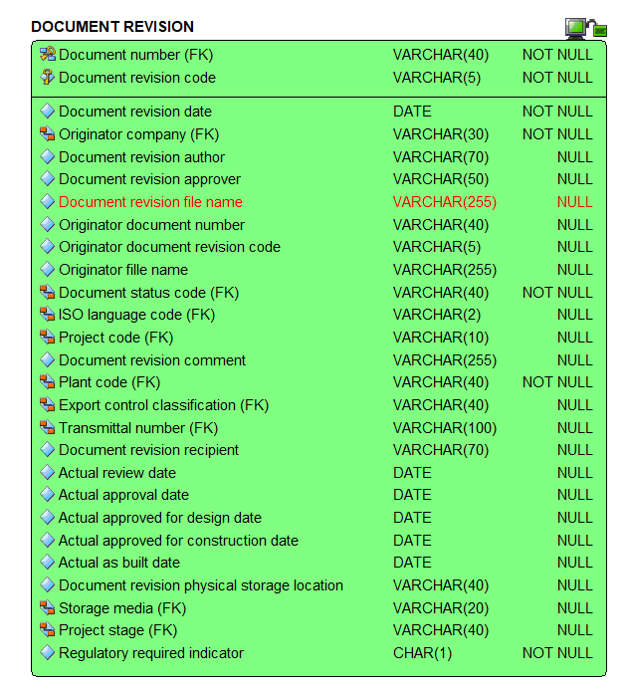
Document revision : zoom on the attributes

Slide 54
Checkpoint 3 : Summary after review of the third third of the data model
As was

Slide 55

Checkpoint 3 : Summary after review of the third third of the data model
As is
Solid line for identifying relationships, dashed line for non identifying ones

Slide 56

JIP33:
the relationships view – what JIP33 would add vs what is already present in CFIHOS data model

Slide 57

How to link tag or equipment classes to source standards : the relationships view

Slide 58

How to link tag or equipment classes to source standards : the definitions view

Slide 59

How to link tag or equipment classes to source standards : the attributes view

Slide 60

Source standard document and data requirements : the relationships view

Slide 61

Source standard document and data requirements : the relationships view

Slide 62

Source standard document and data requirements : the definitions view

Slide 63

Source standard document and data requirements : the definitions view

Slide 64

Source standard document and data requirements : the attributes view

Slide 65

Source standard document and data requirements : the attributes view

Slide 66

From the source standard document and data requirements to the purchase order - the relationships view (1/4)

Slide 67

From the source standard document and data requirements to the purchase order - the relationships view (2/4)

Slide 68

From the source standard document and data requirements to the purchase order - the relationships view (3/4)

Slide 69

Purchase order VDDRs: the relationships view – the case of the tag

Slide 70

Purchase order VDDRs: the relationships view – the case of the model

Slide 71

From the source standard document and data requirements to the purchase order - the relationships view (4/4)

Slide 72

From the source standard document and data requirements to the purchase order - the relationships view (4/4) – including views

Slide 73

Purchase order VDDRs: the relationships view

Slide 74

Purchase order VDDRs: the definitions view

Slide 75

Purchase order VDDRs: the attributes view

Slide 76

Checkpoint 4 : Summary of the vendor document and data requirements
As is (no as was)
Solid line for identifying relationships, dashed line for non identifying ones

Slide 77

Overview of the whole model

Slide 78

Overview of tag or equipment class relationships

Slide 79

Overview of CFIHOS alternate code mapping capabilities

Slide 80

Overview of pick lists

Slide 81

The relationship between the logical model and the CSV files :
1) tag and equipment class

Slide 82

The relationship between the logical model and the CSV files :
2) tag and equipment class property

Slide 83

The relationship between the logical model and the CSV files :
3) Property, pick list and unit of measure

Slide 84

The relationship between the logical model and the CSV files :
4) Discipline and document type

