Slide 1

CFIHOS
Using the Data Model
(C-DM-001)
Version 1.4
Published 17 Oct 2019

Slide 2
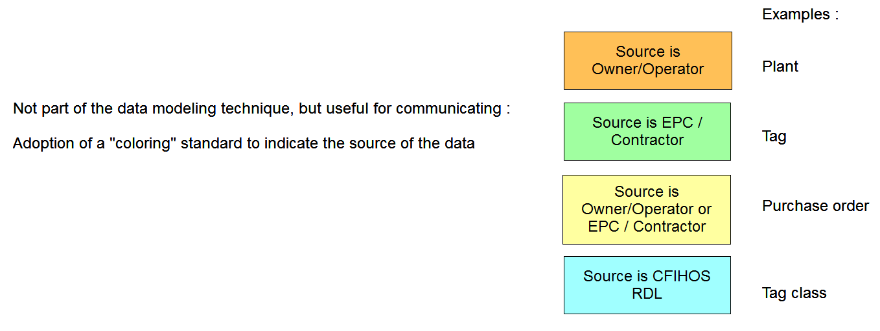
Hints and tips

Slide 3
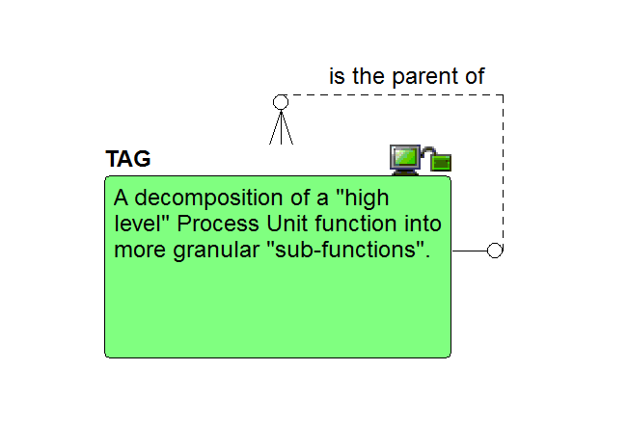
Starting point: the tag

Slide 4
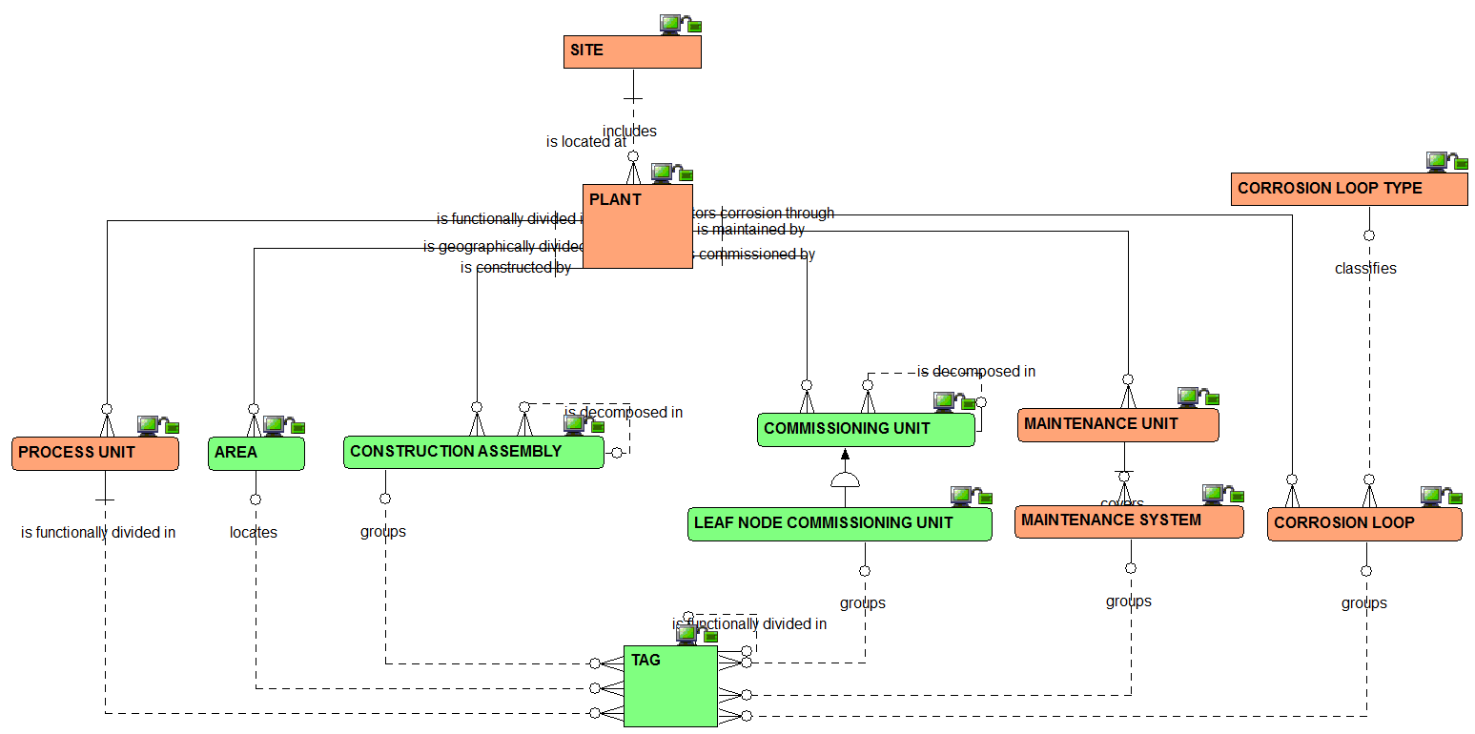
Plant breakdown structure: the relationships view

Slide 5
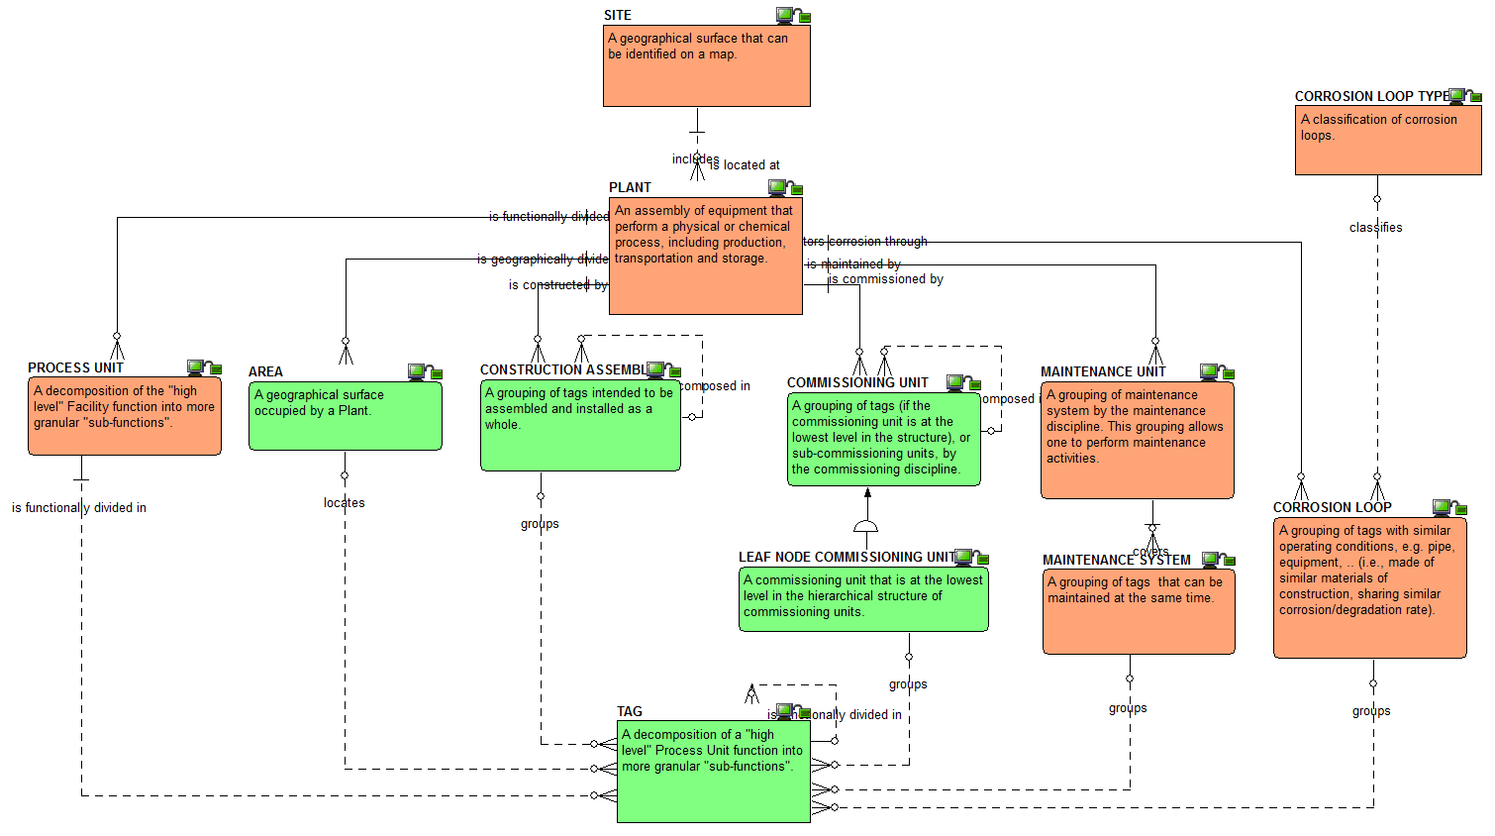
Plant breakdown structure:
the definitions view

Slide 6
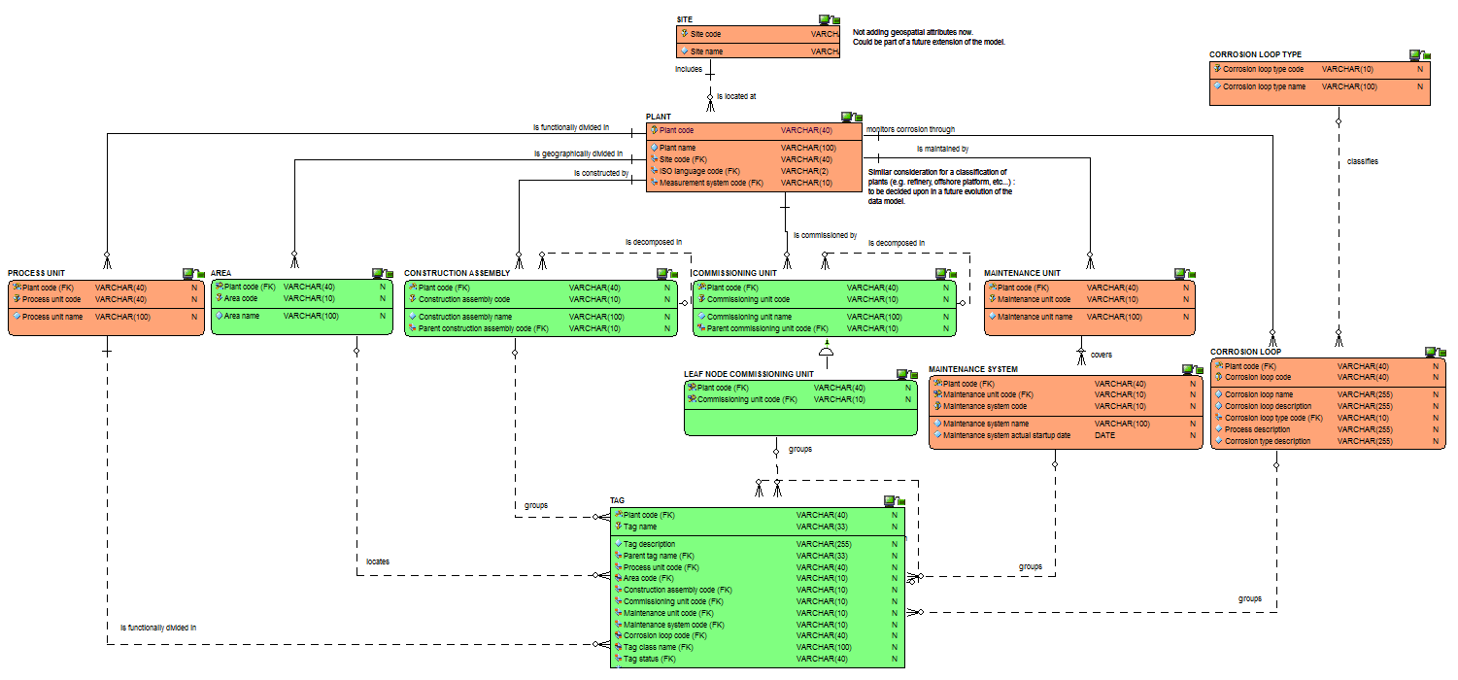
Plant breakdown structure:
the attributes view

Slide 7
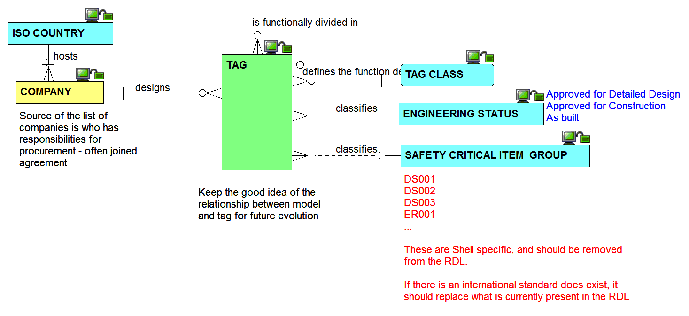
Other tag inbound relationships view

Slide 8
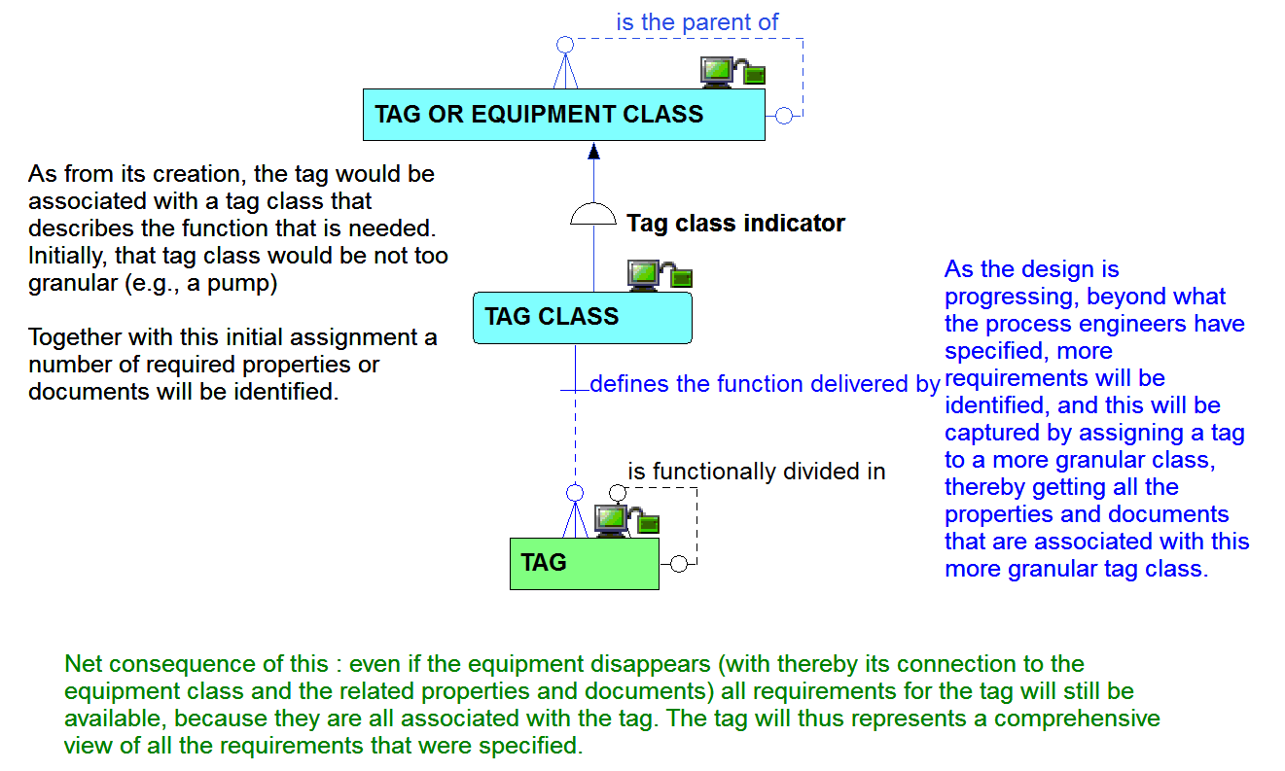
Tag and its relationship to tag class

Slide 9
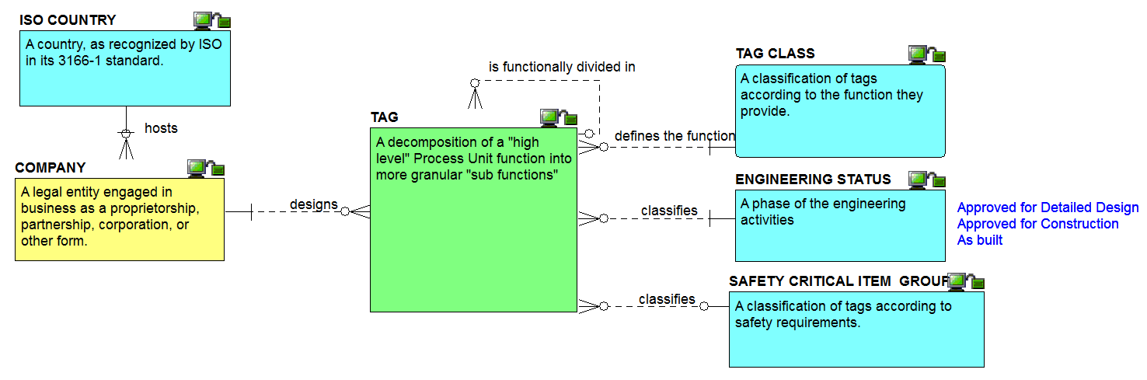
Other tag inbound definitions view

Slide 10
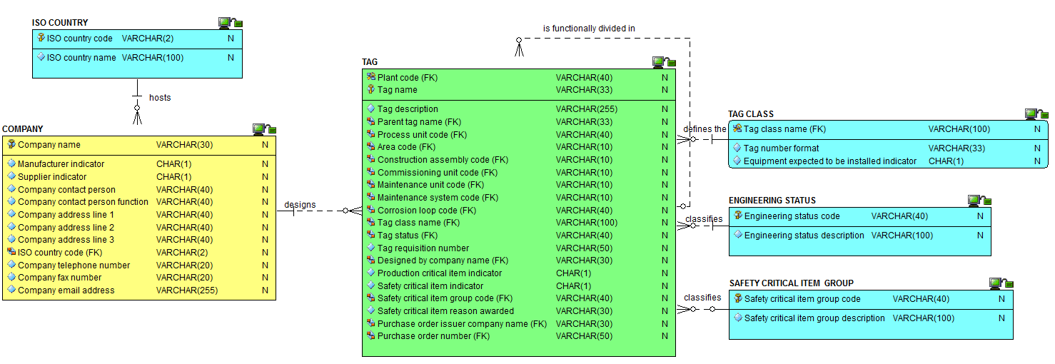
Other tag inbound attributes view

Slide 11
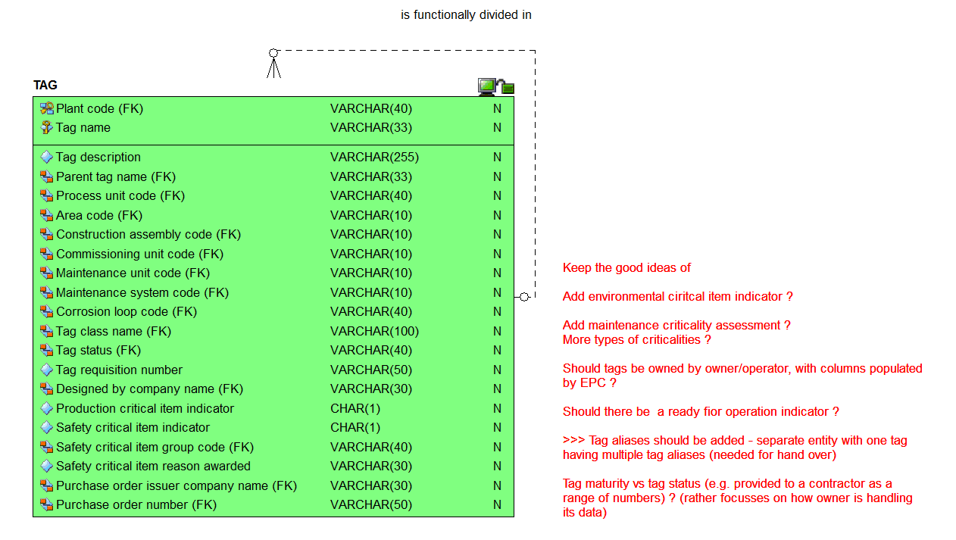
The tag attributes view

Slide 12
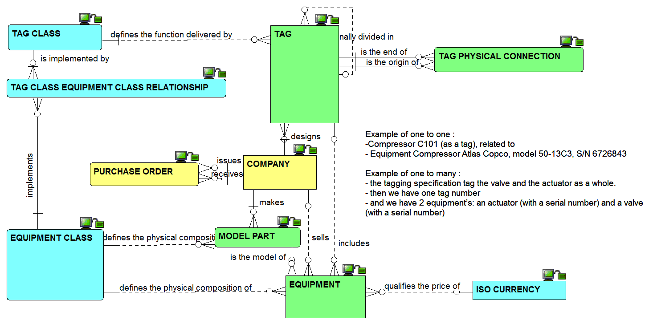
Tag to equipment: the relationships view

Slide 13
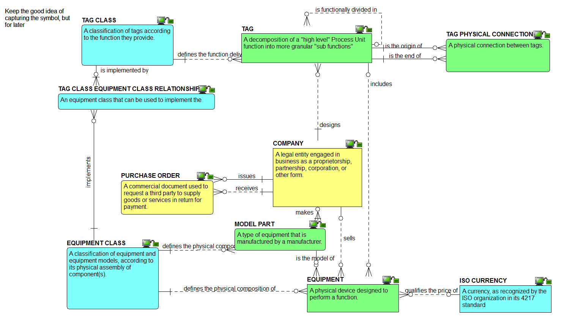
Tag to equipment: the definitions view

Slide 14
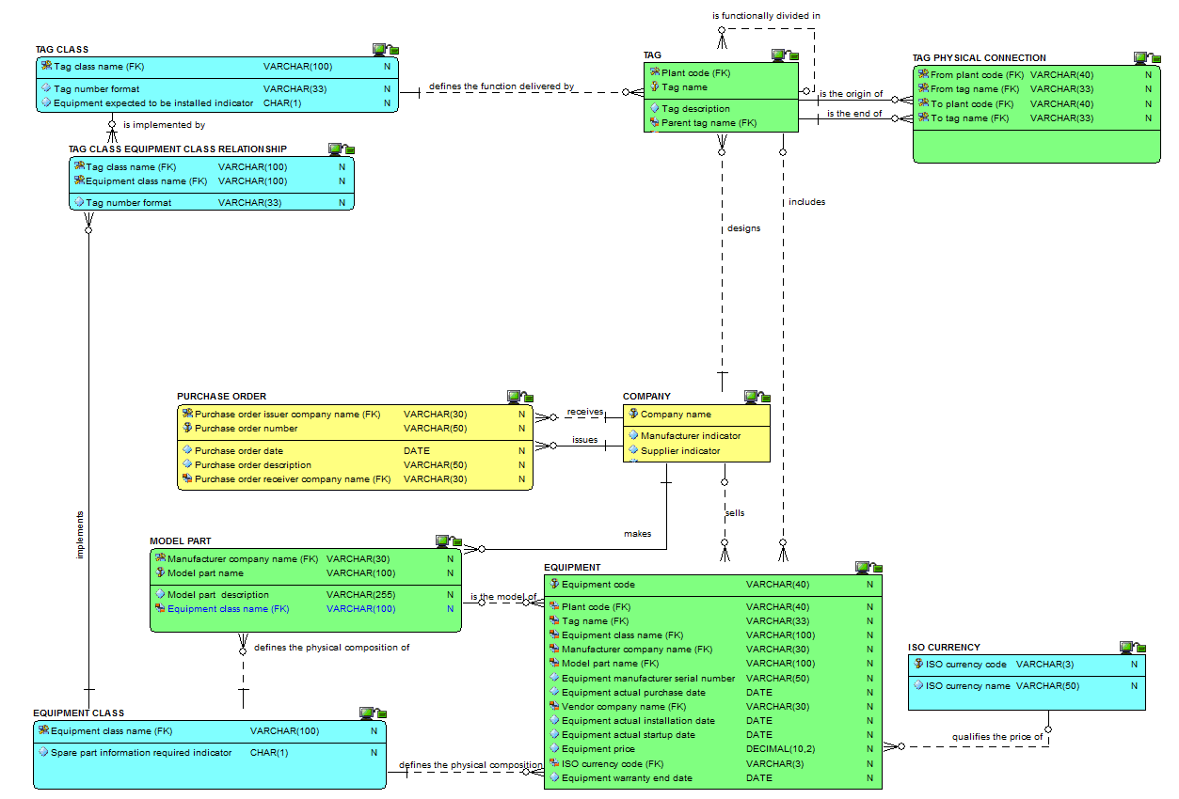
Tag to equipment: the attributes view

Slide 15
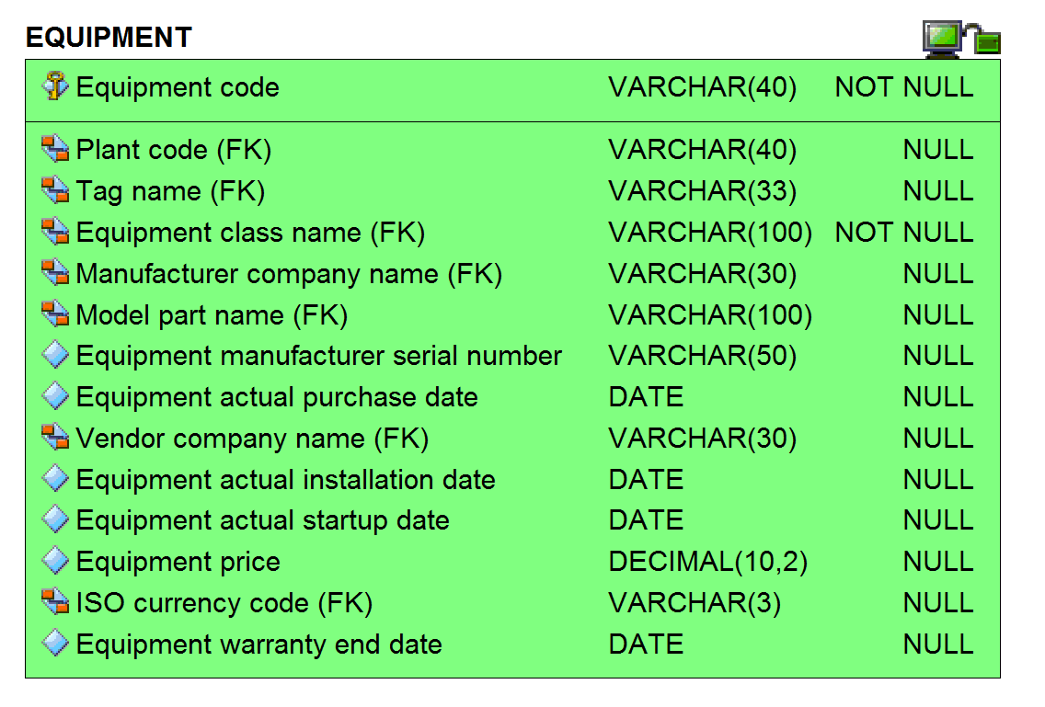
Equipment attributes view

Slide 16
Checkpoint 1 - Summary after review of the first third of the data model
As was

Slide 17
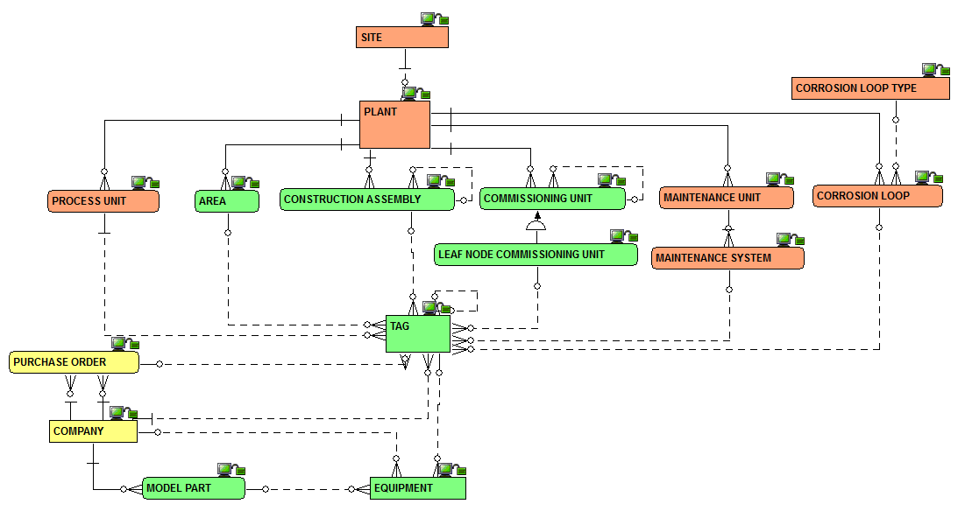
Checkpoint 1 - Summary after review of the first third of the data model
As is
Solid line for identifying relationships, dashed line for non identifying ones

Slide 18
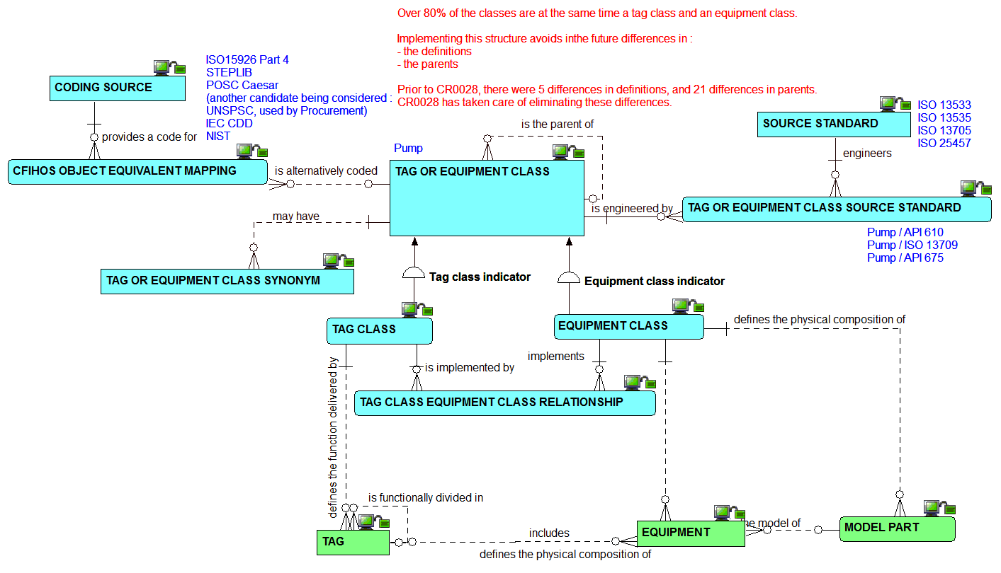
Classes: the relationships view

Slide 19
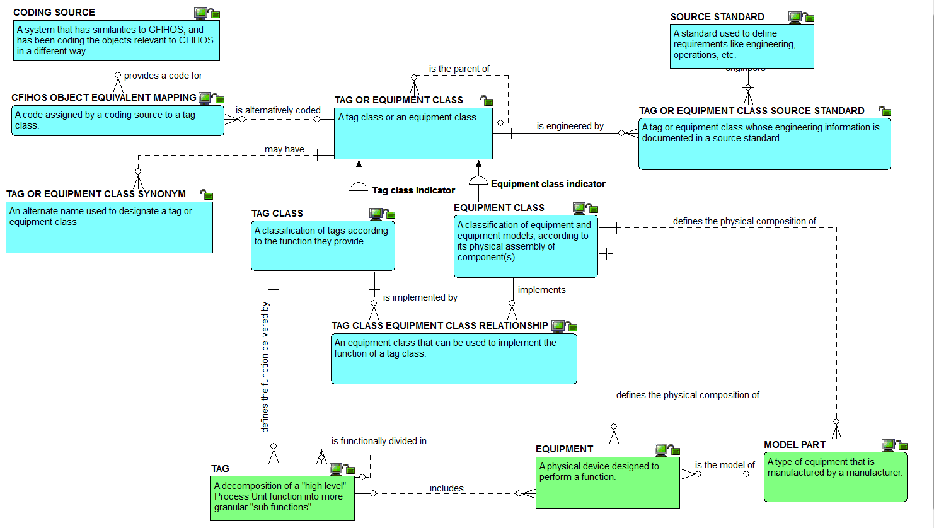
Classes: the definitions view

Slide 20
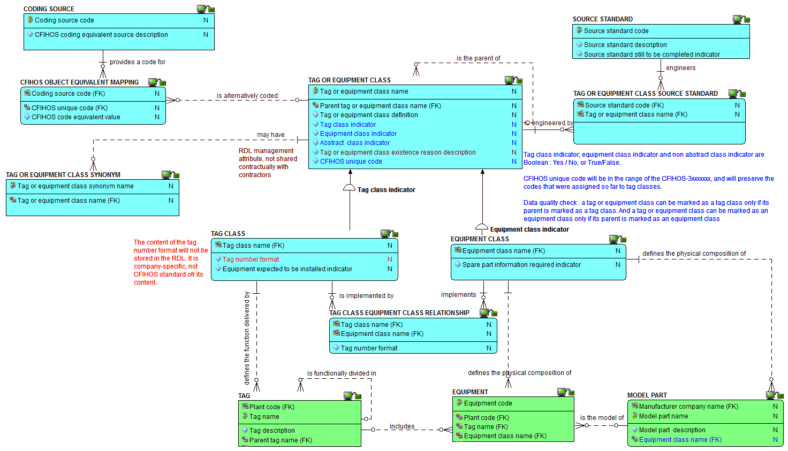
Classes: the attributes view

Slide 21
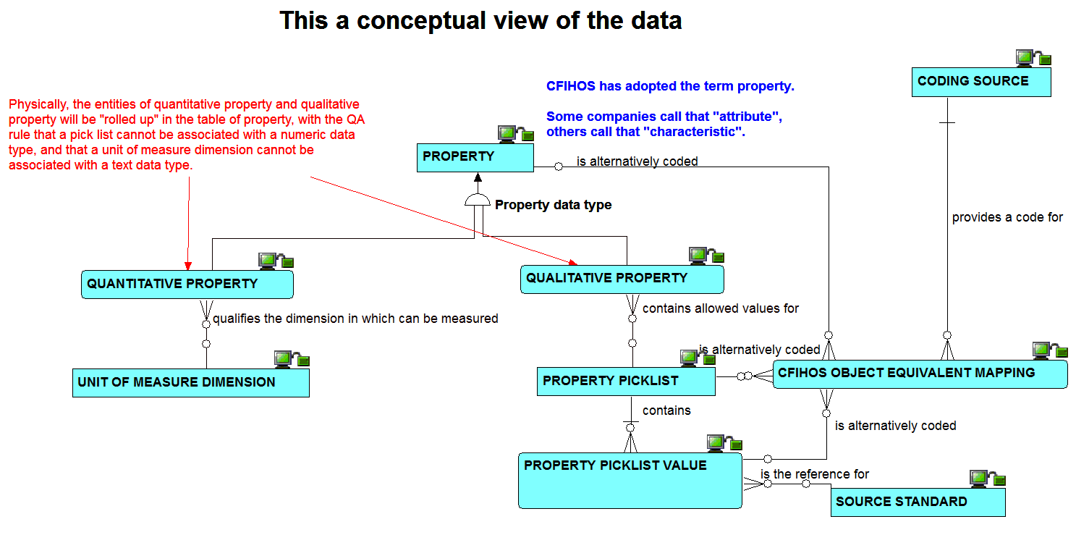
Properties: the conceptual view on relationships

Slide 22
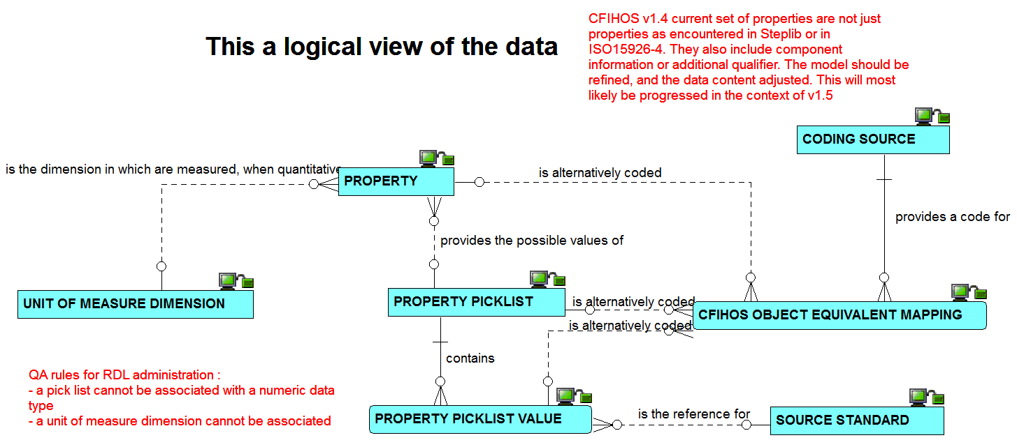
Properties: the logical view on relationships

Slide 23
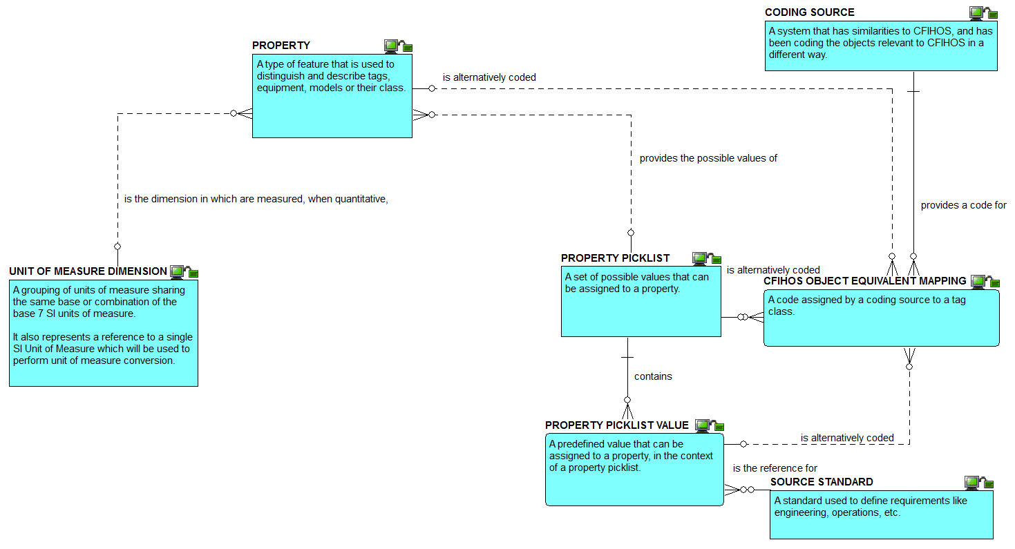
Properties: the definitions view

Slide 24
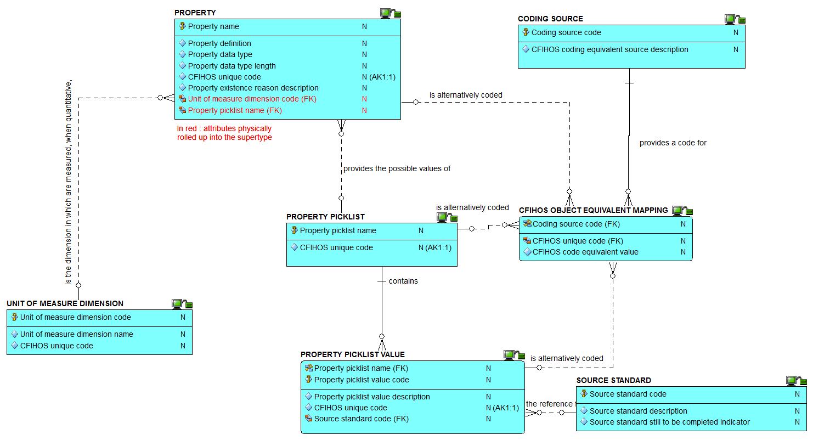
Properties: the attributes view

Slide 25
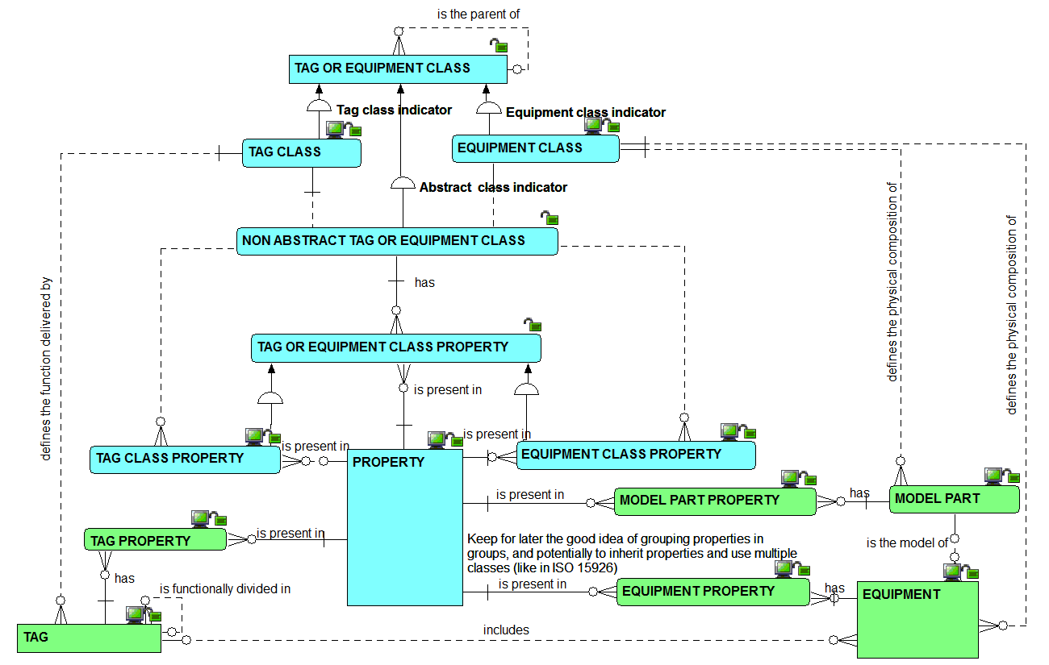
Property use: the relationships view

Slide 26
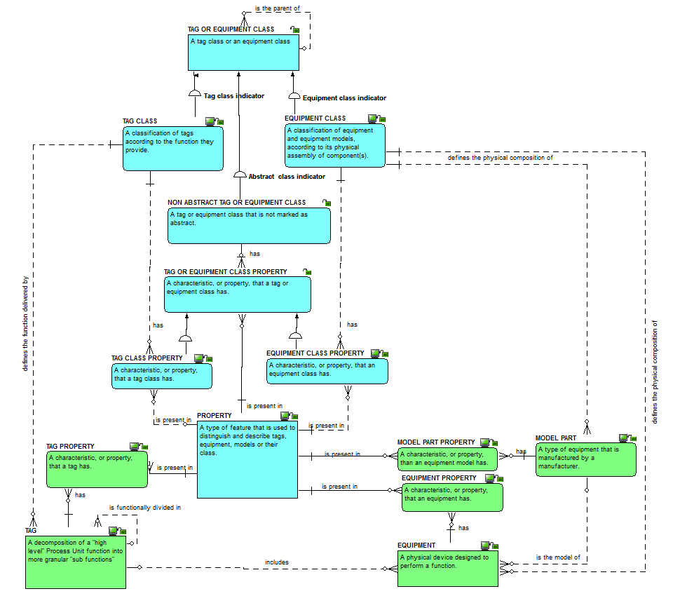
Property use:
the definitions view

Slide 27
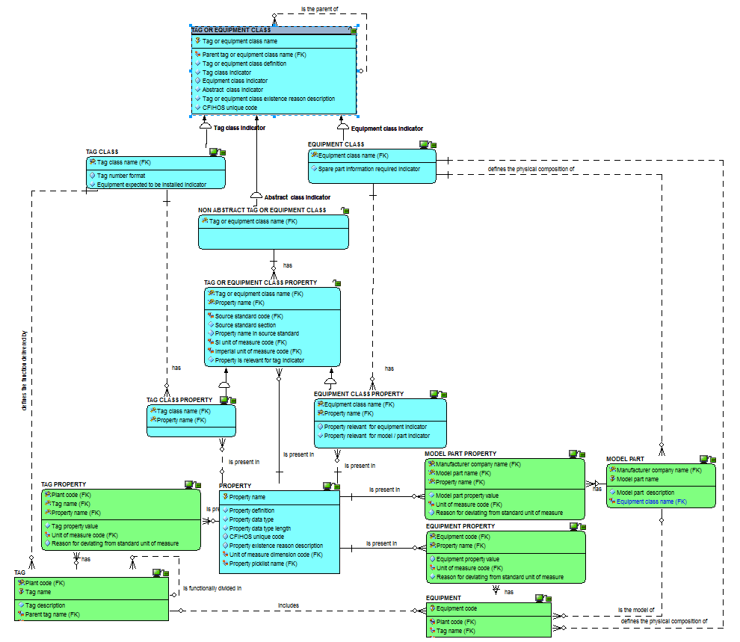
Property use:
the attributes view

Slide 28
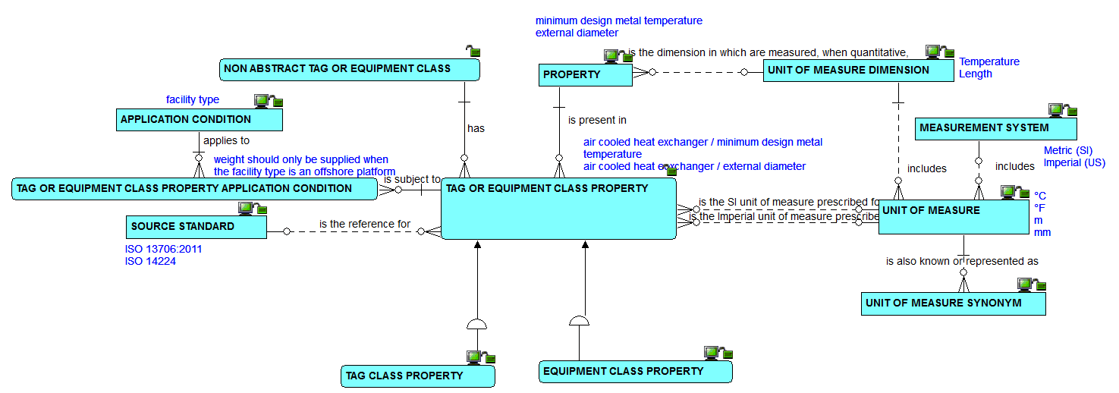
Properties, classes and units of measure: the relationships view

Slide 29
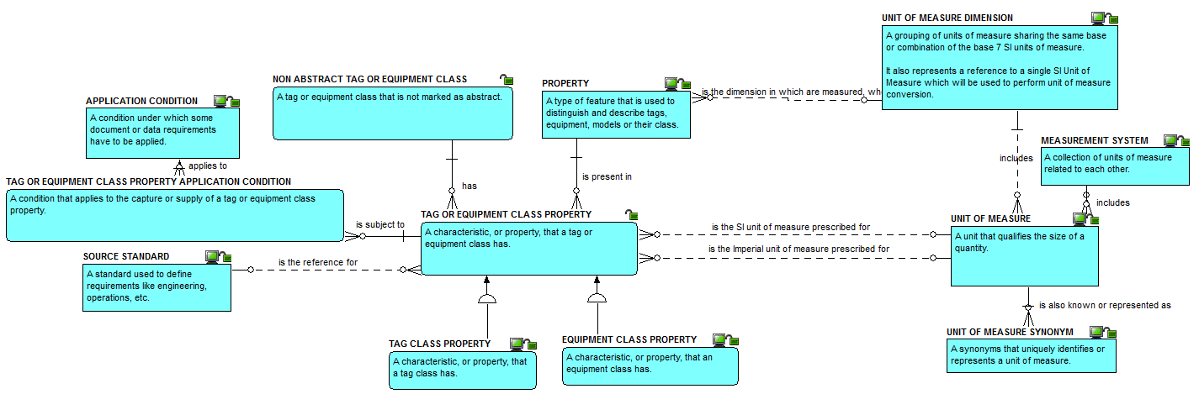
Properties, classes and units of measure: the definitions view

Slide 30
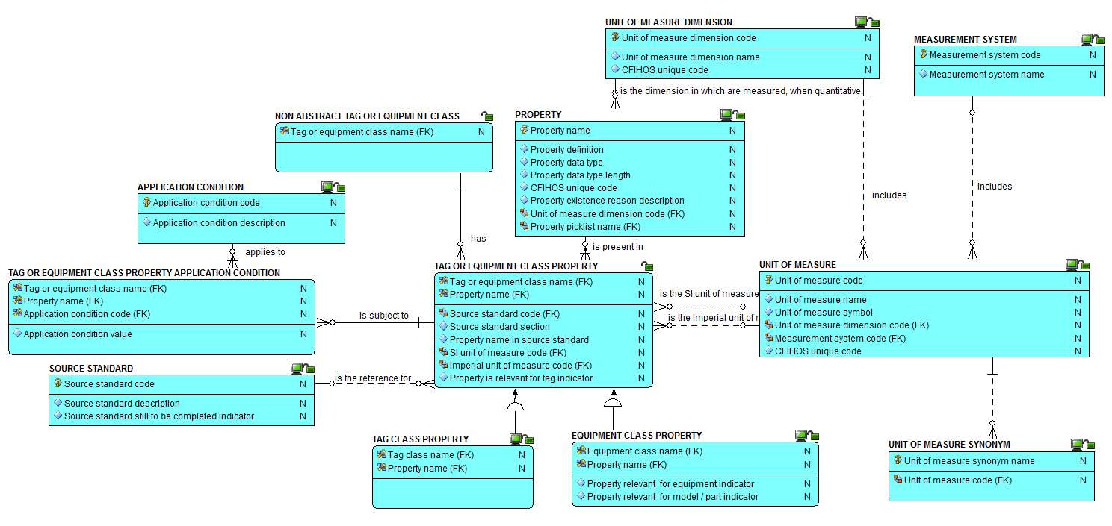
Properties, classes and units of measure: the attributes view

Slide 31
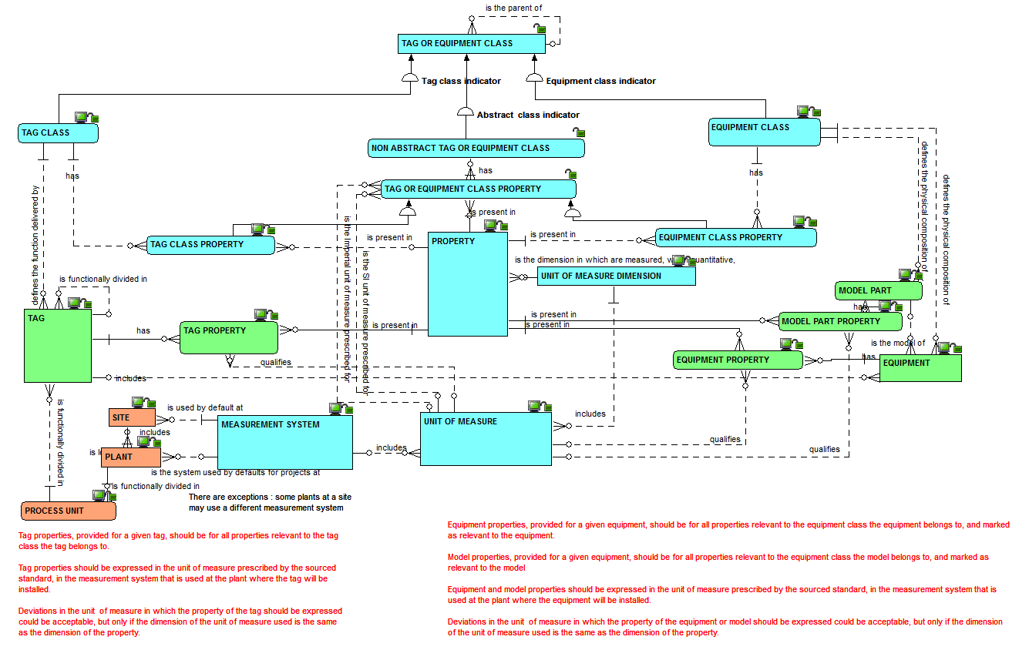
Properties, tags, equipment and units of measure: the relationships view

Slide 32
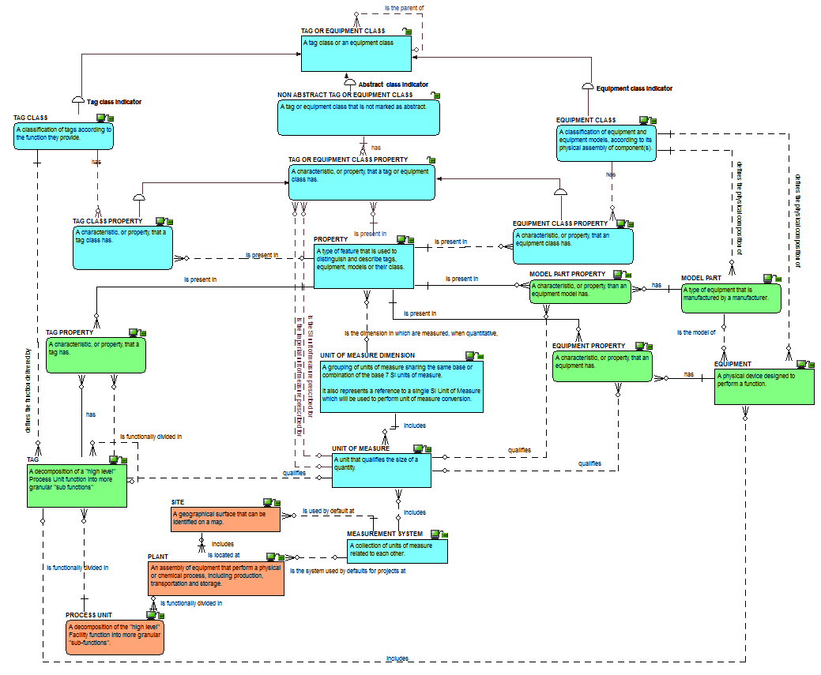
Properties, classes and units of measure:
the definitions view

Slide 33
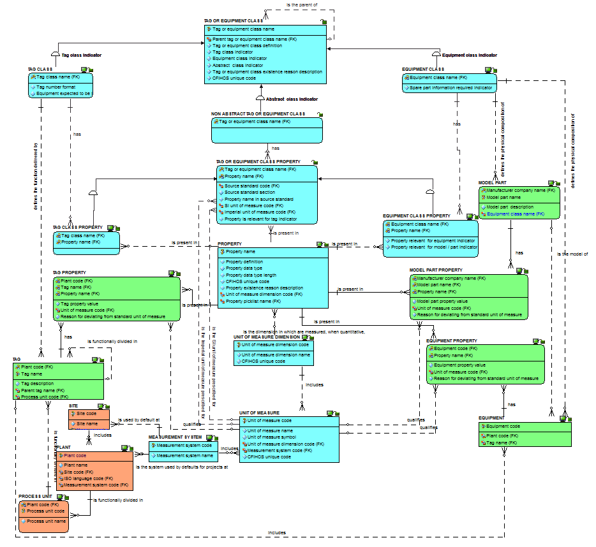
Properties, classes and units of measure:
the attributes view

Slide 34
Checkpoint 2 - Summary after review of the second third of the data model
As was

Slide 35
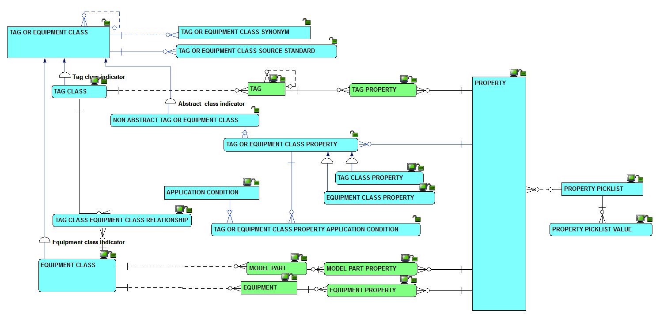
Checkpoint 2 - Summary after review of the second third of the data model
As is
Solid line for identifying relationships, dashed line for non identifying ones

Slide 36
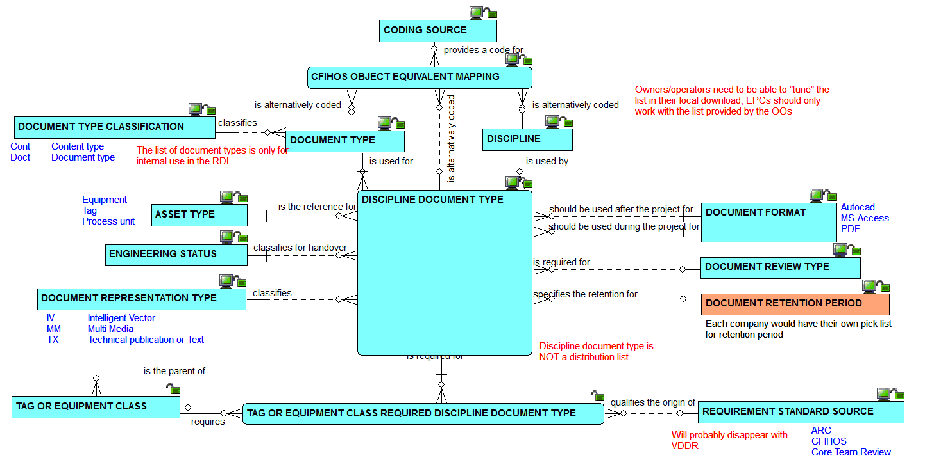
Disciplines and document types: the relationships view

Slide 37
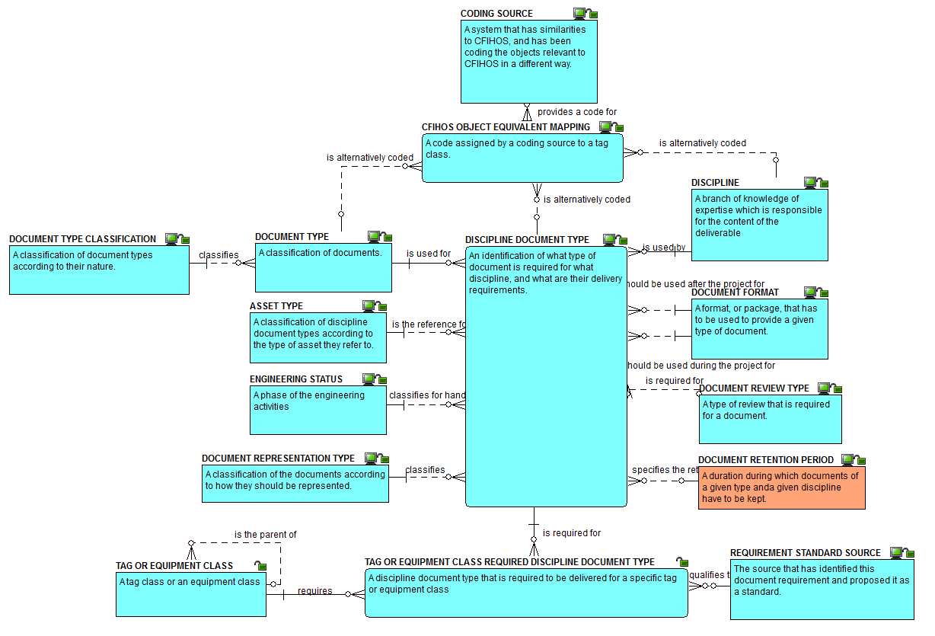
Disciplines and document types:
the definitions view

Slide 38
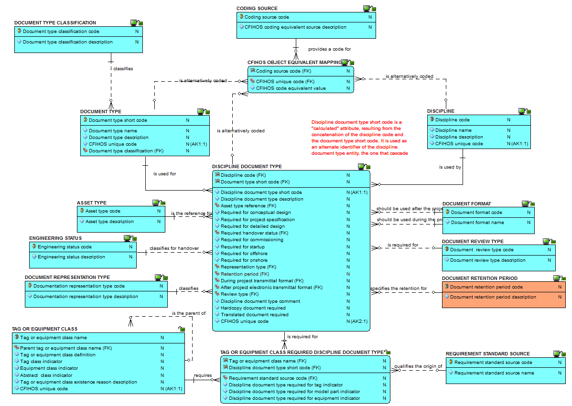
Disciplines and document types:
the attributes view

Slide 39
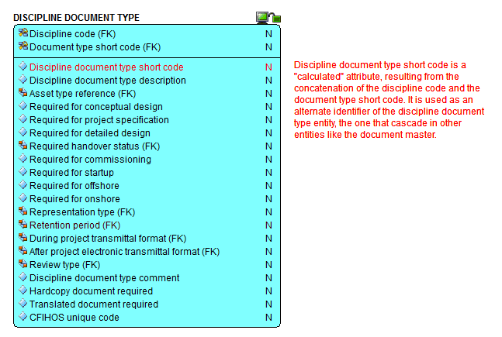
Discipline document type: zoom on the attributes

Slide 40
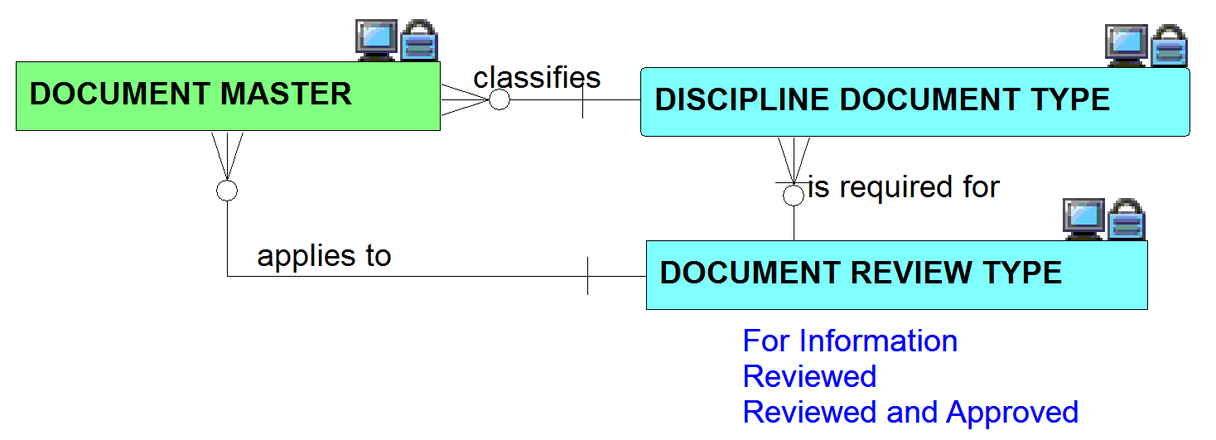
Document master: the relationships view

Slide 41
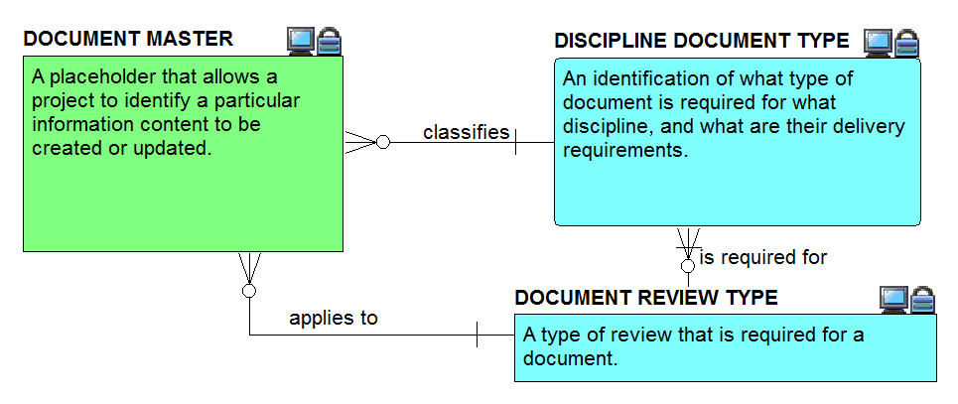
Document master: the definitions view

Slide 42
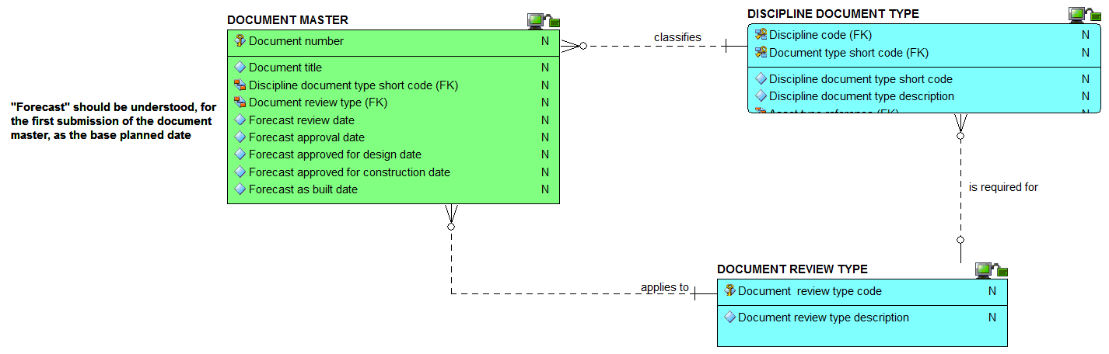
Document master: the attributes view

Slide 43
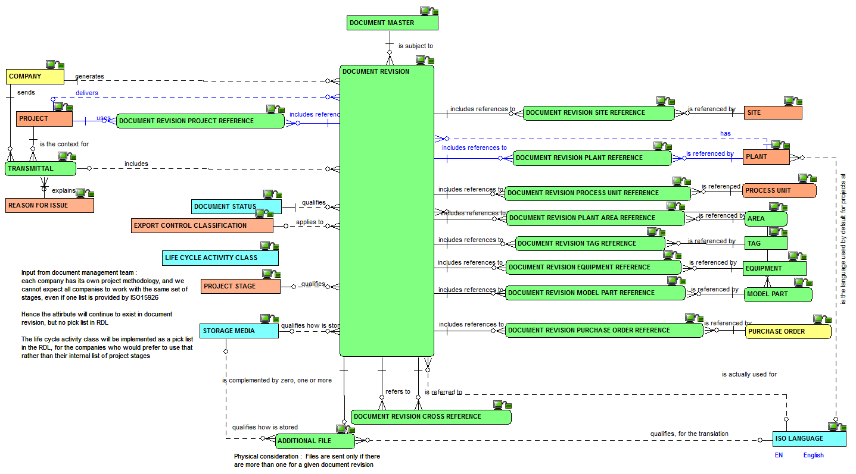
Document revision: the relationships view

Slide 44
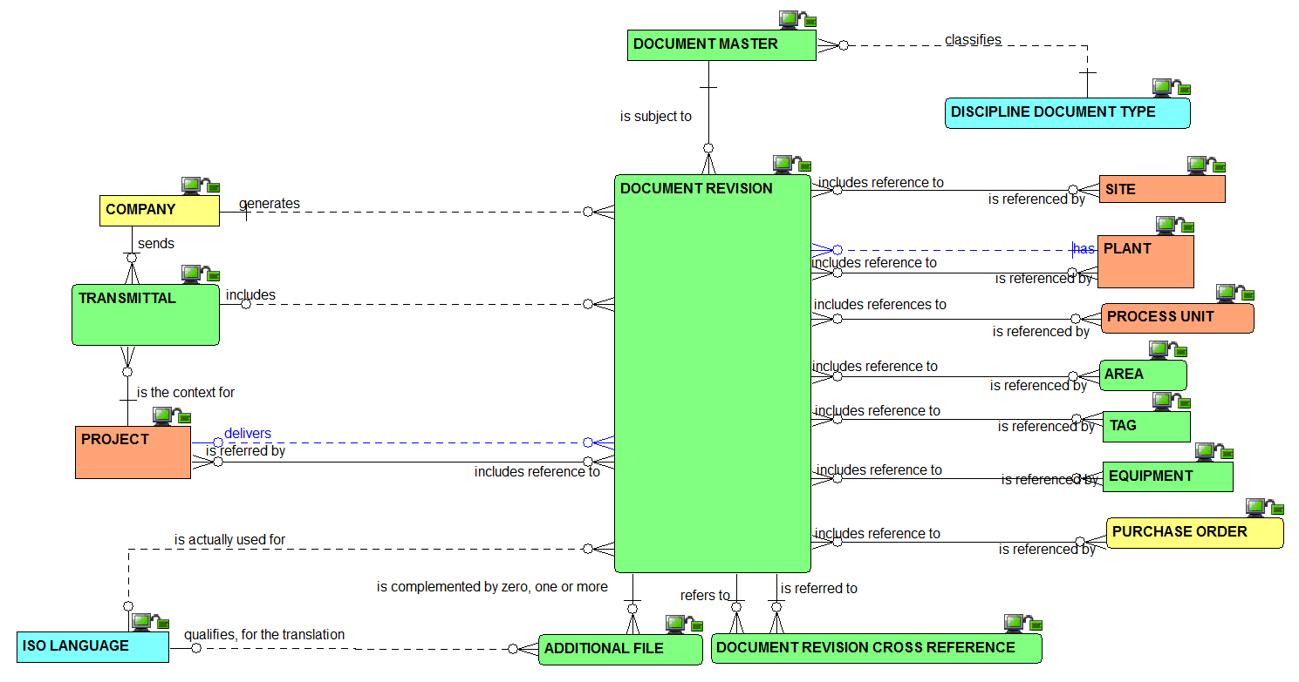
Document revision:
the simplified relationships view

Slide 45
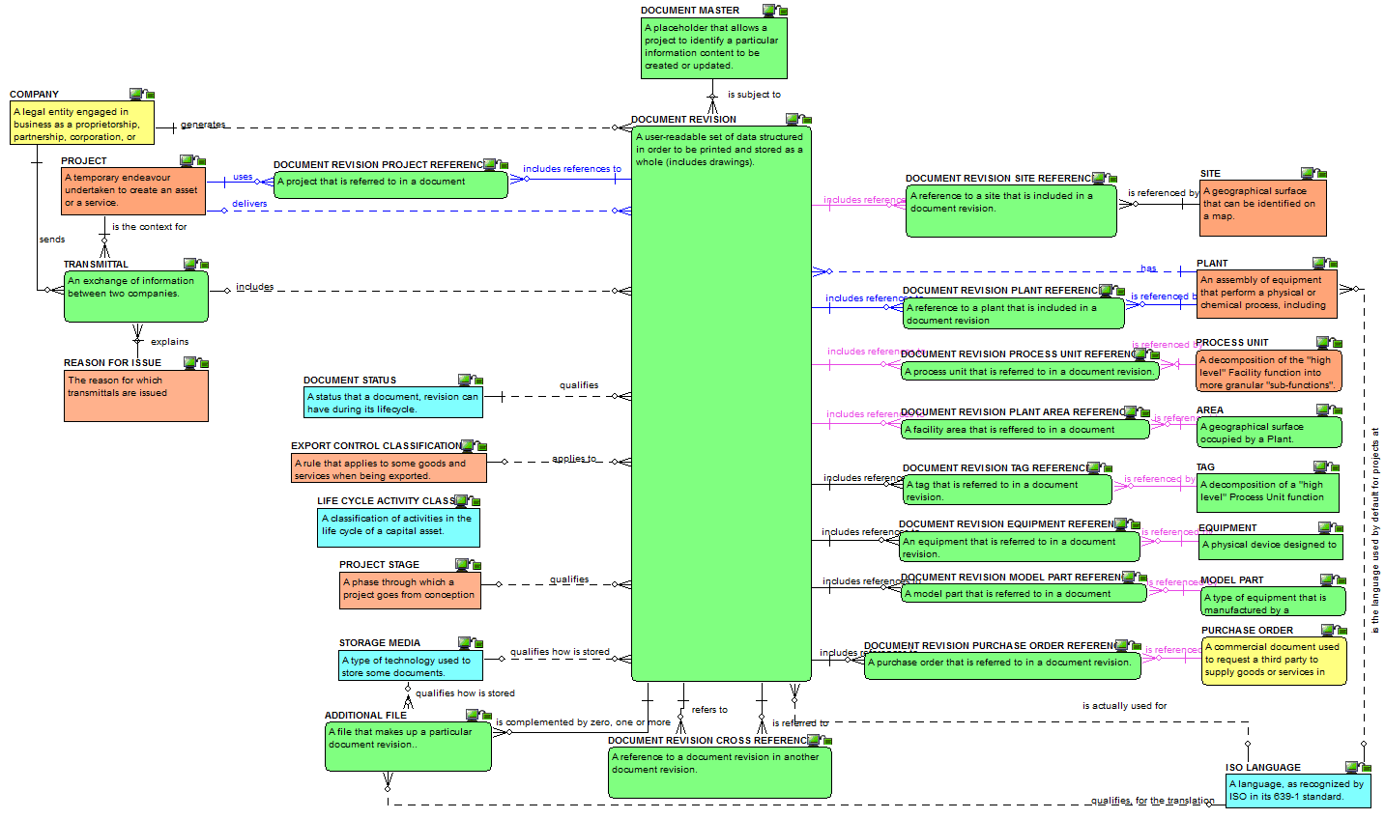
Document revision:
the definitions view

Slide 46
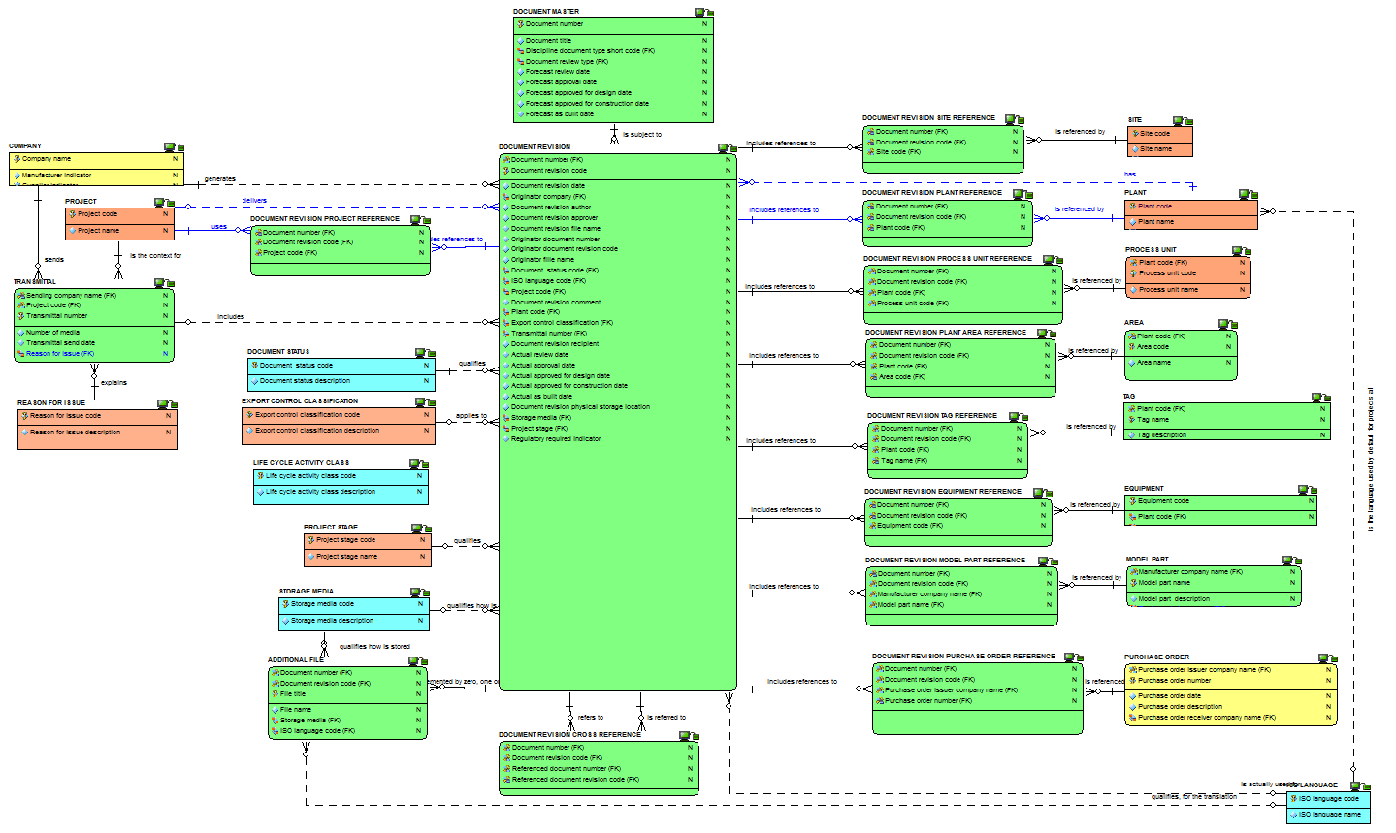
Document revision:
the attributes view

Slide 47
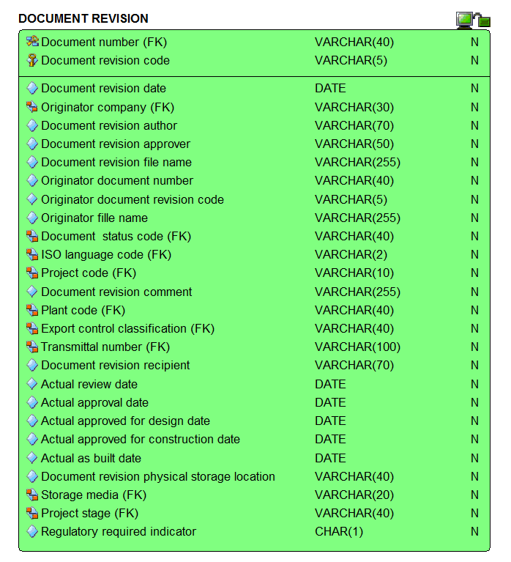
Document revision:
zoom on the attributes

Slide 48
Checkpoint 3 - Summary after review of the third third of the data model
As was

Slide 49
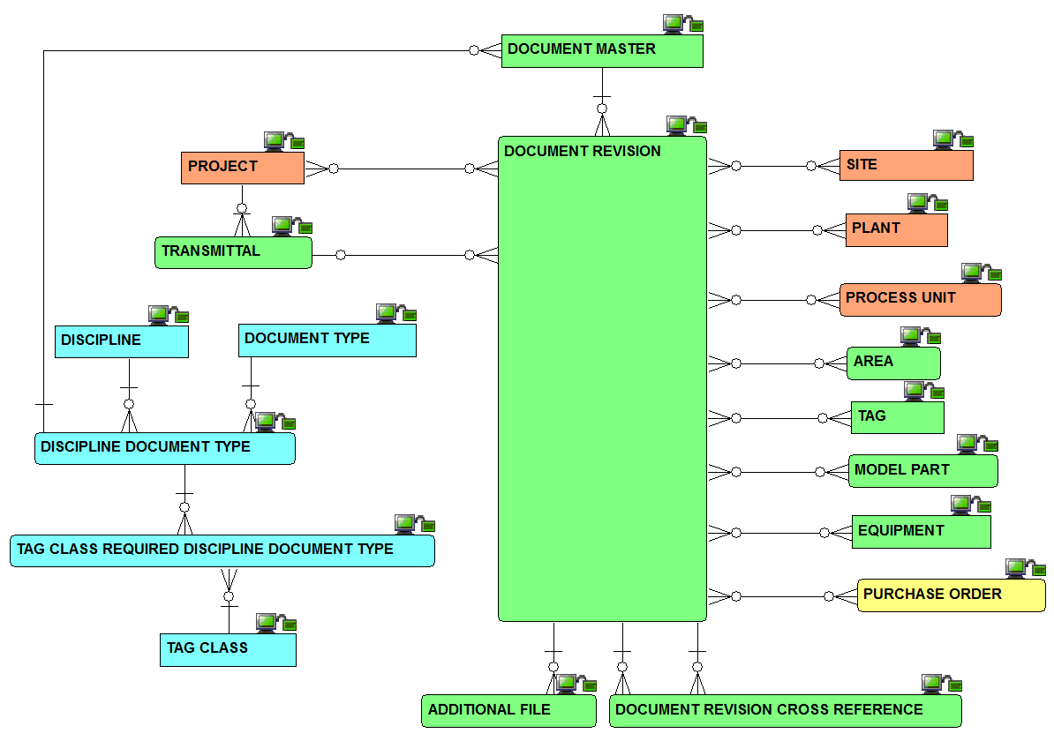
Checkpoint 3 - Summary after review of the third third of the data model
As is
Solid line for identifying relationships, dashed line for non identifying ones

Slide 50
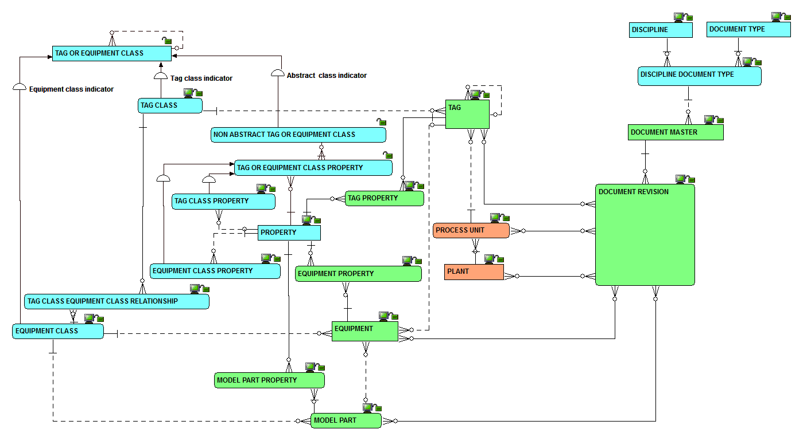
Overview of complete data model

Slide 51
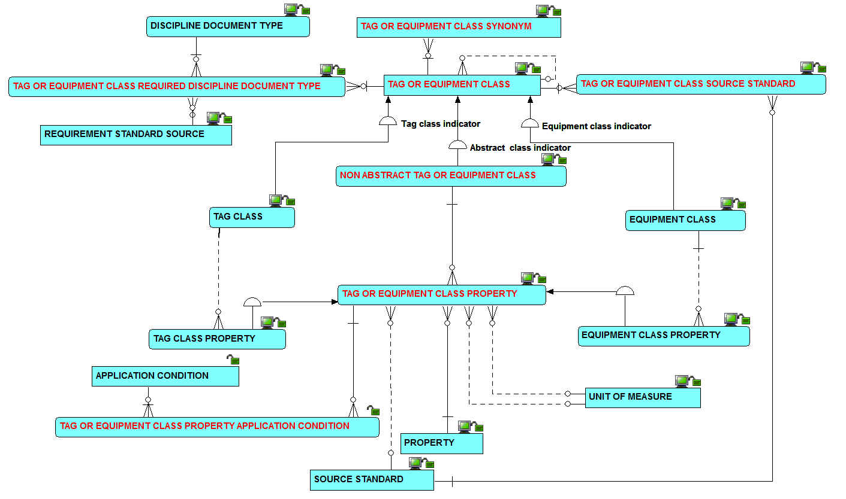
Overview of tag or equipment class relationships

Slide 52
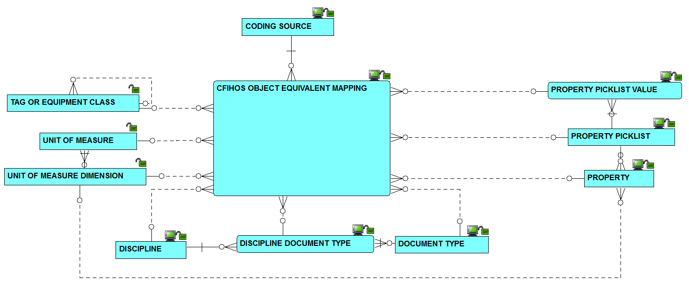
Overview of CFIHOS alternate code mapping capabilities

Slide 53
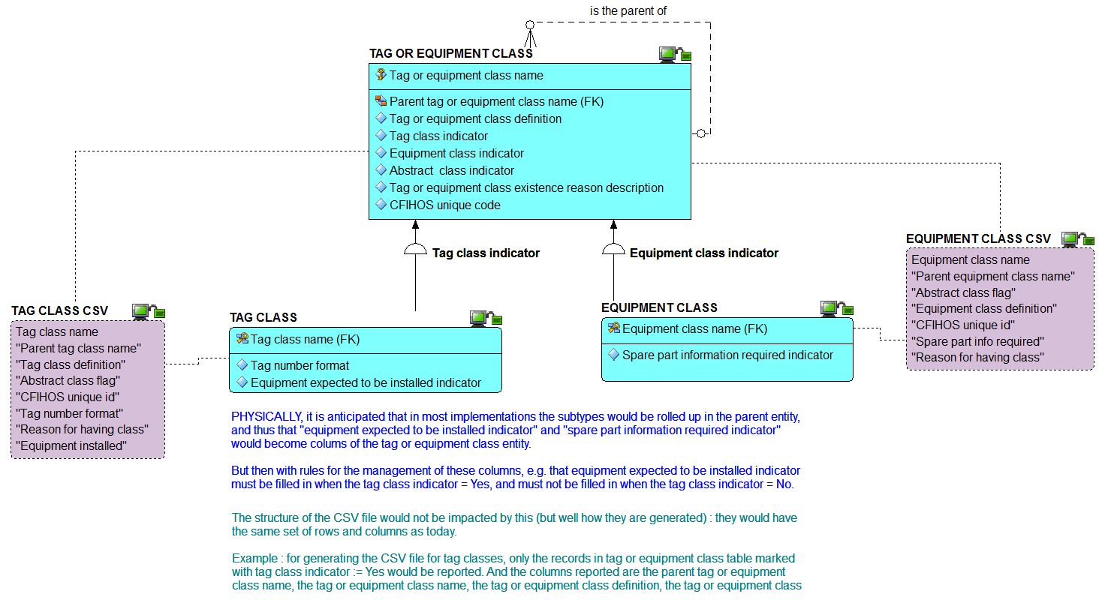
The relationship between the logical model and the CSV files :
1) tag and equipment class

Slide 54
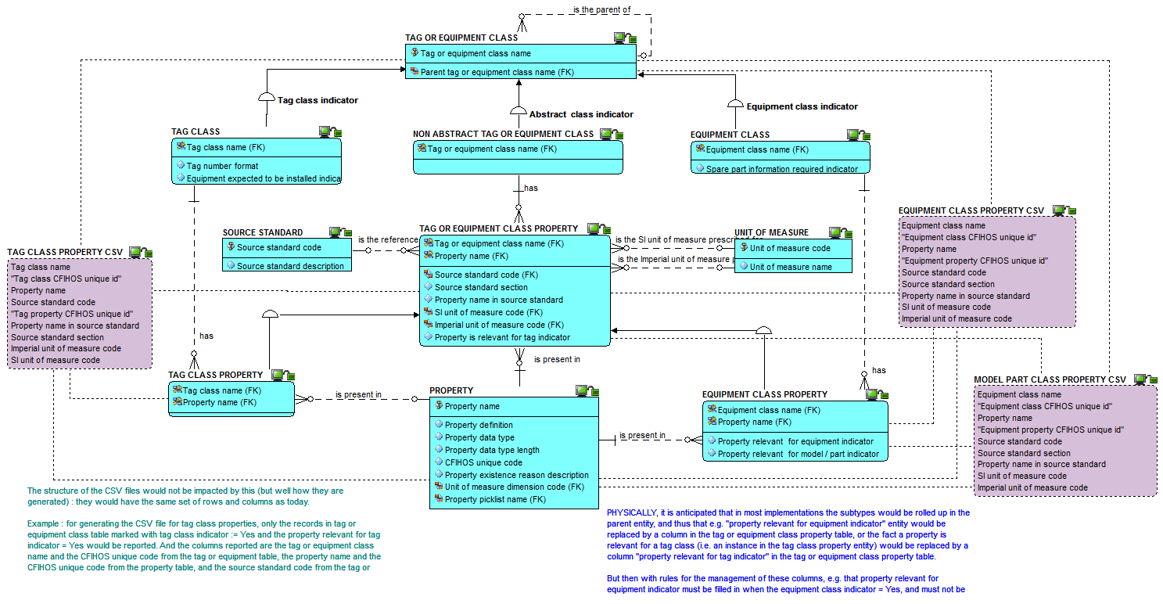
The relationship between the logical model and the CSV files :
2) tag and equipment class property

Slide 55

The relationship between the logical model and the CSV files :
3) Property, pick list and unit of measure

Slide 56

The relationship between the logical model and the CSV files :
4) Discipline and document type

Slide 57

The relationship between the logical model and the CSV files :
5) Entities implemented as pick lists in RDL and its link to CSV

